Slide 1
the moon

Slide 2
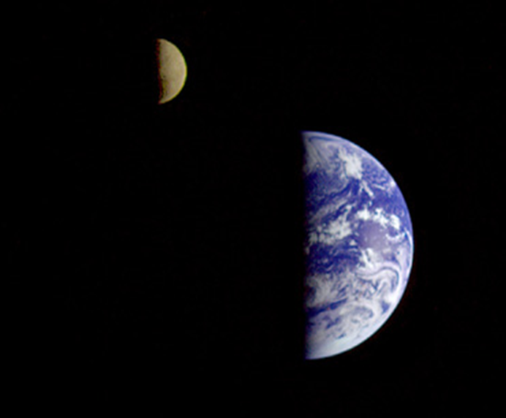
The Earth and Moon photographed by the Galileo spacecraft on its way to Jupiter in 1992.
Credit: : NASA
http://nssdc.gsfc.nasa.gov/photo_gallery/photogallery-earthmoon.html

Slide 3
earth and moon
 | Earth | Moon
Diameter | 12 756 km | 3474 km
Temperature | 15º C (average) | Day: 107 º C Night: -153 º C
Atmosphere | Yes | No
What is visible on the surface | Water, continents, clouds… | Rocky surface, craters, ancient lava flow (seas)
The Earth-Moon system to scale, captured by the spacecrat Mars Odyssey in 2001:
Credit: : NASA/JPL/Arizona State University http://photojournal.jpl.nasa.gov/catalog/PIA00559

Slide 4
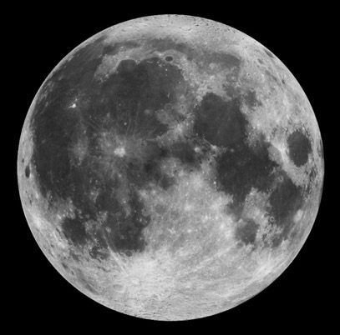
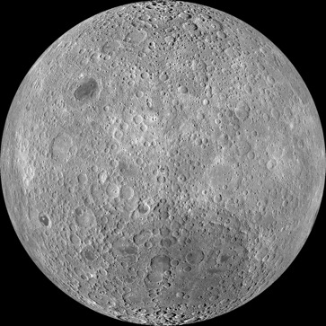
rotation and revolution of the moon
Rotation period : 27.3 days
Orbital (revolution) period: 27.3 days
tidal lock: we always see the same side of the Moon
near side
far side
Credit: : Lunar Reconnaissance Orbiter/NASA
http://www.nasa.gov/mission_pages/LRO/multimedia/moonimg_01.html
http://www.nasa.gov/mission_pages/LRO/news/lro-farside.html

Slide 5
phases of the moon

Slide 6
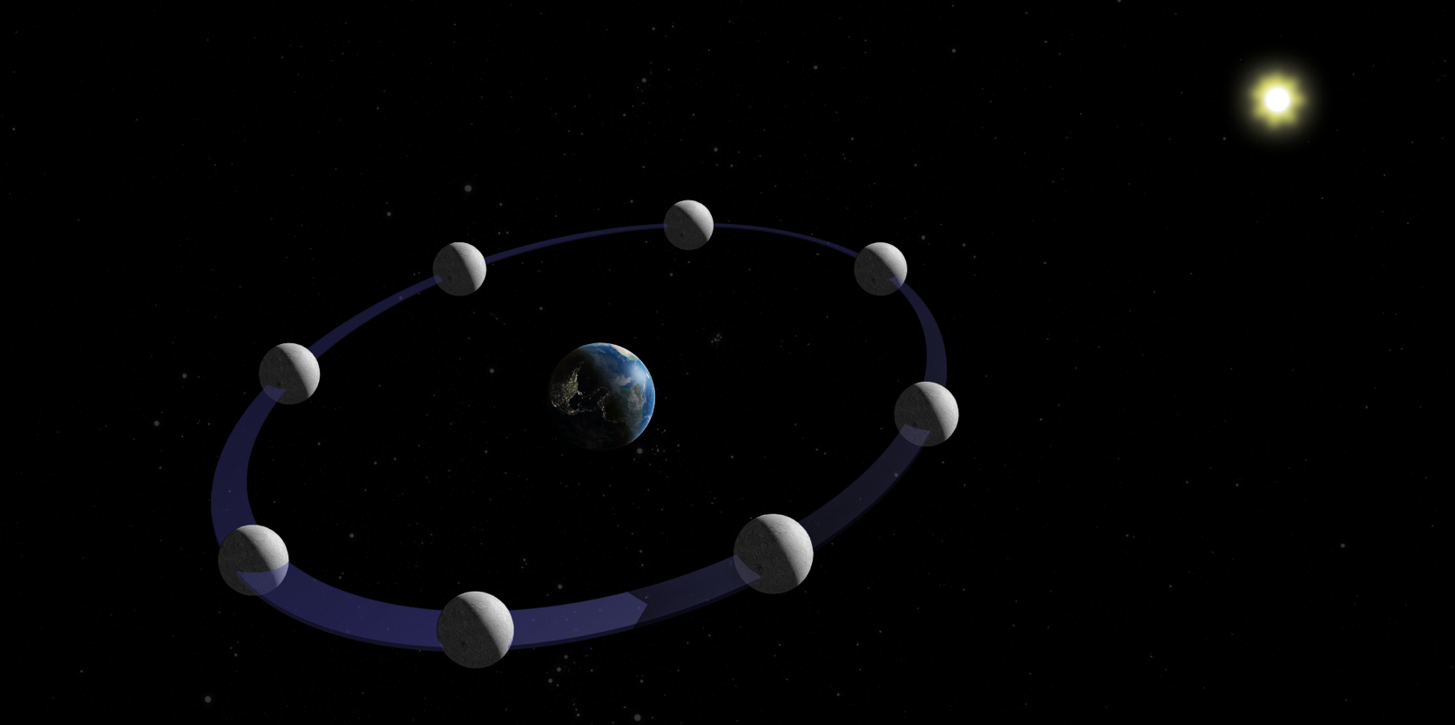
basic concepts
The Moon doesn’t shine on its own, it reflects sunlight.
Half the Moon is always lit (day side).
We don’t always see the same fraction of the lit side. It depends on the position of the Moon around the Earth.
Image not to scale

Slide 7
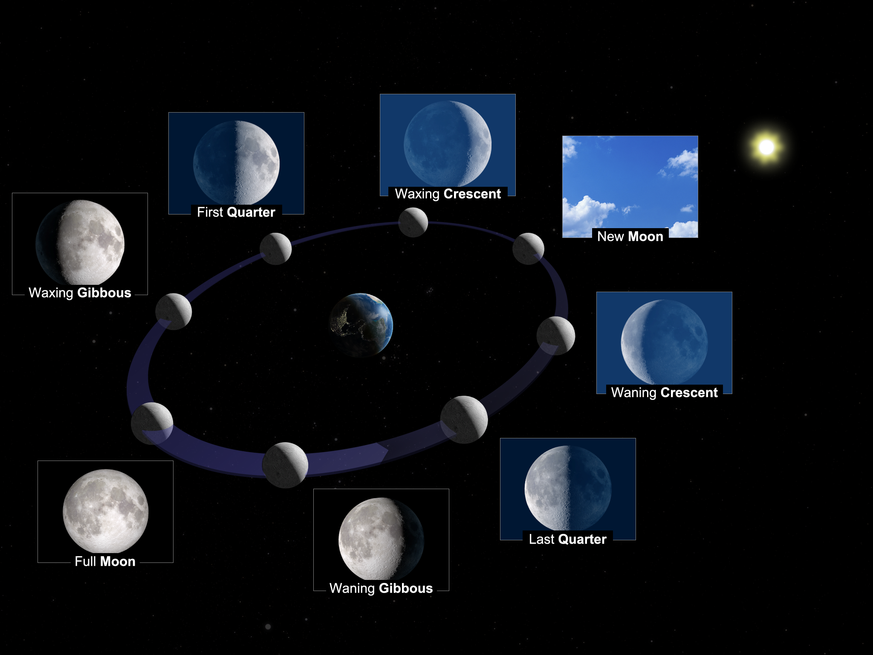
phases of the Moon
Image not to scale

Slide 8
phases of the Moon
Image not to scale

Slide 9
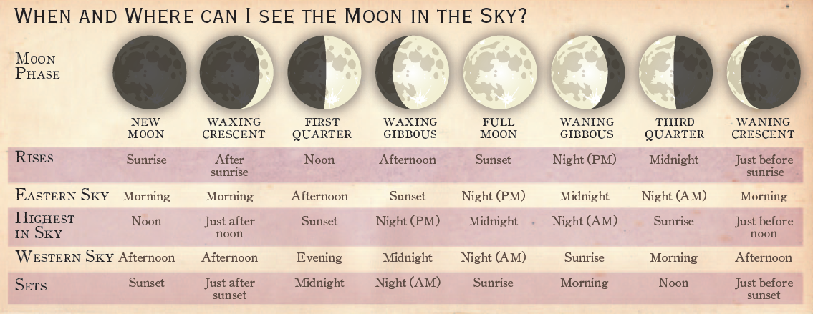
Observing the phases of the moon
Credit: Moon Gazer’s Guide – Royal Astronomical Society of Canada
https://secure.rasc.ca/StoreCat?Category=OBSAIDS

Slide 10
eclipses

Slide 11
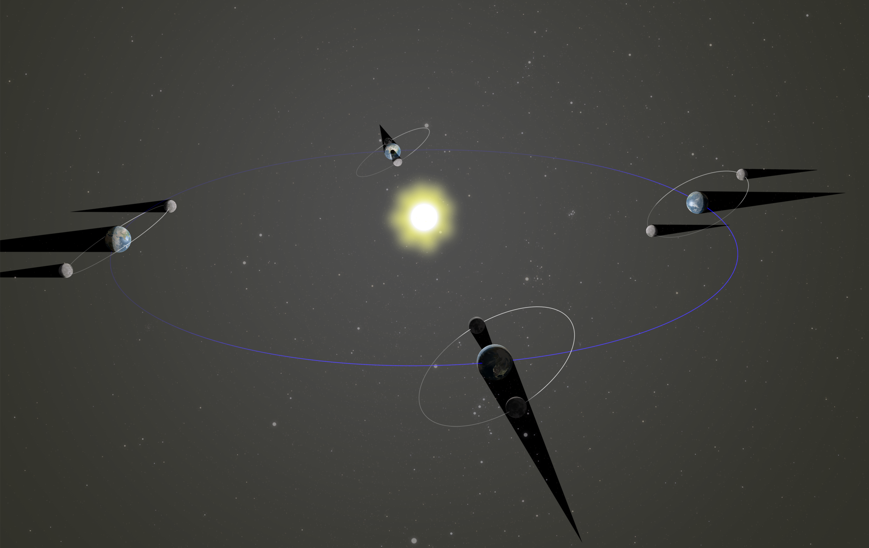
Why aren’t there eclipses every month, when the Moon, the Earth and the Sun are all aligned?
The Moon’s orbit is tilted 5° relative to the ecliptic (shown in blue). Eclipses happen when the Moon’s orbit crosses the ecliptic, which happens twice a year.
Image not to scale

Slide 12
upcoming eclipses
DATE | TYPE | REGIONS WHERE THE ECLIPSE IS VISIBLE
30 November 2020 | Penumbral Lunar Eclipse | Americas, east of Asia, Australia
14 December 2020 | Total Solar Eclipse | South America
26 May 2021 | Total Lunar Eclipse | Oceania, Pacific
10 June 2021 | Annular Solar Eclipse | North-East of Canada, Northern Europe
19 November 2021 | Partial Lunar Eclipse | North America, Pacific, Asia
4 December 2021 | Total Solar Eclipse | Antarctica
Reference: http://eclipsewise.com/

Slide 13
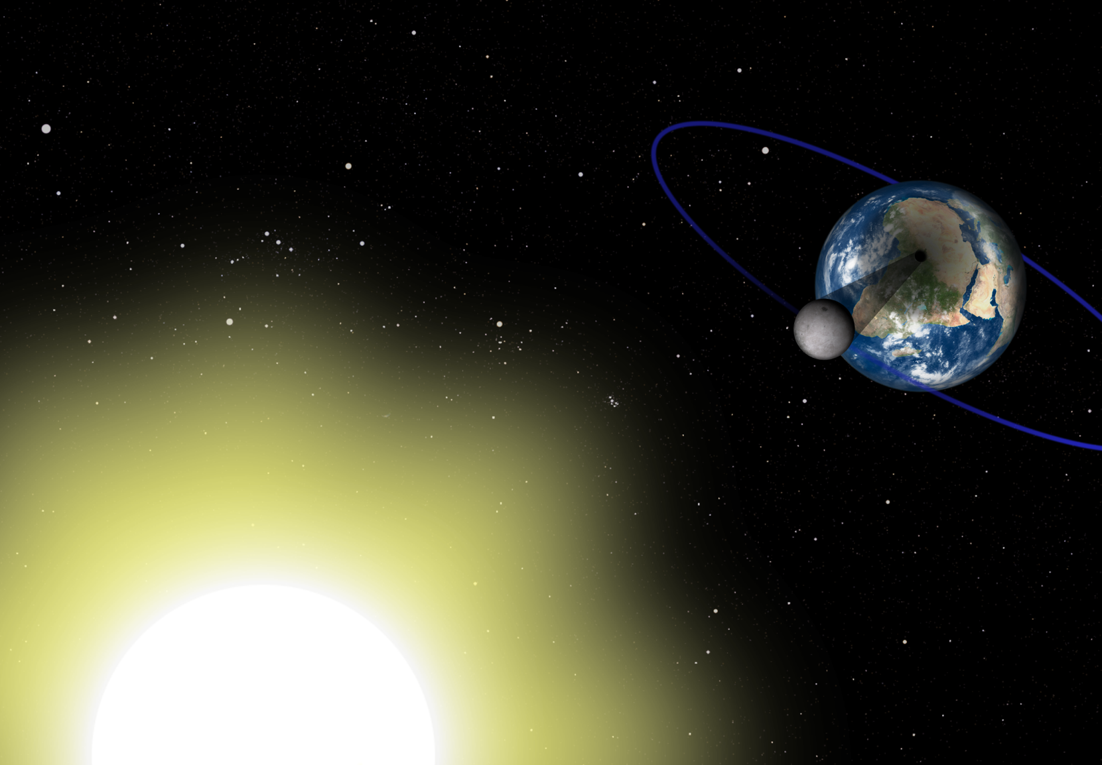
Solar Eclipse
A solar eclipse happens when the Moon passes between the Earth and the Sun (at new moon). If the alignment is perfect, the shadow of the Moon will fall on the surface of the Earth.
Image not to scale

Slide 14
Solar eclipse
A solar eclipse happens when the Moon passes between the Earth and the Sun (at new moon). If the alignment is perfect, the shadow of the Moon will fall on the surface of the Earth.
Image not to scale

Slide 15
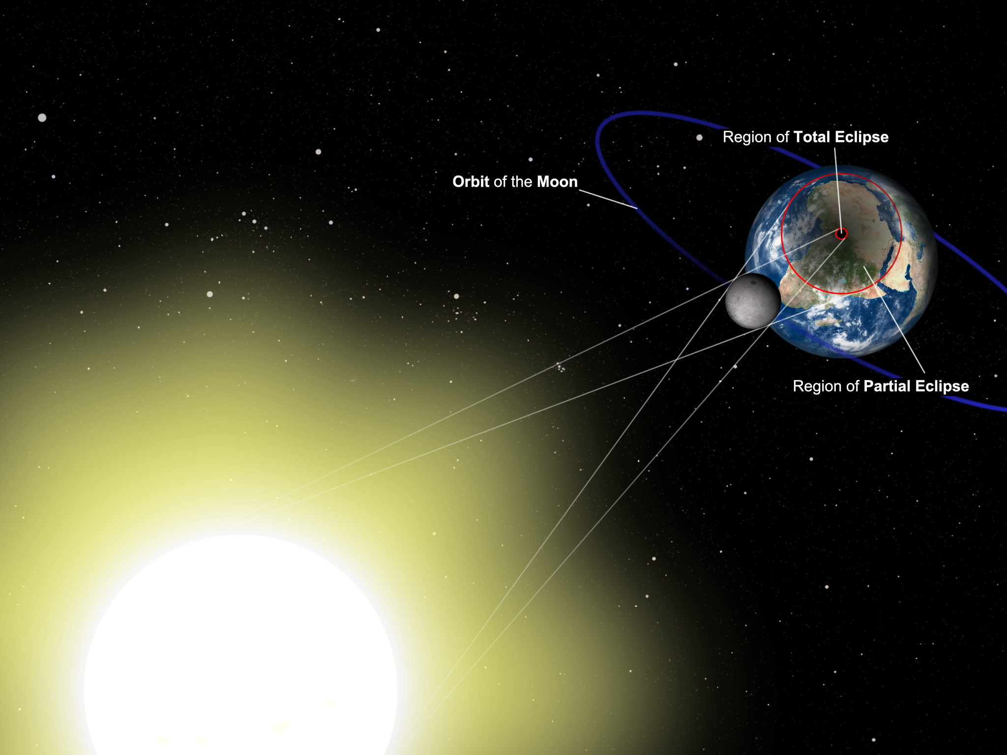
Solar Eclipse
Since the shadow of the Moon is quite small, only a very limited region on Earth can see the eclipse.
Image not to scale

Slide 16
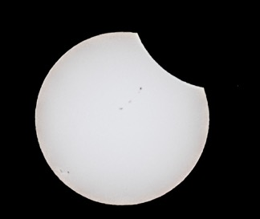
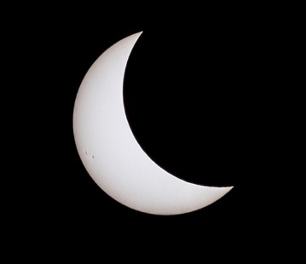
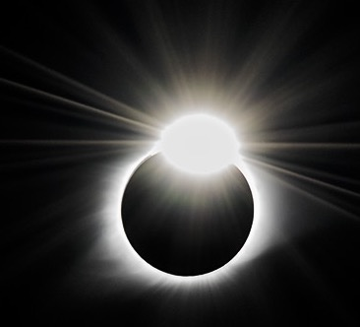
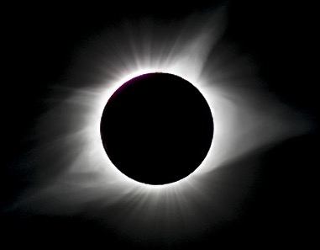
SOLAR ECLIPSE
© Andreu Cardo Martinez

Slide 17
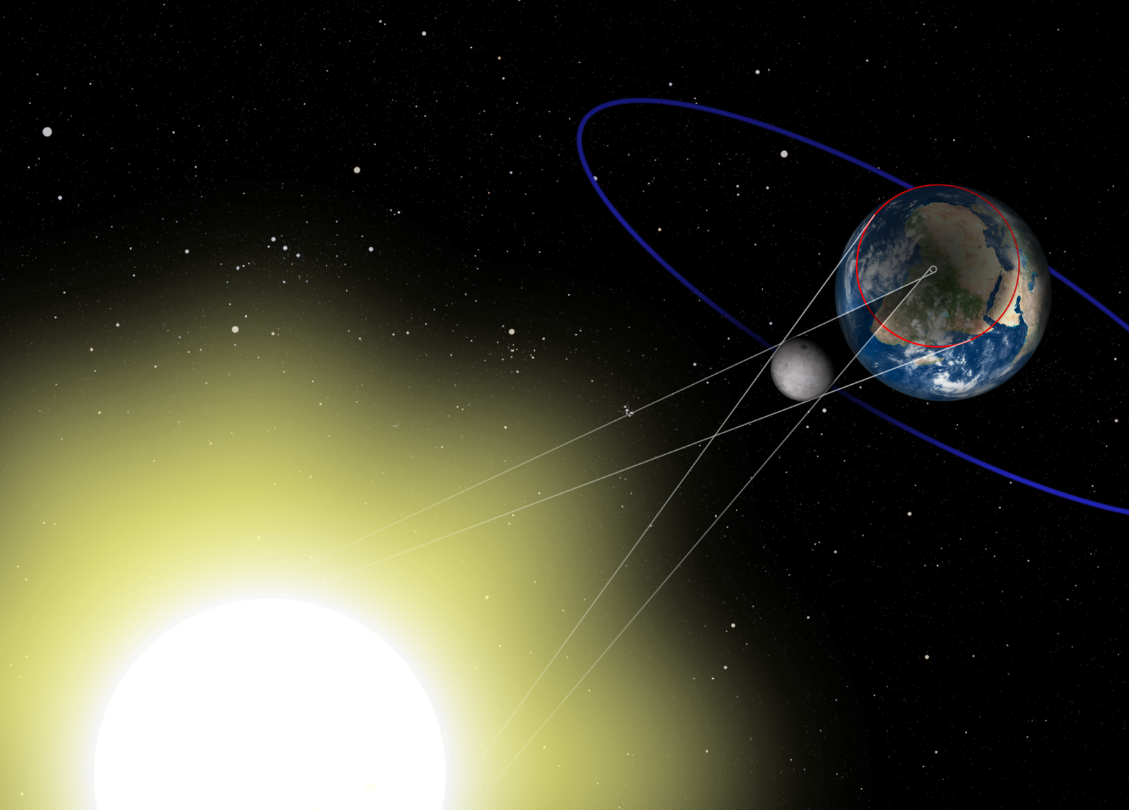
Annular Solar Eclipse
Since the orbit of the Moon is an ellipse, the Moon is sometimes further away from Earth and appears smaller in the sky. If a solar eclipse happens at that time, the Moon won’t cover the Sun completely and a ring of Sun will be visible around it.

Slide 18
Annular solar Eclipse

Slide 19
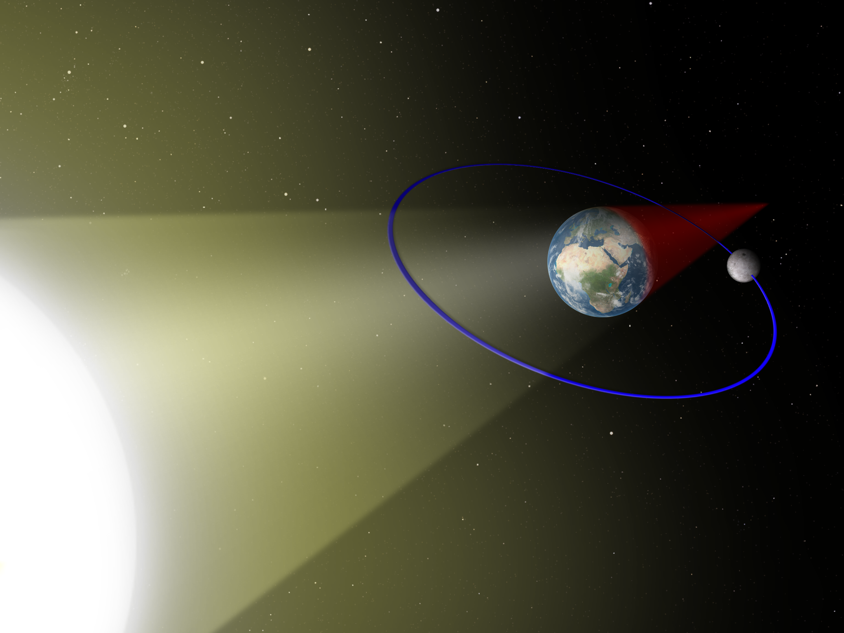
Lunar Eclipse
A lunar eclipse happens when the Earth is between the Sun and the Moon (at full moon). If the alignment is perfect, the Moon will cross the Earth’s shadow.
Image not to scale

Slide 20
Lunar Eclipse
A lunar eclipse happens when the Earth is between the Sun and the Moon (at full moon). If the alignment is perfect, the Moon will cross the Earth’s shadow.
Image not to scale

Slide 21
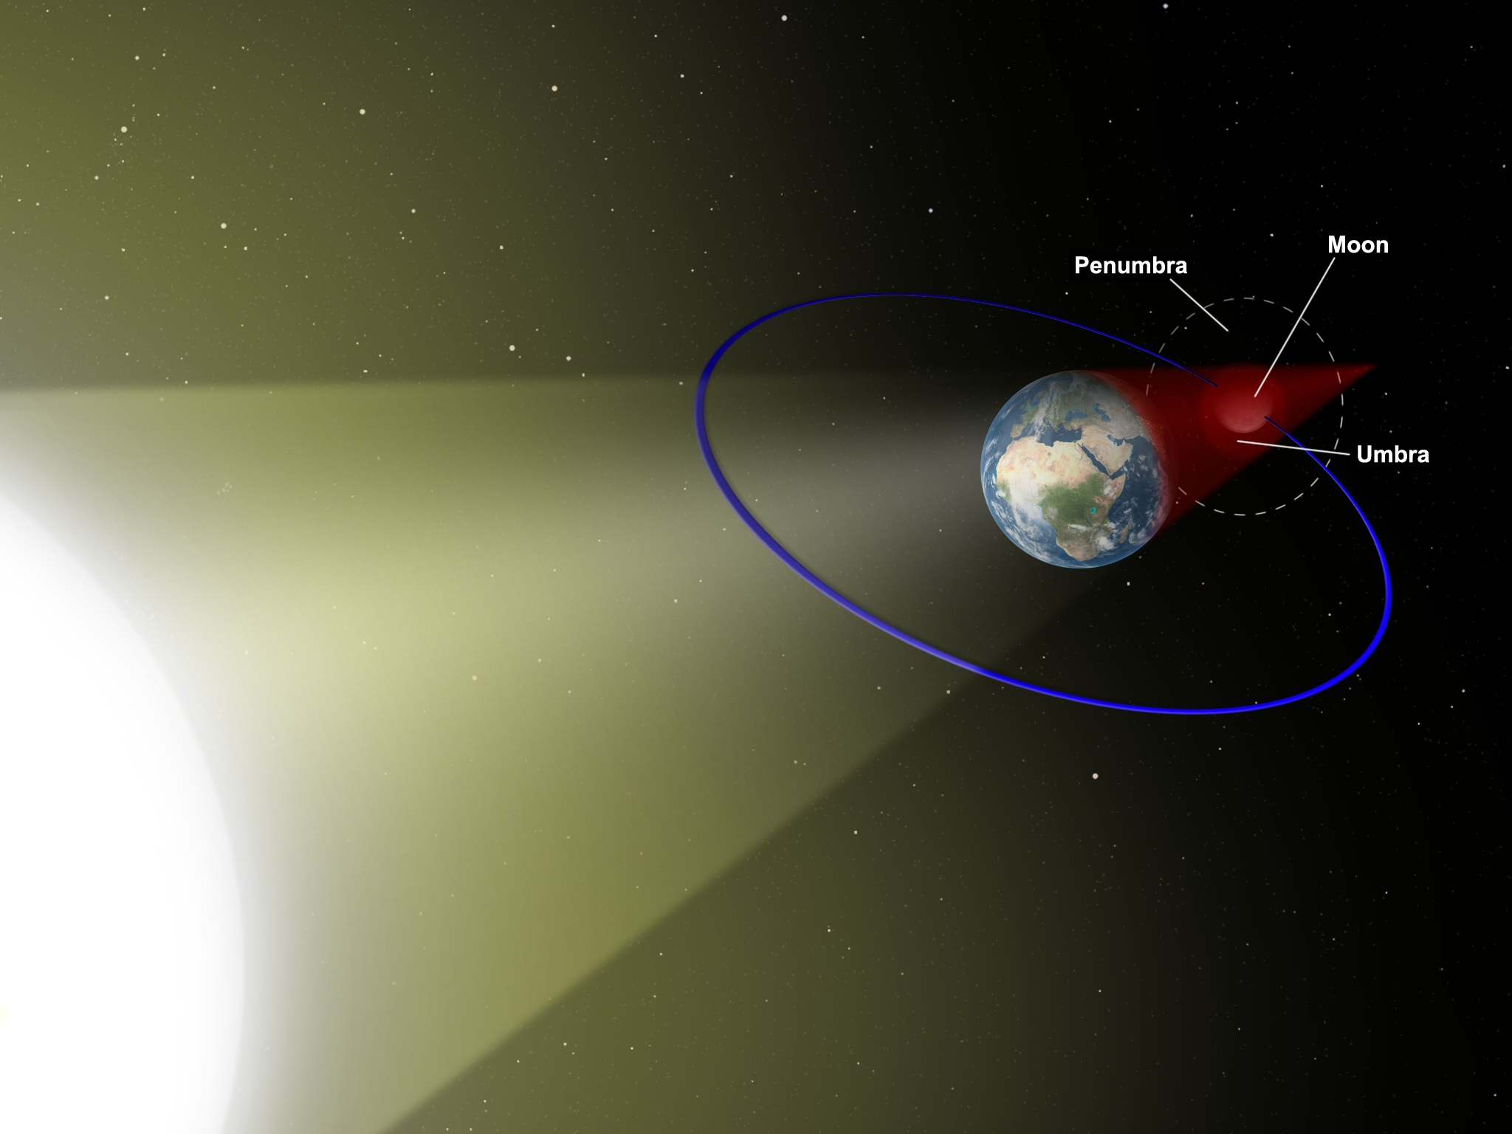
Lunar Eclipse
The eclipse is visible from anywhere on the night side of the Earth.
Image not to scale

Slide 22
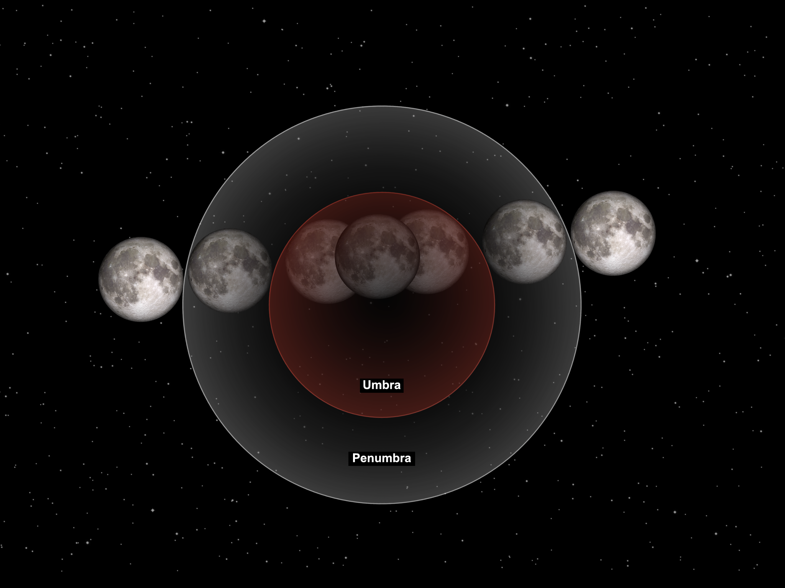
lunar Eclipse
Moon’s orbital motion around the Earth
View from Earth

Slide 23
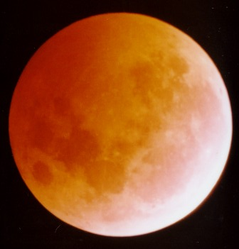
Total Lunar Eclipse
When the Moon is completely in the Earth’s shadow, it appears a lot darker but it’s still possible to see it. It takes a reddish hue and is sometimes called a “blood moon”.
© Thomas Collin

Slide 24
Eclipse Comparison
 | LUNAR | SOLAR
What we’re looking at | Moon | Sun
What’s happening | Moon passes through the Earth’s shadow | The Moon blocks the Sun
Dangerous to observe? | No | YES
When to observe | At night | During the day
Frequency at one place (approx.) | About once a year | Rare since the visibility area is very small

