Slide 1
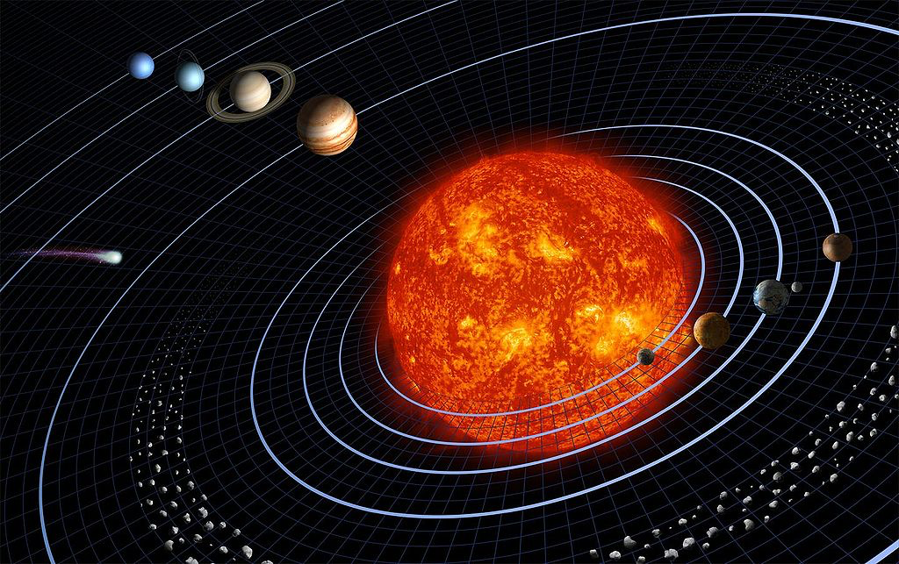
Modelling the Solar System
Welcome!
The webinar will start in a few minutes.
Notes:
Credit: NASA
https://commons.wikimedia.org/wiki/File:Solar_sys.jpg

Slide 2


Discover the Universe
Astronomy training program for teachers and informal educators
  FREE, in English and French
  Available everywhere in Canada and worldwide!
Thanks to our supporters:

Slide 3
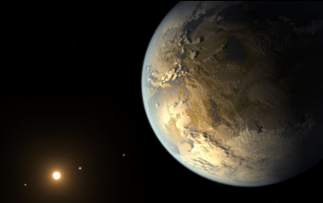
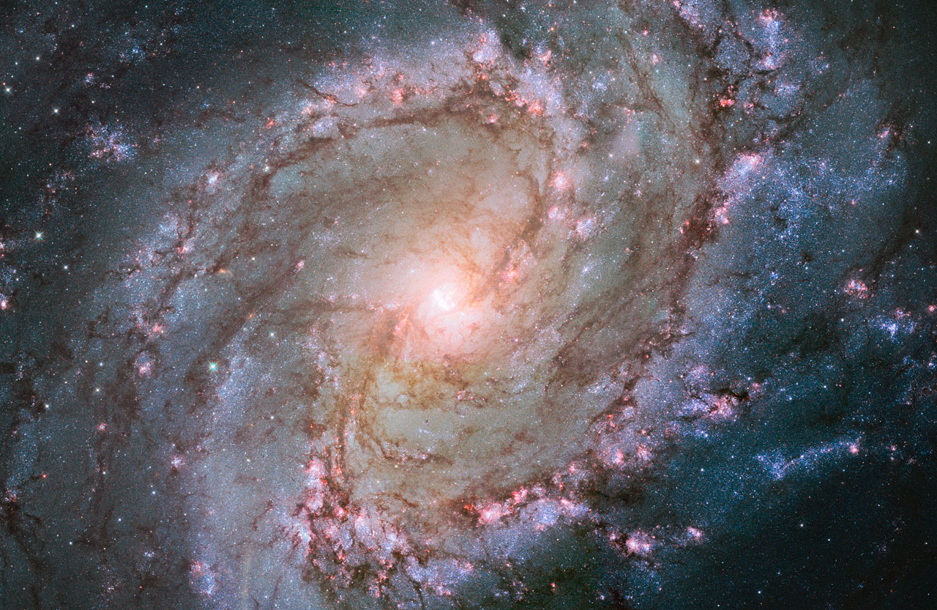
Upcoming Workshops
Is Pluto a Planet or Not?
- October 24, 2018
Workshop for Teachers – Level 2
12 to 30 November 2018

Slide 4





Contact
www.discovertheuniverse.ca

Slide 5
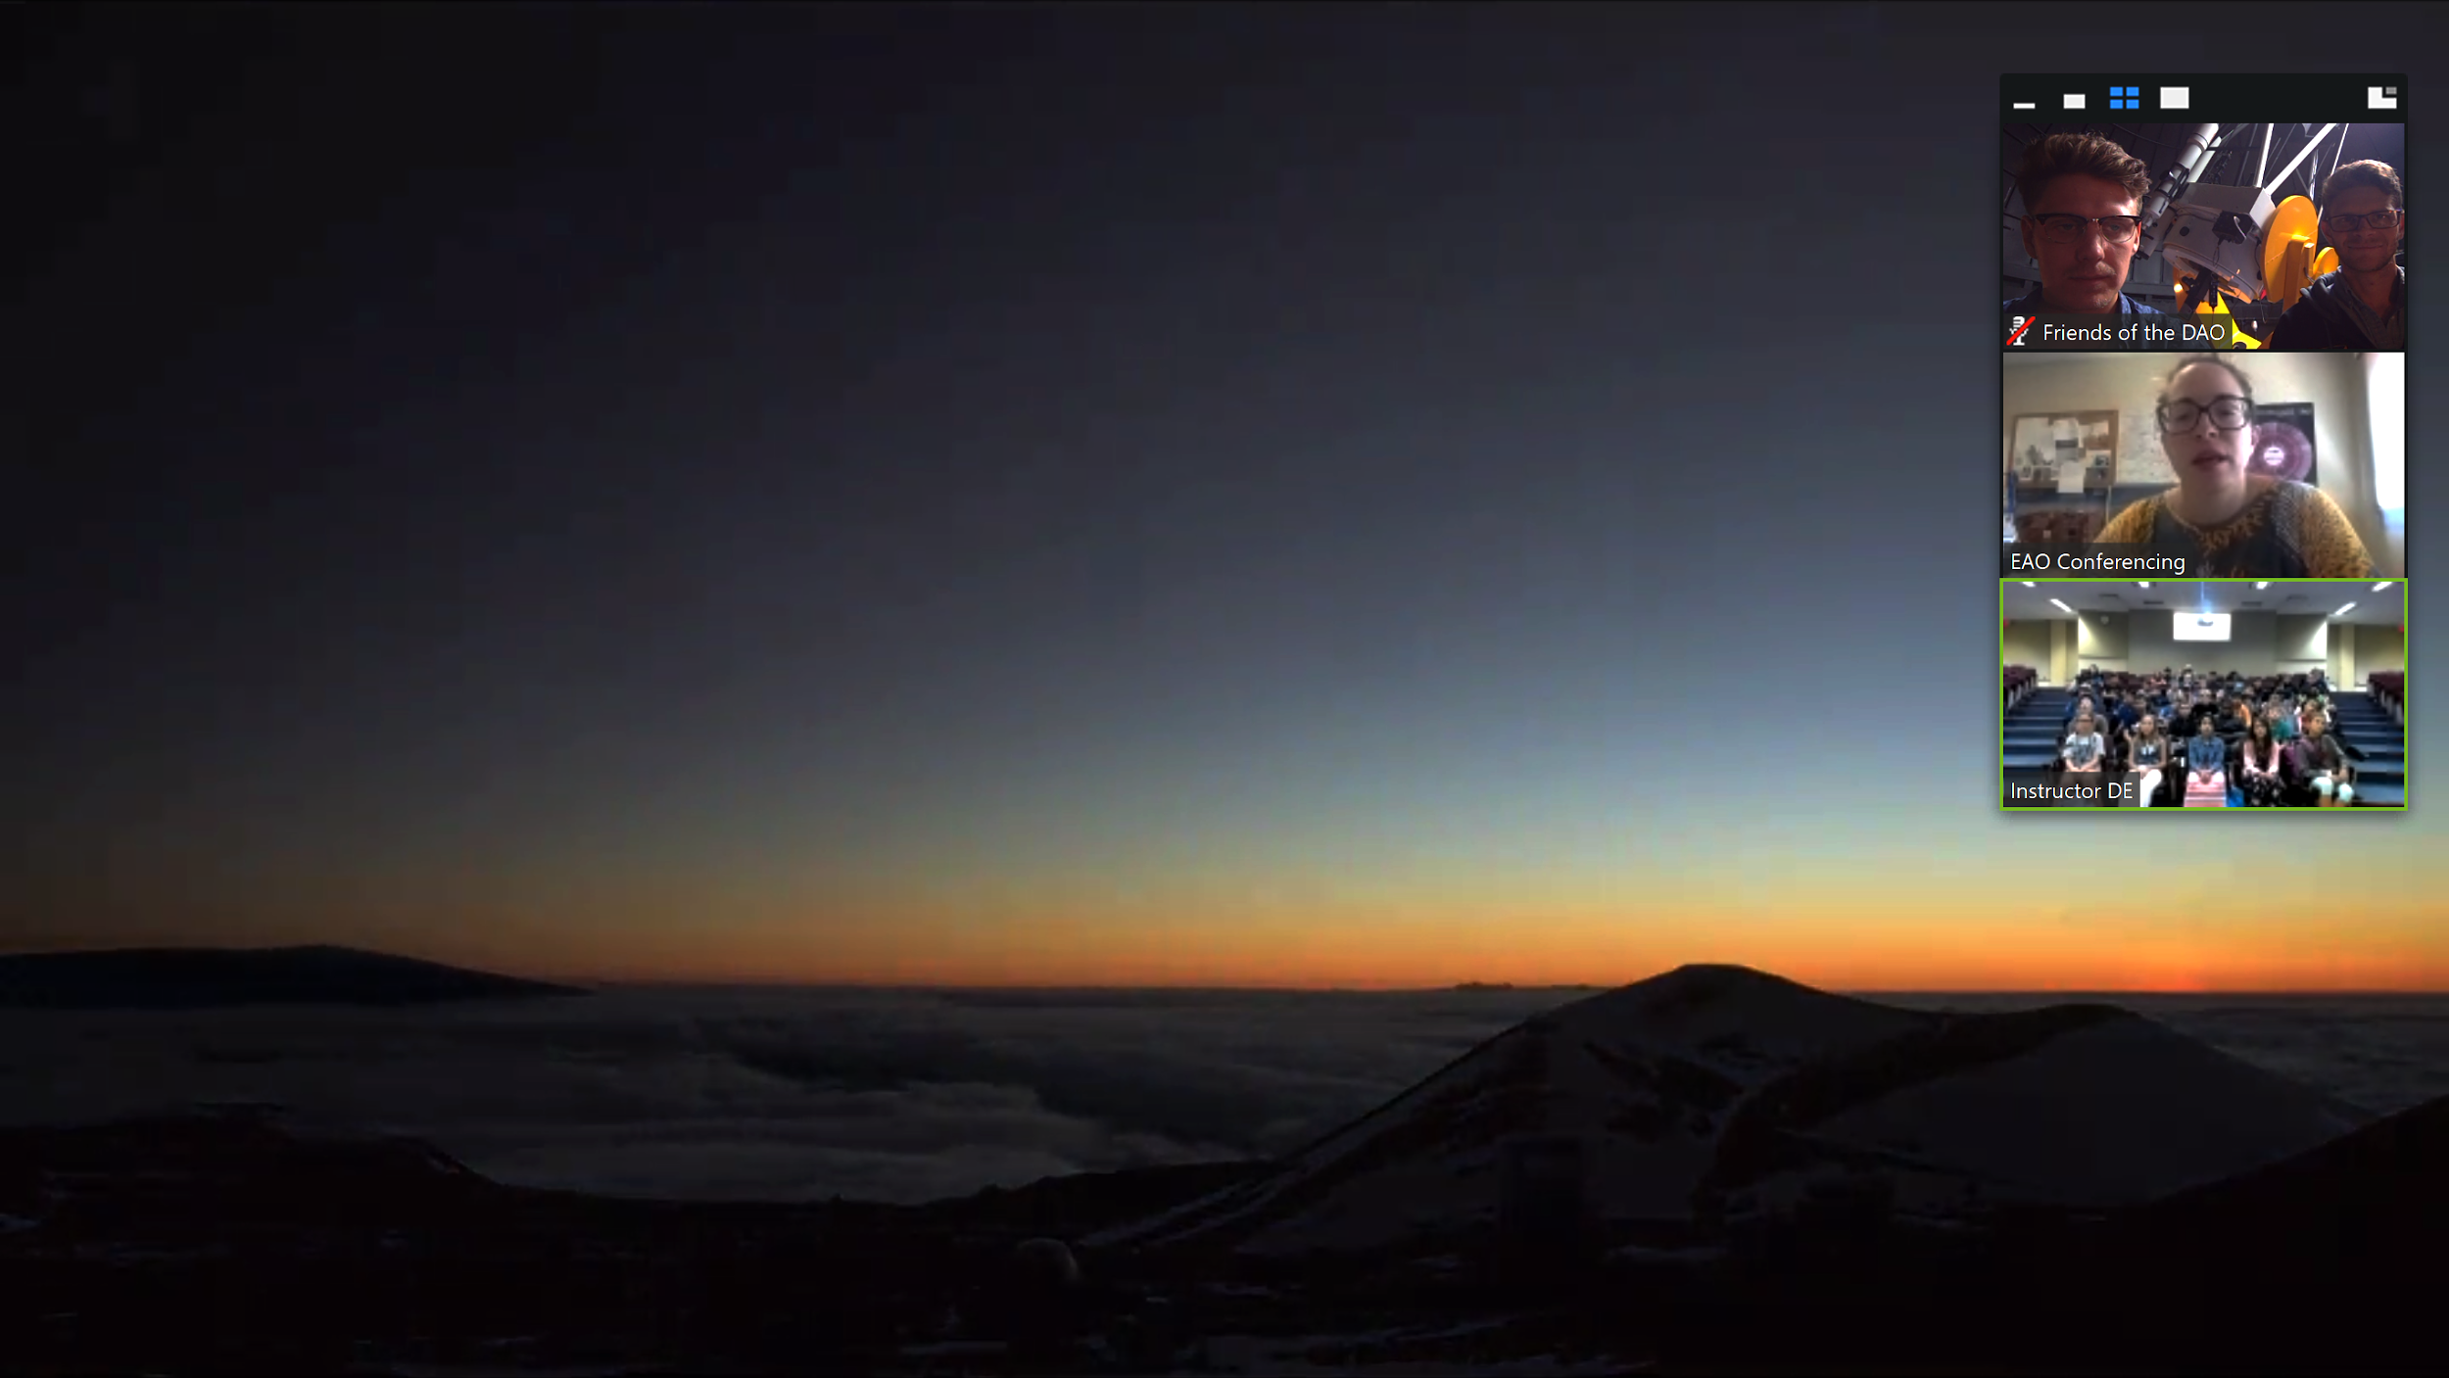
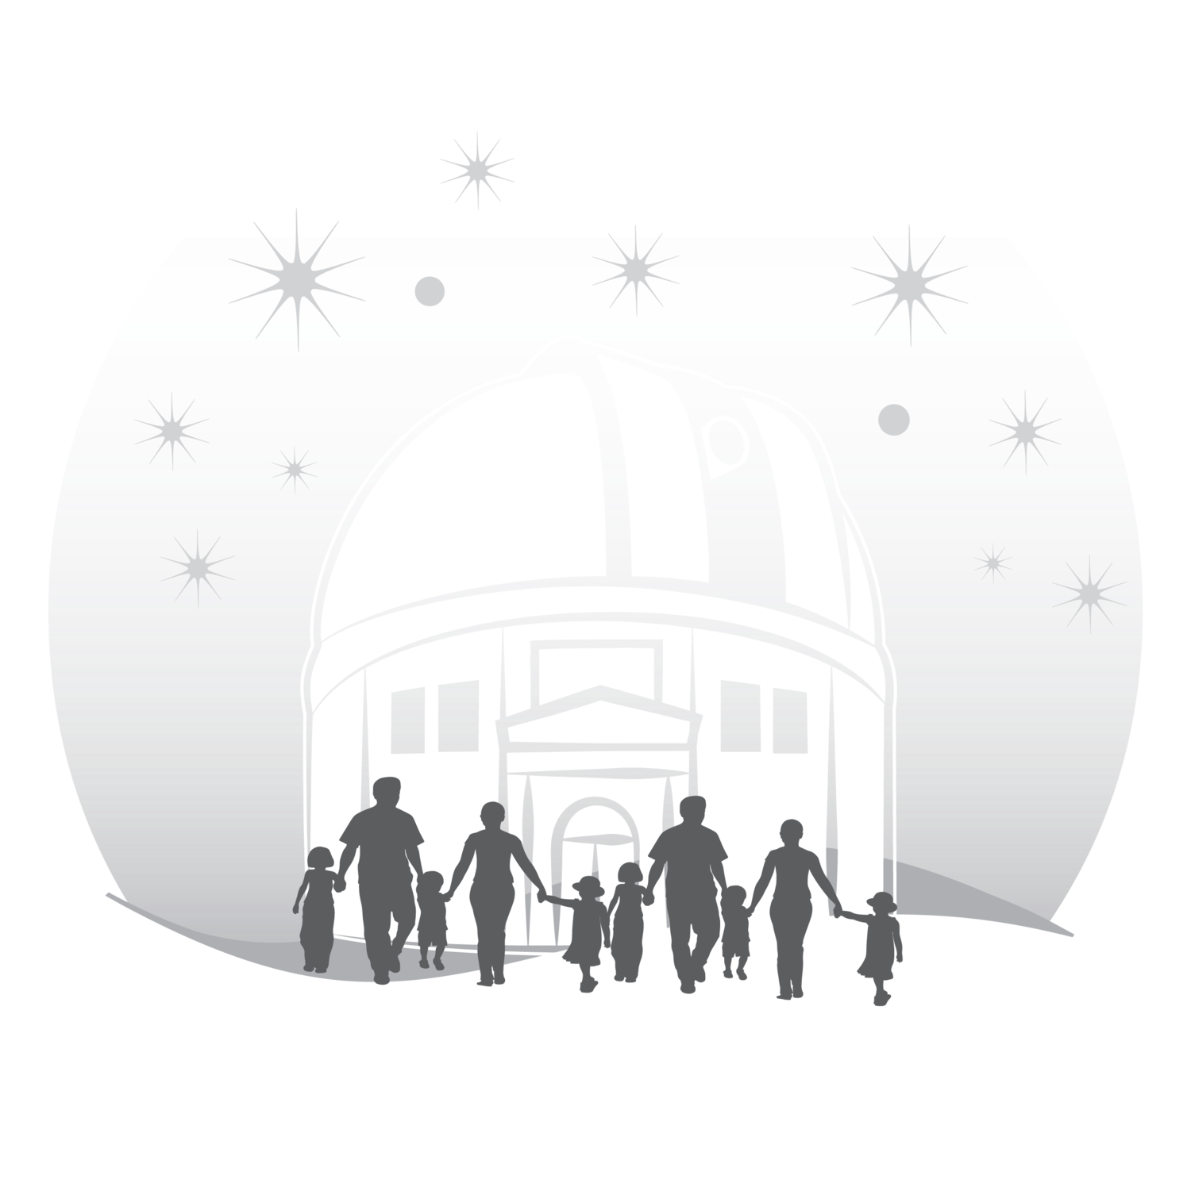
Canadian Youth Exploring Space
(Can-YES)
What we offer:
Live one-on-one interactive video conferences with scientists.
Preparatory astronomy material and interactive activities.
Access to some of Canada’s best research facilities and their data.
For more info and how to book a session
Contact:
nannau@observatoryhill.org
OR VISIT:
https://thecentreoftheuniverse.net/canyes/

Slide 6
Modelling the Solar System
Notes:
Credit: NASA
https://commons.wikimedia.org/wiki/File:Solar_sys.jpg

Slide 7
It’s impossible to represent the solar system to scale on a sheet of paper or a slide!

Slide 8
Representation of the Solar System
Modelling the Solar System
Credit: NASA
Notes:
Credit: NASA
https://commons.wikimedia.org/wiki/File:Solar_sys.jpg

Slide 9
Representation of the Solar System
Modelling the Solar System
  shows different objets, not just planets
  nice global representation
  sizes not to scale
  distances not to scale
  visible orbits
  asteroid belt too localized
Credit: NASA
Notes:
Credit: NASA
https://commons.wikimedia.org/wiki/File:Solar_sys.jpg

Slide 10
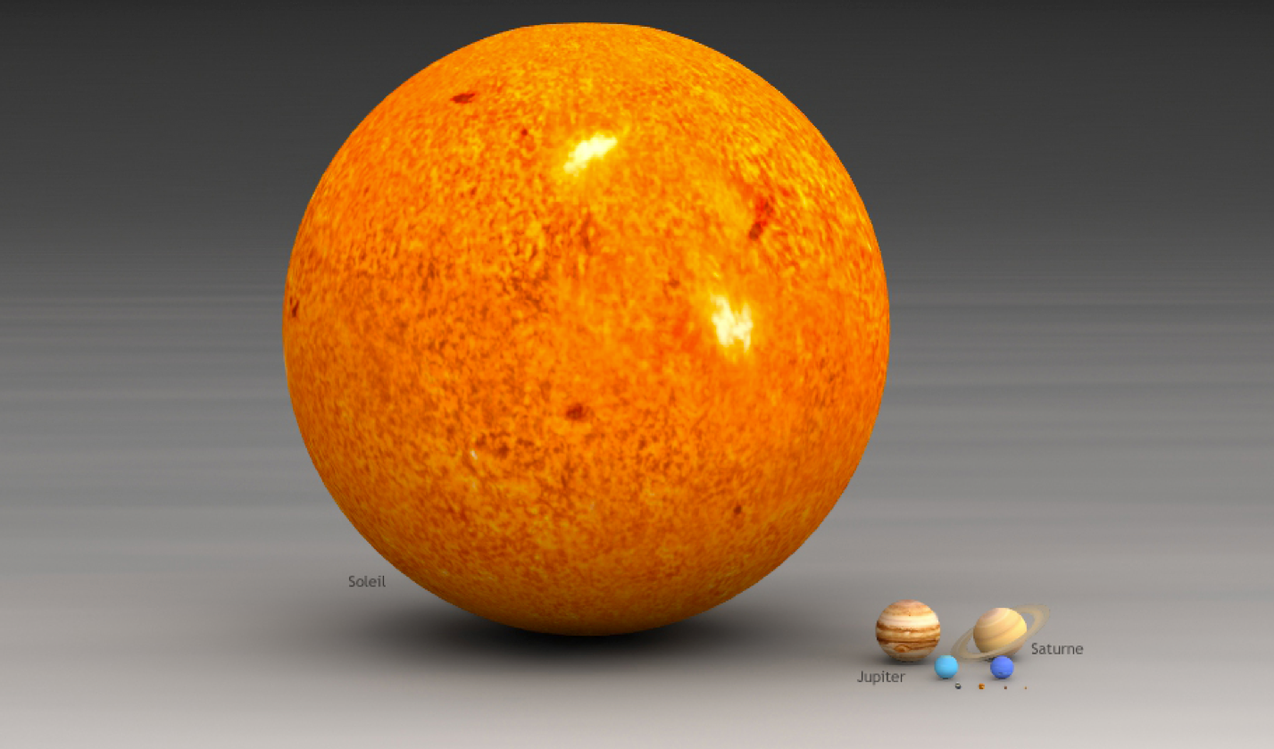
Representation of the Solar System
Modelling the Solar System
Credit: Lsmpascal
Notes:
Credit: Lsmpascal
http://www.lesud.com/lesud-astronomy_pageid81.html

Slide 11
Representation of the Solar System
Modelling the Solar System
  sizes to scale
  nice rendering of the objets’ surfaces
  nothing about distances
  only Sun and planets (everything else would be too small)
Credit: Lsmpascal
Notes:
Credit: Lsmpascal
http://www.lesud.com/lesud-astronomy_pageid81.html

Slide 12
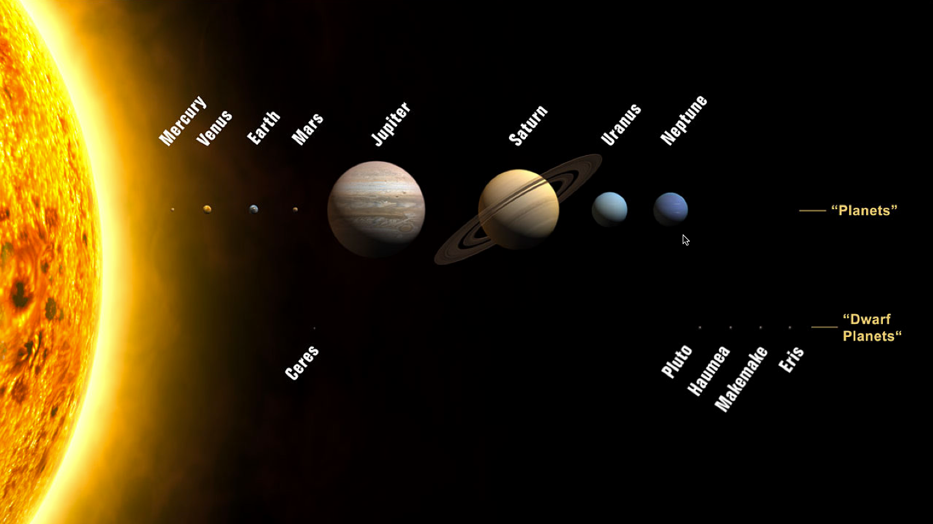
Representation of the Solar System
Modelling the Solar System
Credit: NASA
Notes:
Credit: NASA
https://commons.wikimedia.org/wiki/File:Planets2008.jpg

Slide 13
Representation of the Solar System
Modelling the Solar System
  sizes to scale
  includes dwarf planets
  distances not to scale
  planets are not in a line
Credit: NASA
Notes:
Credit: NASA
https://commons.wikimedia.org/wiki/File:Planets2008.jpg

Slide 14
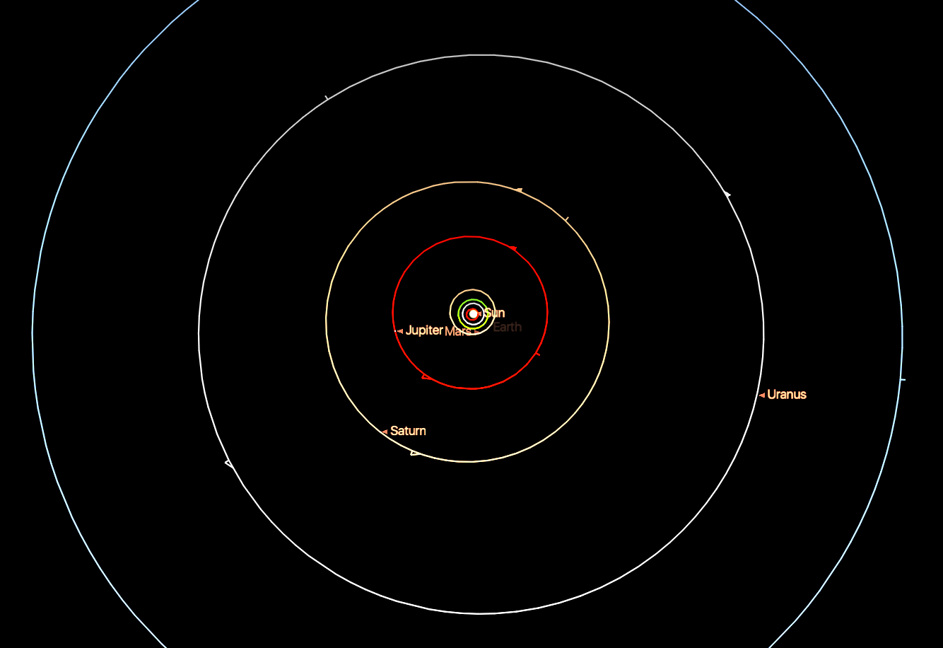
Representation of the Solar System
Modelling the Solar System
Image created with Starry Night

Slide 15
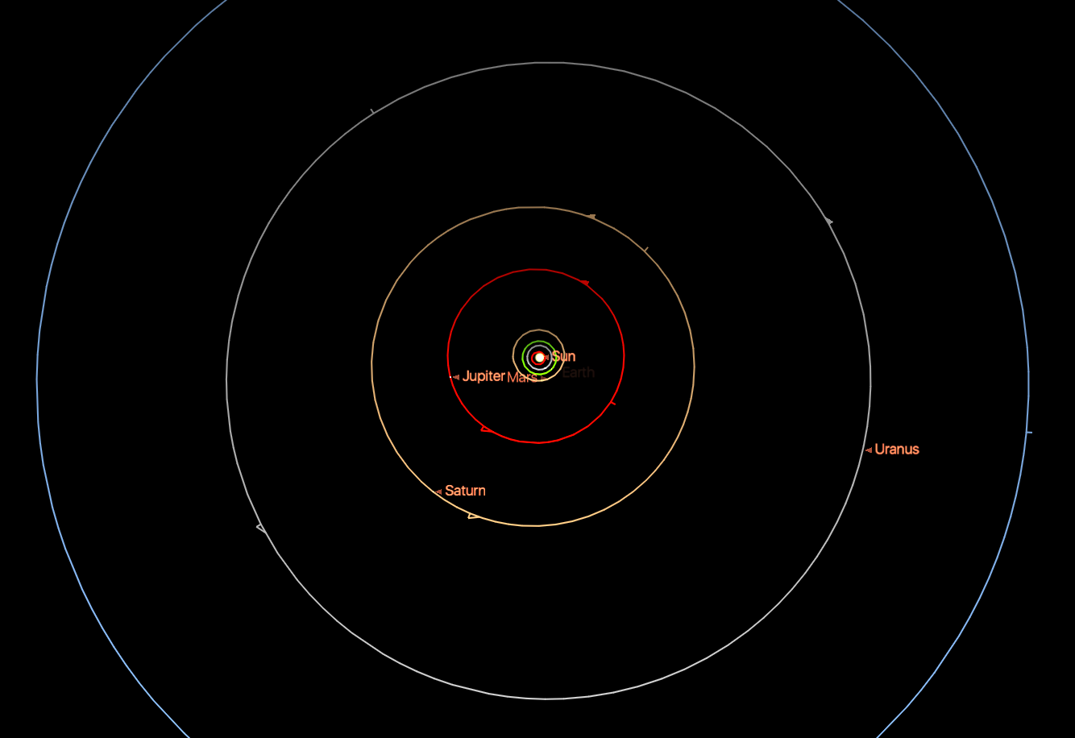
Representation of the Solar System
Modelling the Solar System
  distances to scale
  can see current position
  planets too small to be seen
  visible orbits (but they are necessary…)
Image created with Starry Night

Slide 16
What should we do?
Create models!

Slide 17
A few basic concepts…

Slide 18
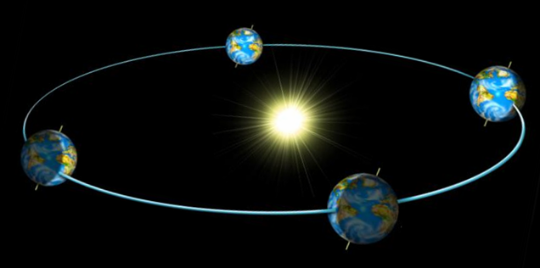
Ecliptic
Modelling the Solar System
The plane formed by the orbit of the Earth around the Sun is called the ecliptic.
Credit: FAAQ/Montreal Planetarium
Image not to scale
Notes:
Image credit: Federation des astronomes amateurs du Quebec and Montreal Planetarium
http://www.faaq.org/ateliers/index.htm in the Powerpoint presentation about the solar system

Slide 19
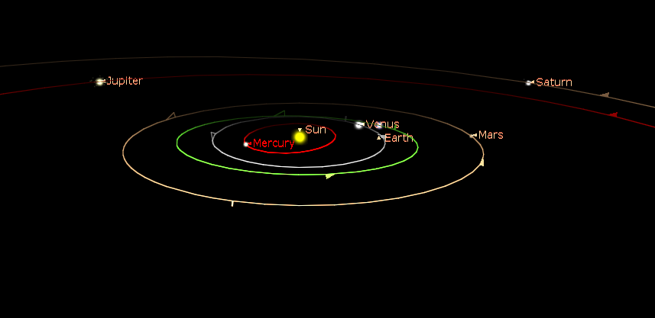
Ecliptic
Modelling the Solar System
The orbits of the other planets are also on the ecliptic, within a few degrees.
Image created with Starry Night

Slide 20
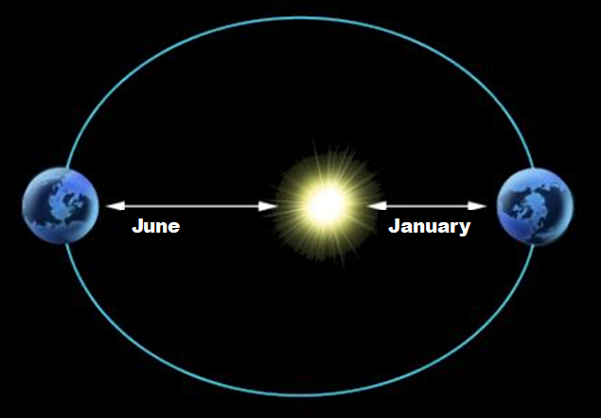
Astronomical Unit
Modelling the Solar System
1 astronomical unit (au) =
= average Earth-Sun distance
= 149.6 million km
152.6 million km
147.5 million km
Credit: FAAQ/Montreal Planetarium
Image not to scale
Notes:
Image credit: Federation des astronomes amateurs du Quebec and Montreal Planetarium
http://www.faaq.org/ateliers/index.htm in the Powerpoint presentation about the solar system

Slide 21
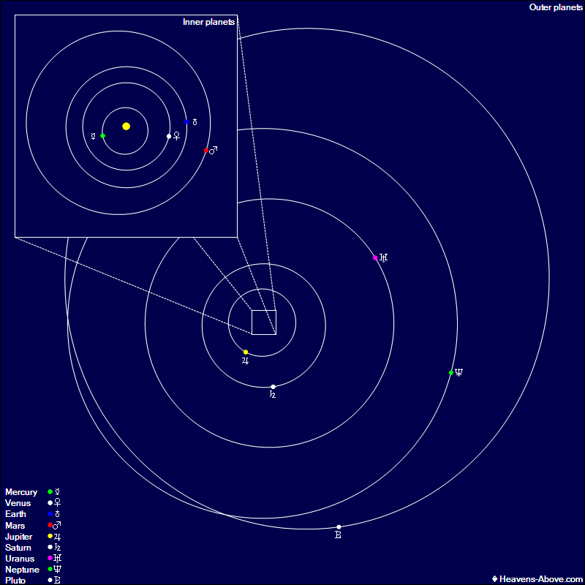
Orbits of the Planets
Modelling the Solar System
The orbits are not circles, but almost. They are ellipses with the Sun at one focus.
Notes:
Image credit: https://www.heavens-above.com/planets.aspx?lat=0&lng=0&loc=Unspecified&alt=0&tz=UCT

Slide 22
Size of the Solar System
Modelling the Solar System
Object | Diameter (km) | Distance from Sun (km) | Distance from Sun (au)
Sun | 1 392 530 | --- | ---
Mercury | 4879 | 57 900 000 | 0.4
Venus | 12 104 | 108 200 000 | 0.7
Earth | 12 756 | 149 600 000 | 1.0
Mars | 6792 | 227 900 000 | 1.5
Ceres (asteroid belt) | 952 | 414 000 000 | 2.8
Jupiter | 142 984 | 778 600 000 | 5.2
Saturn | 120 536 | 1 433 500 000 | 9.6
Uranus | 51 118 | 2 872 500 000 | 19.2
Neptune | 49 528 | 4 495 100 000 | 30.1
Pluto (Kuiper belt) | 2390 | 5 906 400 000 | 39.5

Slide 23
Activity ideas

Slide 24
Pocket Solar System

Slide 25
Pocket Solar System
Modelling the Solar System
  Simple and surprising activity to learn about the distances in the solar system.
Adapted from « Pocket Solar System » from the Astronomical Society of the Pacific/Night Sky Network: http://nightsky.jpl.nasa.gov/download-view.cfm?Doc_ID=392

Slide 26
Cut out a piece of paper tape – about 1m long.
Write “Sun” at one end and “Pluto – Kuiper Belt” at the other end.
Sun
Pluto / K.B.

Slide 27
Sun
Mercury
Venus
Earth
Mars
Ceres (asteroid belt)
Jupiter
Saturn
Uranus
Neptune
Pluto (Kuiper belt)
We now need to place all these objects between the Sun and Pluto.
You can ask your students to predict where they go, either on the other side of the paper or with another colour. We’ll then make the real model.

Slide 28
Which object would be in the middle of the tape?
Sun
Uranus
Pluto / K.B.

Slide 29
Which object is halfway between Uranus and Pluto?
Which object is halfway between the Sun and Uranus?
Sun
Saturn
Uranus
Neptune
Pluto / K.B.

Slide 30
Which object is halfway between the Sun and Saturn?
Sun
Jupiter
Uranus
Saturn
Neptune
Pluto / K.B.

Slide 31
Which object is halfway between the Sun and Jupiter?
Sun
Jupiter
Uranus
Saturn
Neptune
Pluto / K.B.
Ceres / Asteroid belt

Slide 32
Which object is halfway between the Sun and Ceres?
Sun
Mars
Ceres / A.B.

Slide 33
Finally, we draw three lines between the Sun and Mars for Mercury, Venus and the Earth.
Sun
Earth
Ceres / A.B.
Venus
Mars
Mercury

Slide 34
Now look at the entire solar system.
Any surprise?!?
Sun
Uranus
Mars
Jupiter
Ceres / A.B.
Saturn
Neptune
Pluto / K.B.
Earth
Venus
Mercury

Slide 35
 | Real distance (au) | Approximate distance (au)
Mercury | 0,39 | 0,4
Venus | 0,72 | 0,7
Earth | 1 | 1
Mars | 1,52 | 1,5
Ceres | 2,77 | 2,8
Jupiter | 5,20 | 5
Saturn | 9,54 | 10
Uranus | 19,19 | 20
Neptune | 30,06 | 30
Pluto | 39,44 | 40

Slide 36
Pocket Solar System
Modelling the Solar System
  very simple, short and efficient
  shows distances to scale
  shows objects in a straight line
  no information about sizes of the objects
  may be too abstract for some people (tip: draw planets instead of writing names…)

Slide 37
Planets in Playdough

Slide 38
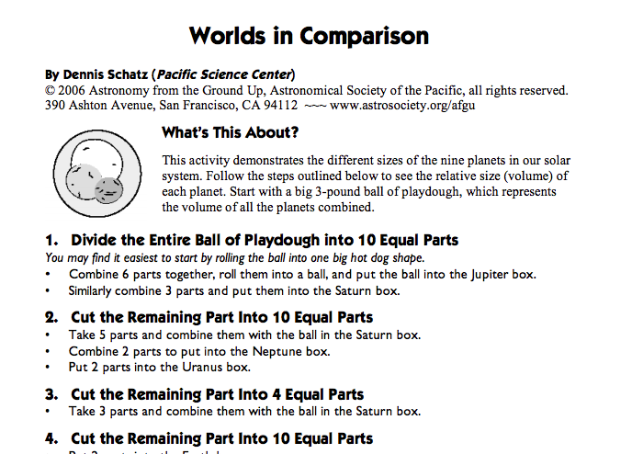
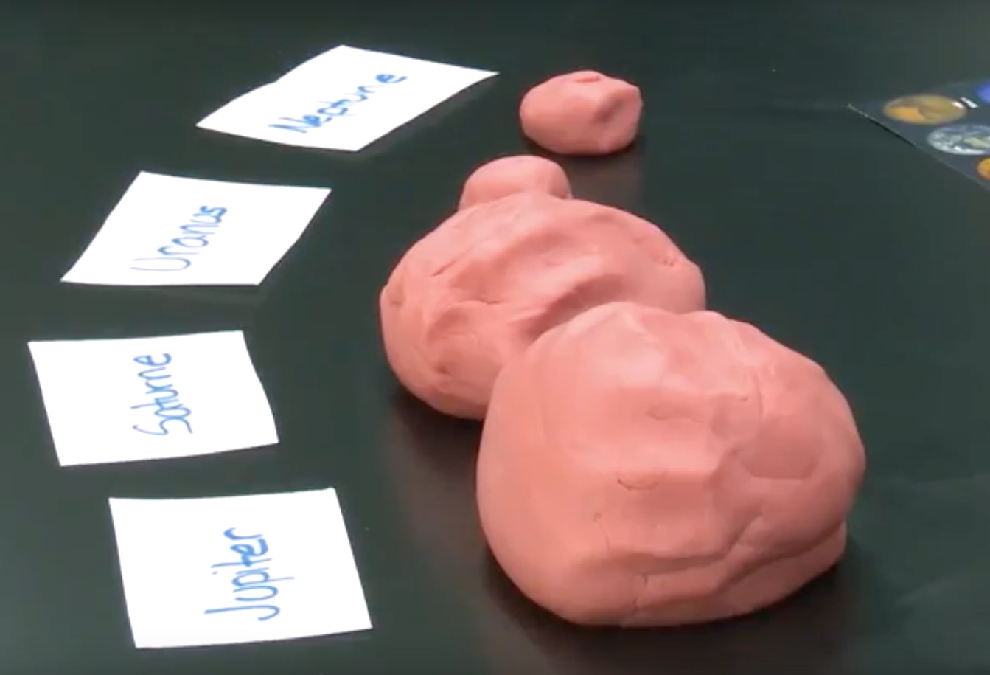
Planets in Playdough
Modelling the Solar System
  Models the volumes of the planets to scale.
  Info: http://astronomy.sdsu.edu/projectastro/resources/WorldsInComparison.pdf

Slide 39
Planets in Playdough
Modelling the Solar System
  excellent activity to model sizes (volume, not just diameter)
  very surprising!
  needs a lot of playdough
  impossible to do perfectly (but that’s part of the challenge!)
  nothing about distances
  planets only – the other objects would be too small

Slide 40
Scale Model of the Solar System

Slide 41
Scale Model of the Solar System
Modelling the Solar System
  Recreates the main objects in the solar system using the right scale for both size AND distance.
  You can find everyday items to represent the planets and put them at the right distance from your Sun (get ready for a long walk!)

Slide 42


Calculate your Model
Modelling the Solar System
  If you want the Sun to be 30 cm in diameter, how big should Earth be?
$\frac{30 cm}{1392530 km}$ = $\frac{x}{12756 km}$
$$𝓍=\frac{30 cm × 12756 km}{1392530 km}=0.27 cm=2.7 mm$$

Slide 43
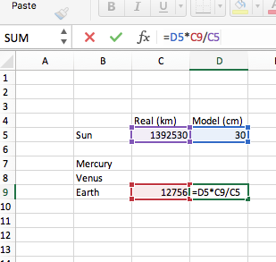
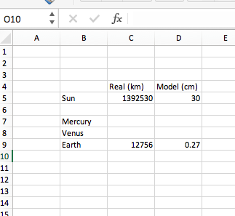
Calculate your Model in Excel
Modelling the Solar System

Slide 44
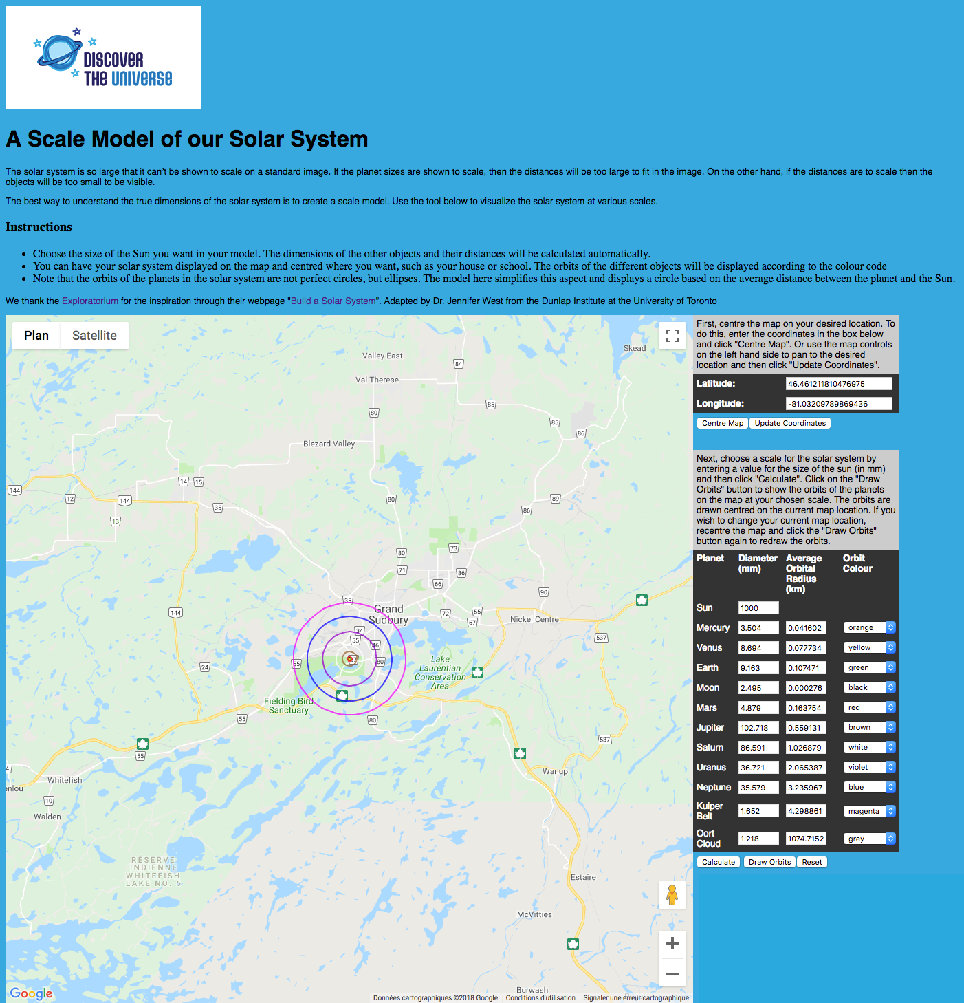
Scale Model of the Solar System
Modelling the Solar System
  http://www.discovertheuniverse.ca/solarsystem.html
  Enter the size of the Sun you want for your model. Everything else is calculated automatically.
  Show the scale solar system on the map, centred where you want.

Slide 45
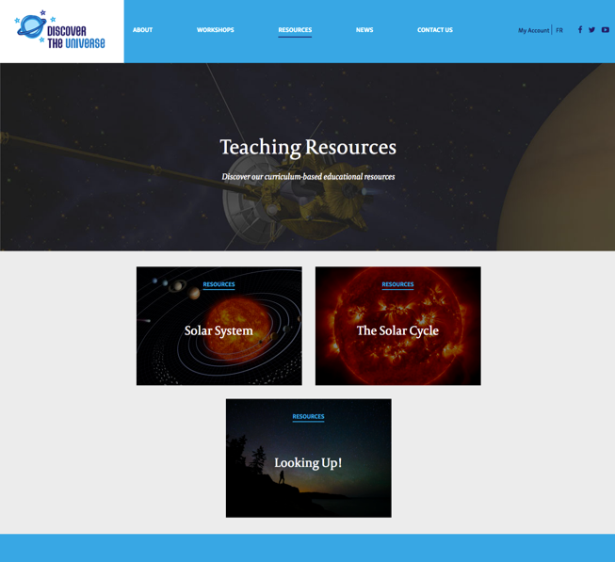
Scale Model of the Solar System
Modelling the Solar System
  Also available in our Resources section.

Slide 46
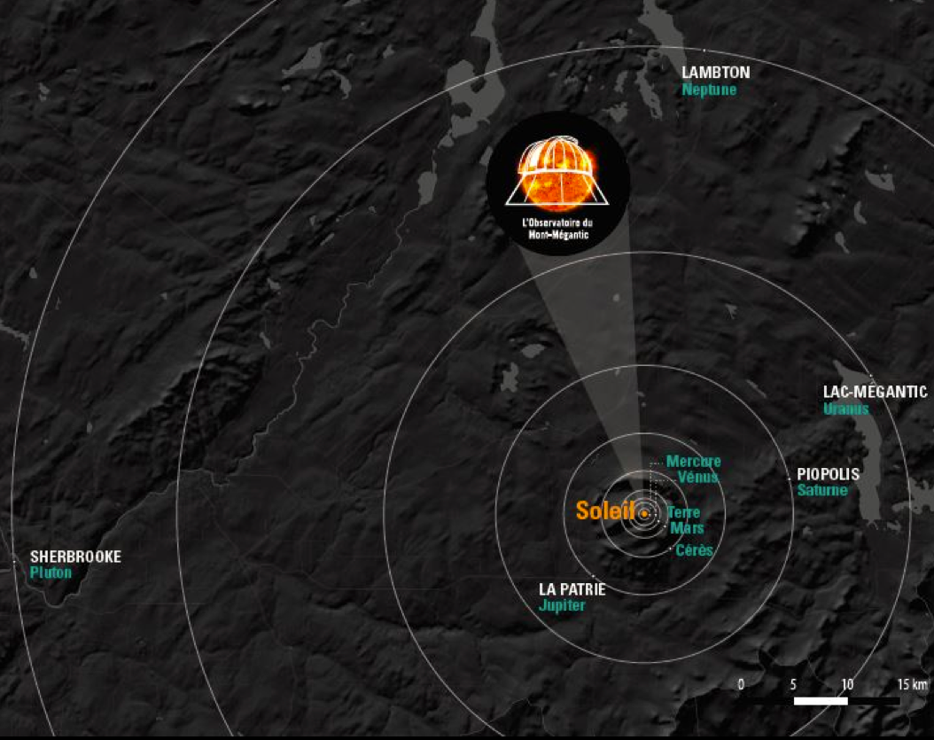
Scale Model of the Solar System - Example
Modelling the Solar System
  Giant scale model based on the Observatory of Mont Megantic, near Sherbooke, QC.

Slide 47
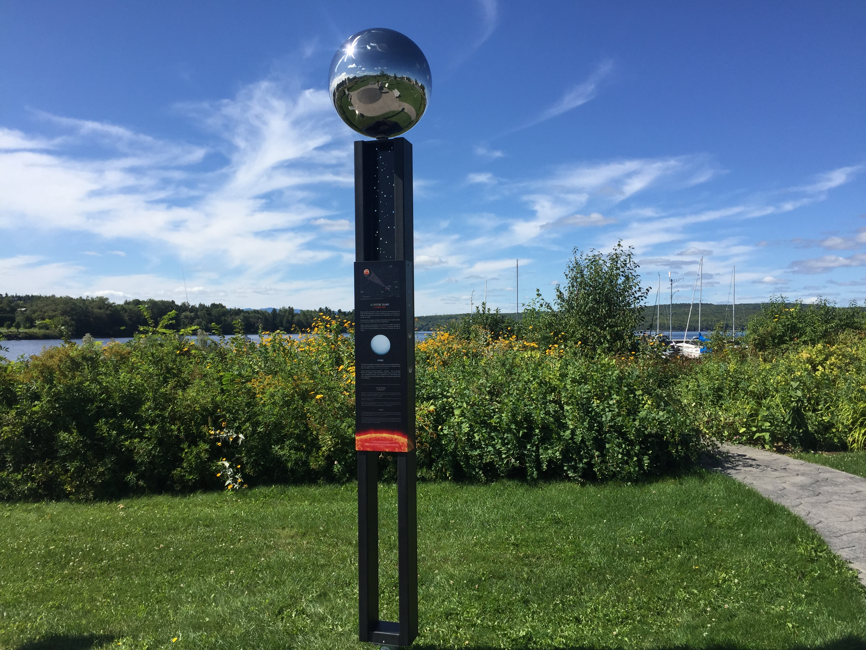
Scale Model of the Solar System - Example
Modelling the Solar System
  Uranus, in Lac-Mégantic
  Info : http://www.astrolab-parc-national-mont-megantic.org/en/giant.solar.system.htm

Slide 48
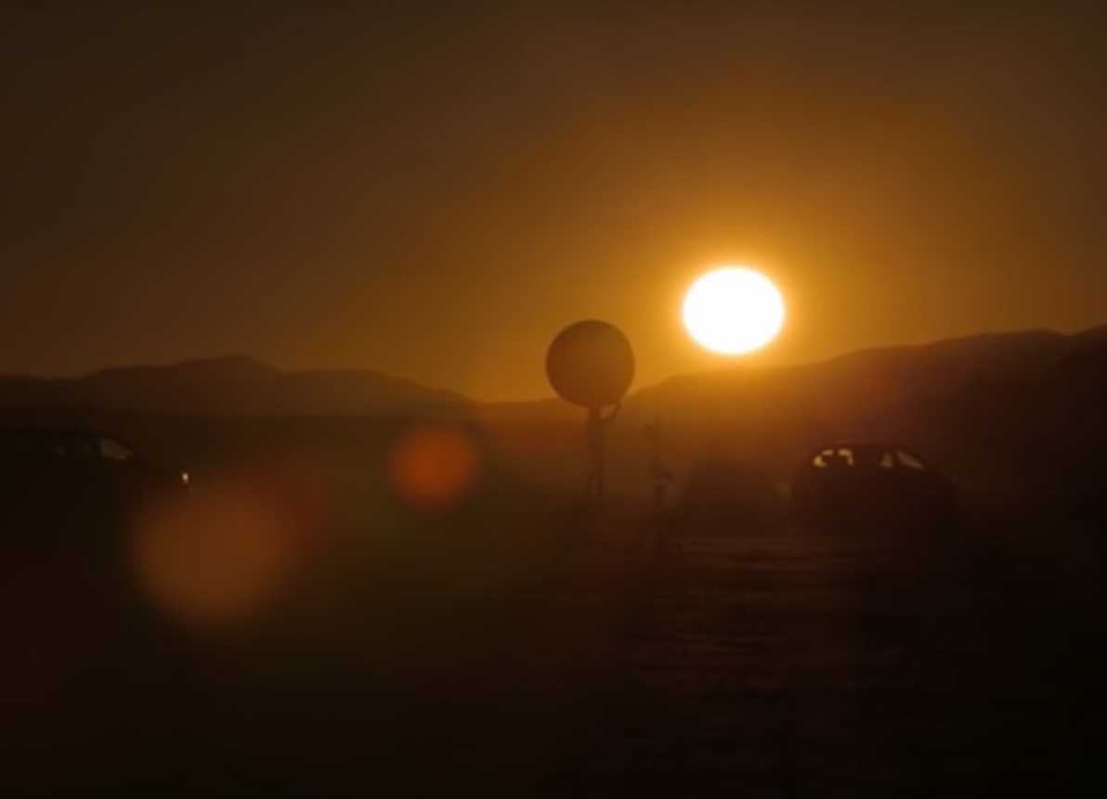
Scale Model of the Solar System - Example
Modelling the Solar System
  Excellent video– Solar system to scale in the Nevada desert: https://youtu.be/zR3Igc3Rhfg

Slide 49
Scale Model of the Solar System
Modelling the Solar System
  models distances AND sizes
  gives an excellent idea of the true scale of the solar system
  needs many items and long distance
  might be difficult to have a general overview
  might give the impression that planest are all in a line
  very difficult to model the smaller objects

Slide 50
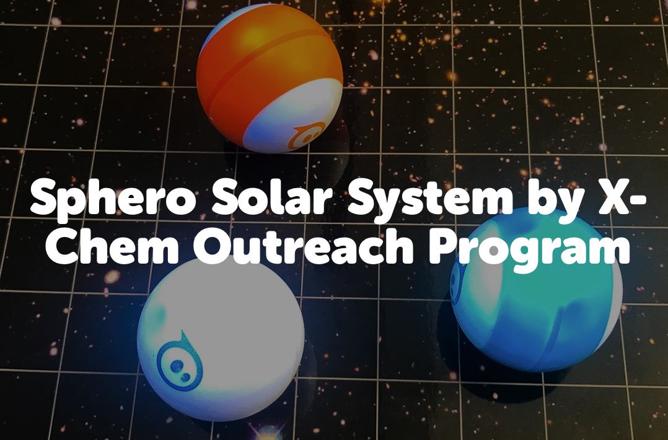

Slide 51

Sphero Solar System
Modelling the Solar System
  Activity developed by X-Chem Outreach and Actua
  includes robotics, coding, and math to calculate orbital periods and speeds to scale

Slide 52

Sphero Solar System
Modelling the Solar System
  What you’ll need:
  4-5 Sphero SPRK+ or Sphero Mini
  4-5 tablets to control each Sphero
  large surface (up to Mars: radius of 1.6 m; up to Jupiter: radius of 5.3 m)

Slide 53
Sphero Solar System
Modelling the Solar System
  We know:
  distances to each planet (1au becomes 1m in the model);
  orbital speeds in km/s of each planet.
  Need to calculate:
  speeds in Sphero unit (or use calculated values in activity description);
  orbital periods, using the speeds and circumferences (or use values in activity description).

Slide 54
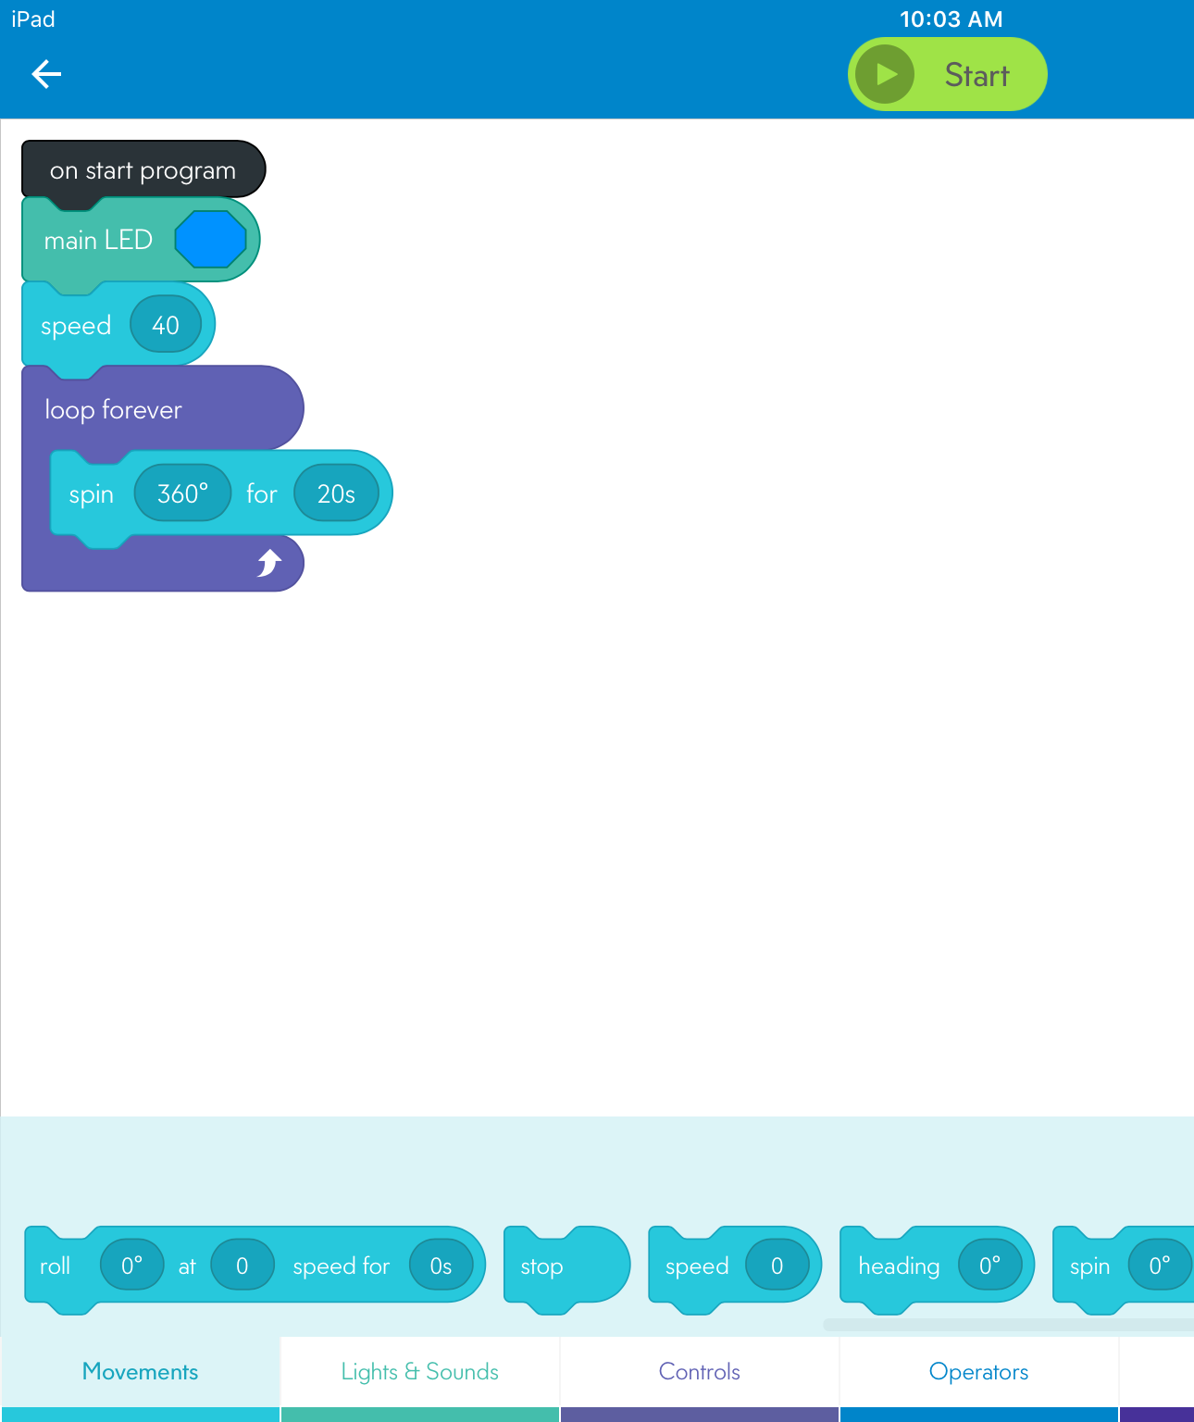
Sphero Solar System
Modelling the Solar System
  Coding in blocks using the app Sphero Edu:
  And we get 4 or 5 planets orbiting the Sun at different speeds and with different colours!

Slide 55
Sphero Solar System
Modelling the Solar System
  Detailed description: https://actua.ca/en/activities/sphero-solar-system-by-x-chem-outreach-program

Slide 56
Sphero Solar System
Modelling the Solar System
  multidisciplinary activity: astronomy, robotics, coding and math
  models distances and motion to scale
  needs equipment
  sizes of planets not to scale
  system becomes unstable after a few orbits

Slide 57
Modelling the Solar System
Modelling the Solar System
  No model is perfect but they are better than still images.
  Don’t hesitate to discuss limitations of the models with your students.

Slide 58
Questions?
Thank you!
Notes:
Credit: NASA
https://commons.wikimedia.org/wiki/File:Solar_sys.jpg

