Slide 1
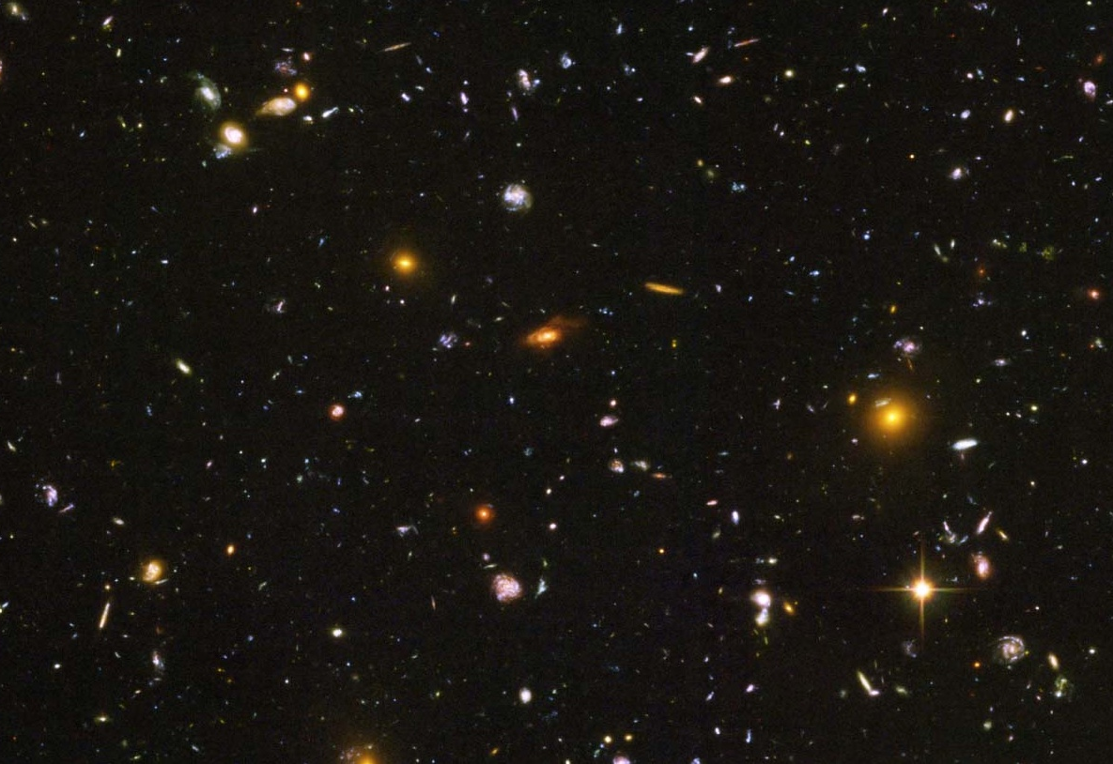
Light – Cosmic Messenger
Notes:
Credit: NASA, ESA
http://hubblesite.org/image/3380/news_release/2014-27

Slide 2
What is Light?

Slide 3
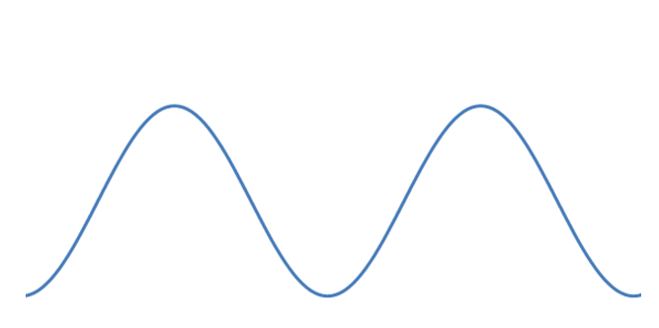
What is Light?
Light – Cosmic Messenger
Light is an electromagnetic wave…
AND a particle (photon).
Wavelength
Notes:
Image source: Discover the Universe

Slide 4
Speed of Light
Light – Cosmic Messenger
In vacuum, light travels at 300,000 km/s.
According to Einstein’s theory of relativity, nothing can travel faster.
The speed of light is used to calculate distances in astronomy:
One light-year is the distance traveled by light in one year.

Slide 5
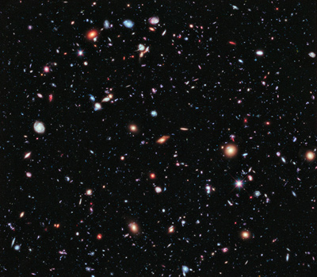
Telescope = Time Travel Machine
Light – Cosmic Messenger
Light is fast but not infinitely fast.
When we look at a star 100 light-years away, we see it the way it was 100 years ago.
Some galaxies in this image are billions of light-years away…
Notes:
Image credit: NASA, ESA, G. Illingworth, D. Magee, and P. Oesch (University of California, Santa Cruz), R. Bouwens (Leiden University), and the HUDF09 Team
http://hubblesite.org/newscenter/archive/releases/2012/37/

Slide 6
Visible Light
Light – Cosmic Messenger
Our eyes perceive different wavelengths of light as different colours. We can see light with wavelengths between 400nm and 700 nm.
1 nm = 1 nanometre = 10⁻⁹ m = one millionth of 1 mm
Notes:
Image source: Wikipedia
http://commons.wikimedia.org/wiki/File:Linear_visible_spectrum.svg

Slide 7
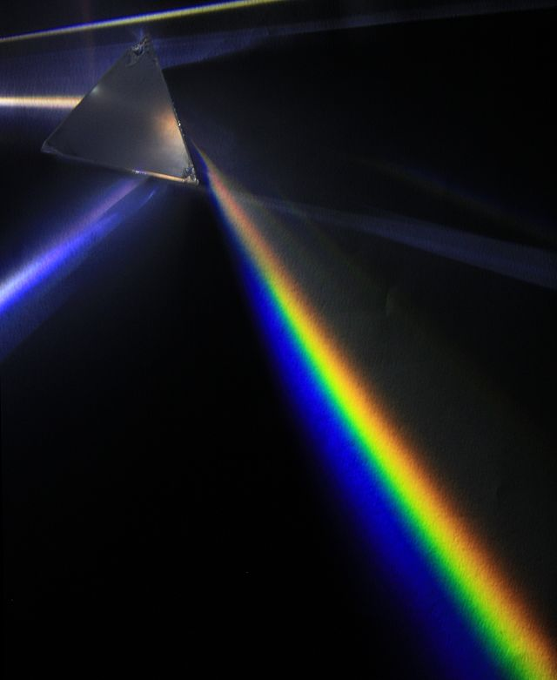
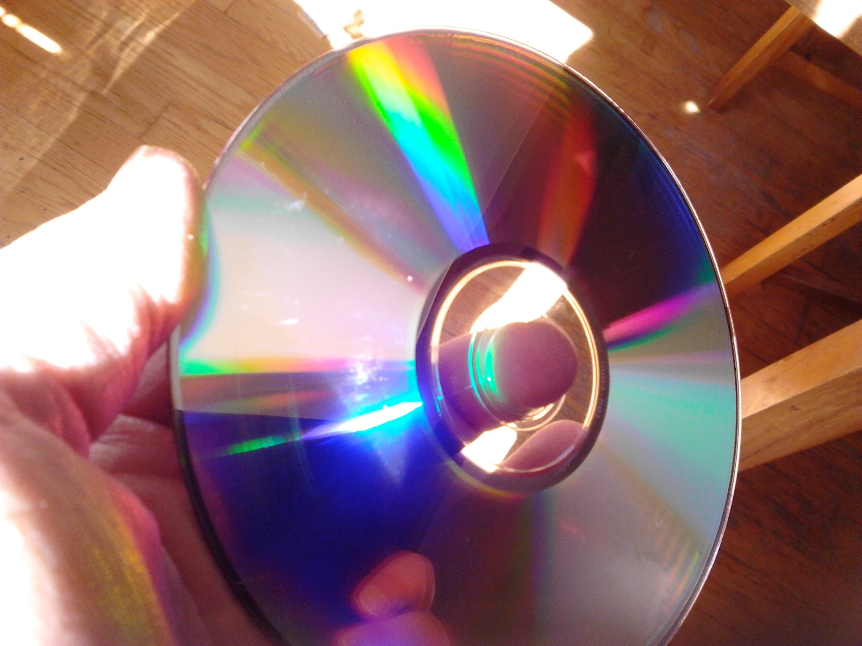
Visible Light
Light – Cosmic Messenger
White light is composed of all colours in the visible spectrum.
Notes:
Image credit: prism: D-Kuru/Wikimedia Commons - http://en.wikipedia.org/wiki/Visible_spectrum
cd: Discover the Universe

Slide 8
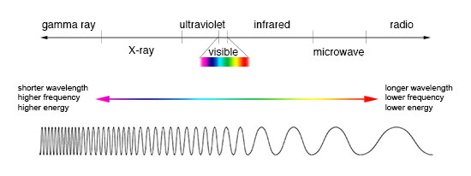
Electromagnetic Spectrum
Light – Cosmic Messenger
Visible light is only a tiny part of the entire electromagnetic spectrum.
Notes:
Image credit: NASA/Imagine the Universe
http://imagine.gsfc.nasa.gov/science/toolbox/emspectrum1.html

Slide 9
Electromagnetic Spectrum
Light – Cosmic Messenger
Gamma rays
X-rays
Ultraviolet
Infrared
Microwaves
Radio waves
« Colours » which we can’t see.
Radiation : emission or transmission of energy (not necessarily dangerous!)

Slide 10
How can we use the different types of light to learn about objects?

Slide 11
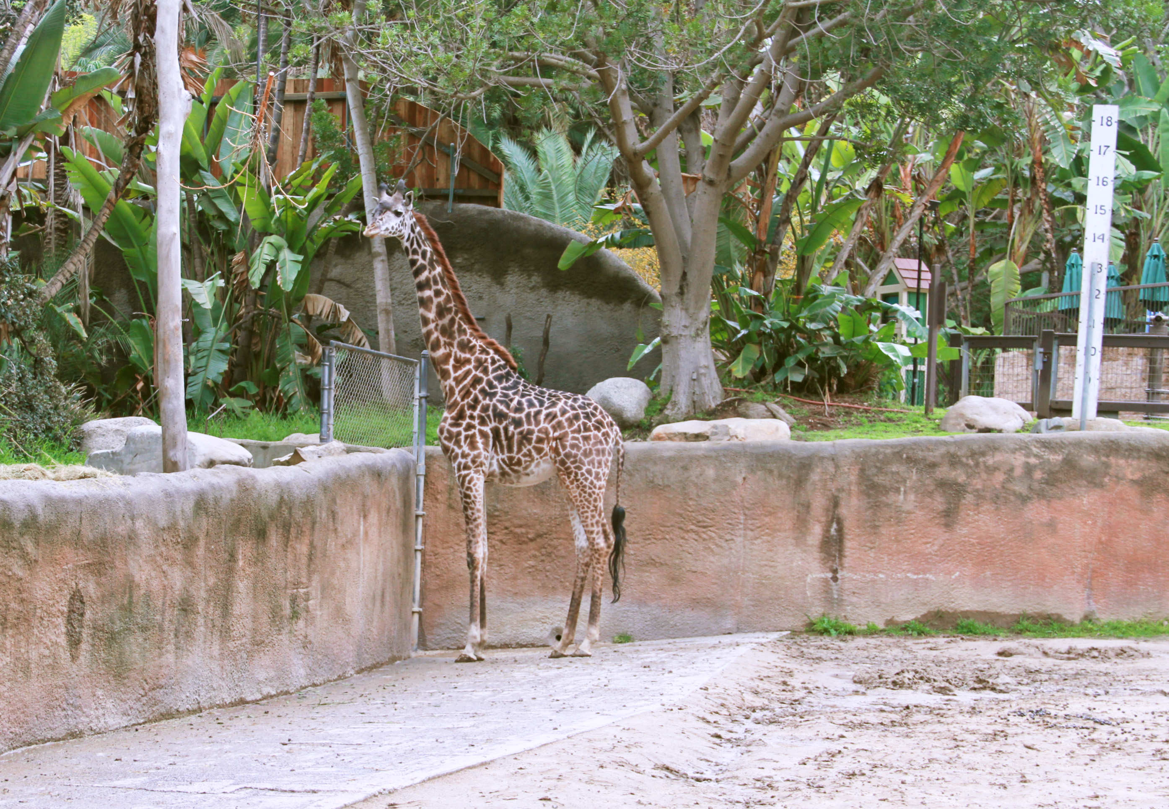
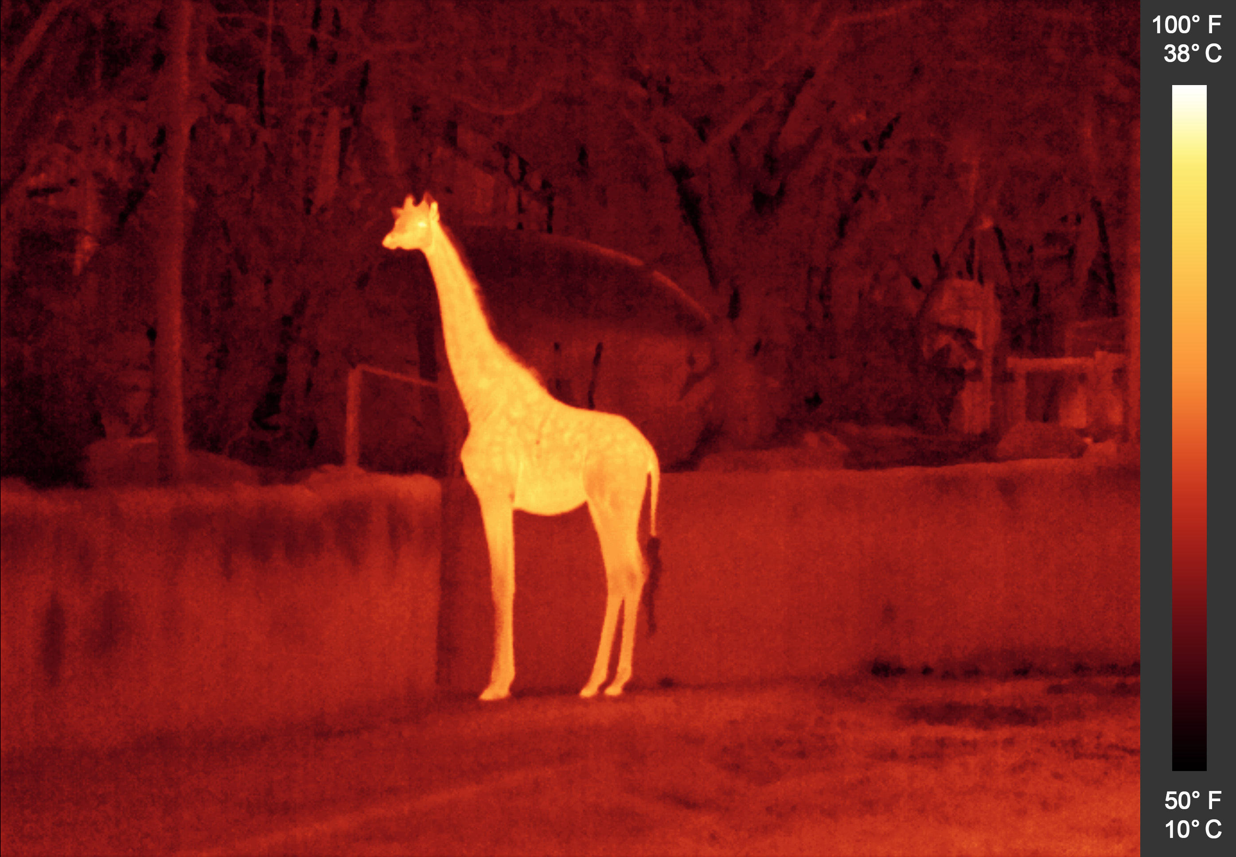
Infrared
Light – Cosmic Messenger
Notes:
Credit:NASA/JPL-Caltech
Image from our educational module The Solar Cycle: http://www.discovertheuniverse.ca/resource/the-solar-cycle/

Slide 12
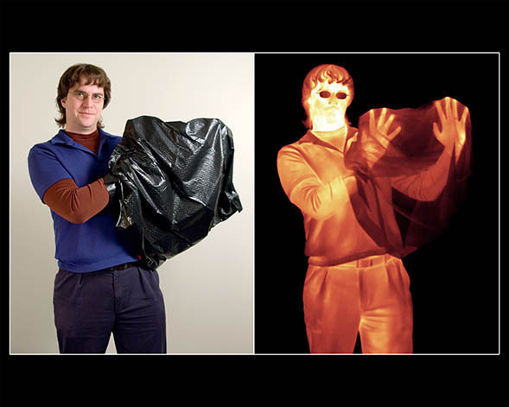
Infrared
Light – Cosmic Messenger
Notes:
Credit: NASA / Spitzer Space Telescope
http://www.spitzer.caltech.edu/images/2154-sig08-004-Hands-in-a-Bag-color-Visible-vs-Infrared-Light

Slide 13
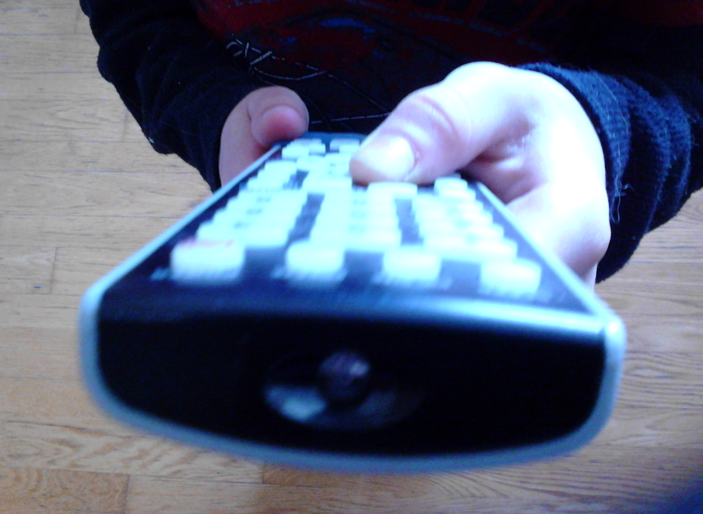
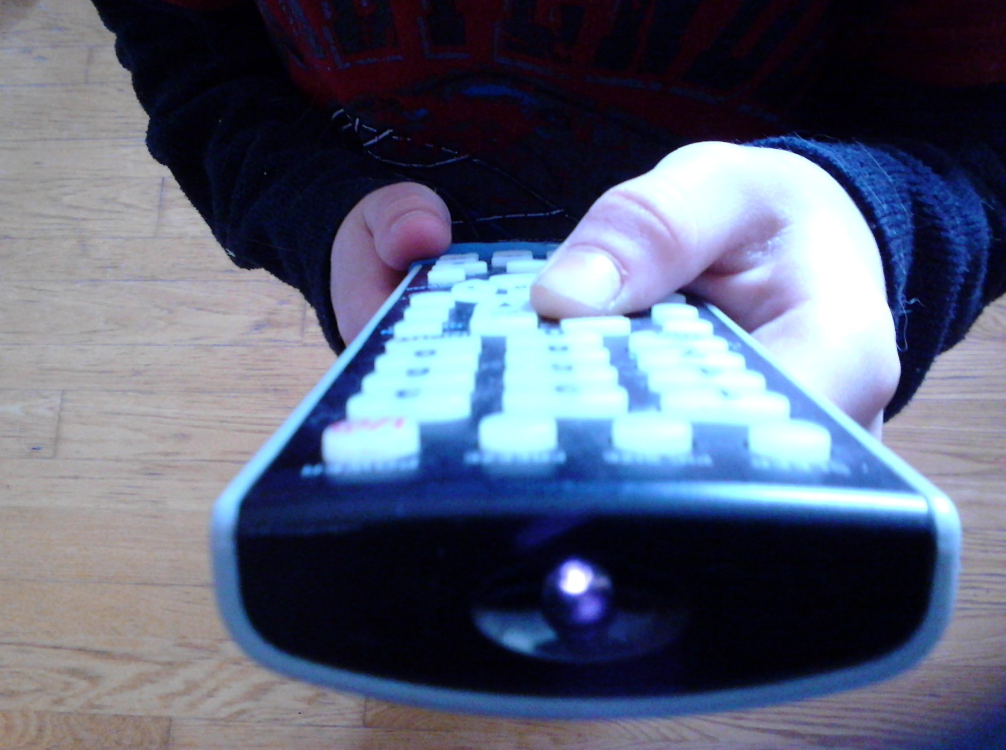
Infrared - Experiment
Light – Cosmic Messenger
Digital cameras are sensitive to infrared light and can detect the signal emitted by remote controls.
With the eye
Through a camera
Notes:
Credit: Discover the Universe

Slide 14
Infrared - Experiment
Light – Cosmic Messenger
You can try it in class or with a group.
For once, ask your students to take out their cellphones, iPod or other electronic device with a camera!
The signal might not be very strong: ask the students to get closer to the remote control and to be directly in line with the infrared LED.

Slide 15
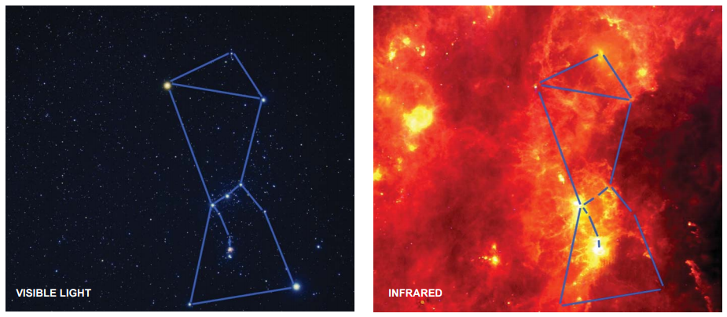
The Sky in Infrared
Light – Cosmic Messenger
Notes:
Credit: NASA - Akito Fujii, visible-light image; Infrared Astronomical Satellite, infrared image
http://coolcosmos.ipac.caltech.edu/system/media_files/binaries/94/original/orion_litho.pdf?1375837456

Slide 16
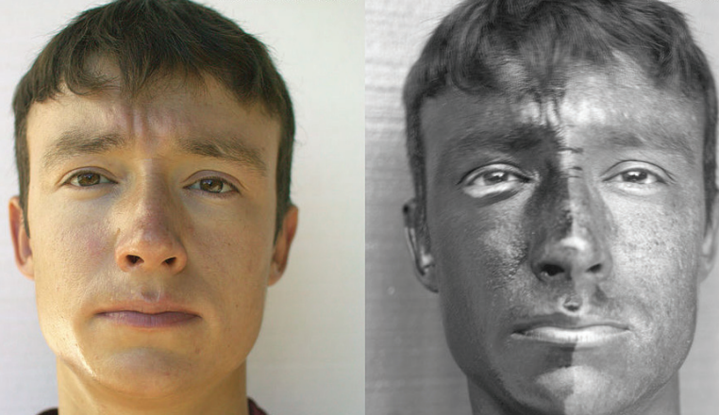
Ultraviolet
Light – Cosmic Messenger
Notes:
Credit: Spigget / Wikimedia Commons
Image from our educational module The Solar Cycle: http://www.discovertheuniverse.ca/resource/the-solar-cycle/

Slide 17
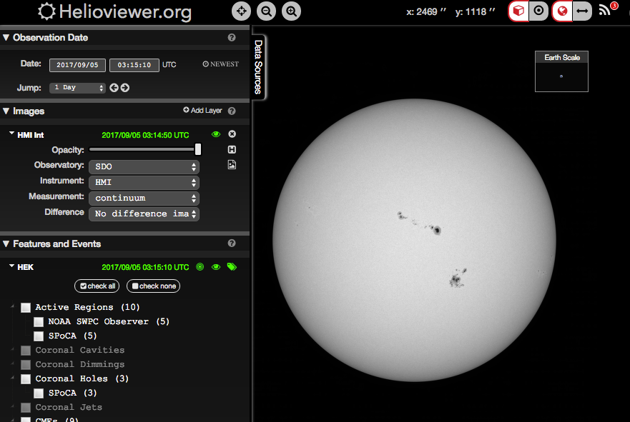
Sun in Visible Light and UV – Helioviewer.org
Light – Cosmic Messenger
Notes:
Credit: Helioviewer.org

Slide 18
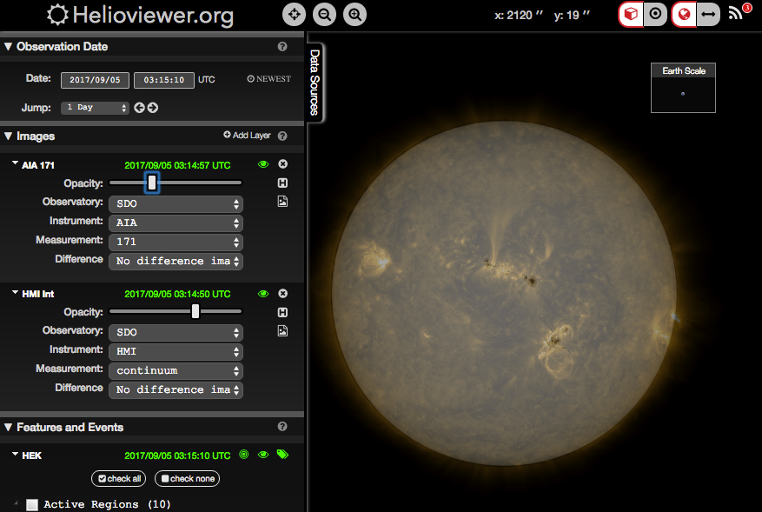
Sun in Visible Light and UV – Helioviewer.org
Light – Cosmic Messenger
Notes:
Credit: Helioviewer.org

Slide 19
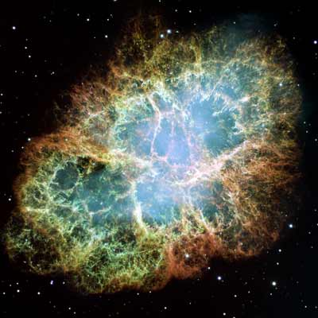
Crab Nebula – M1
Light – Cosmic Messenger
Notes:
Credit: NASA, ESA, J. Hester and A. Loll (Arizona State University)
http://hubblesite.org/newscenter/archive/releases/2005/37/image/a/

Slide 20
Crab Nebula – M1
Light – Cosmic Messenger
Notes:
Image source: Wikipedia
http://commons.wikimedia.org/wiki/File:Crab_Nebula_in_Multiple_Wavelengths.png

Slide 21
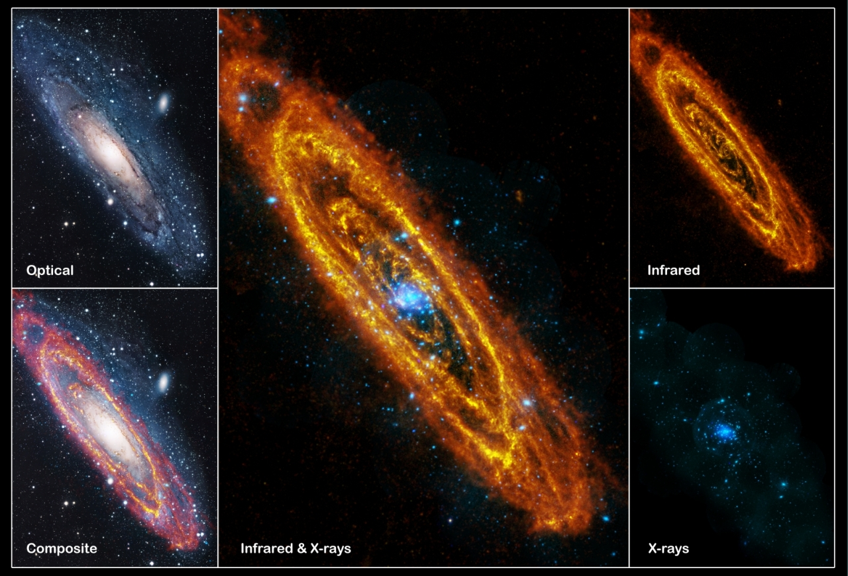
Andromeda Galaxy
Light – Cosmic Messenger
Notes:
Credit: © infrared: ESA/Herschel/PACS/SPIRE/J. Fritz, U. Gent; X-ray: ESA/XMM-Newton/EPIC/W. Pietsch, MPE; optical: R. Gendler
http://sci.esa.int/xmm-newton/48317-multiwavelength-images-of-the-andromeda-galaxy-m31/

Slide 22
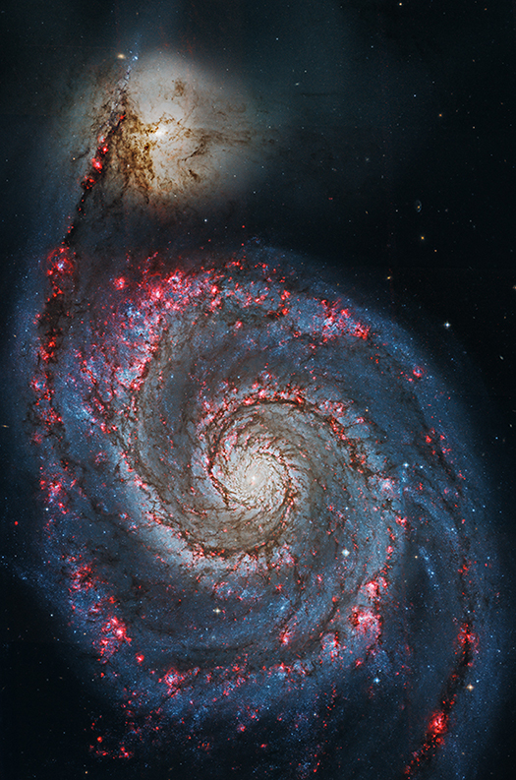
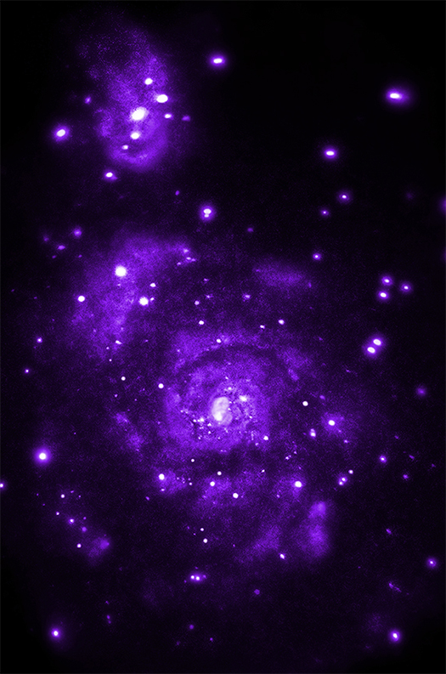
M51 – Whirlpool Galaxy
Light – Cosmic Messenger
Visible light
X-rays
Notes:
Credit:X-ray: NASA/CXC/Wesleyan Univ./R.Kilgard, et al; Optical: NASA/STScI
http://chandra.harvard.edu/photo/2014/m51/

Slide 23
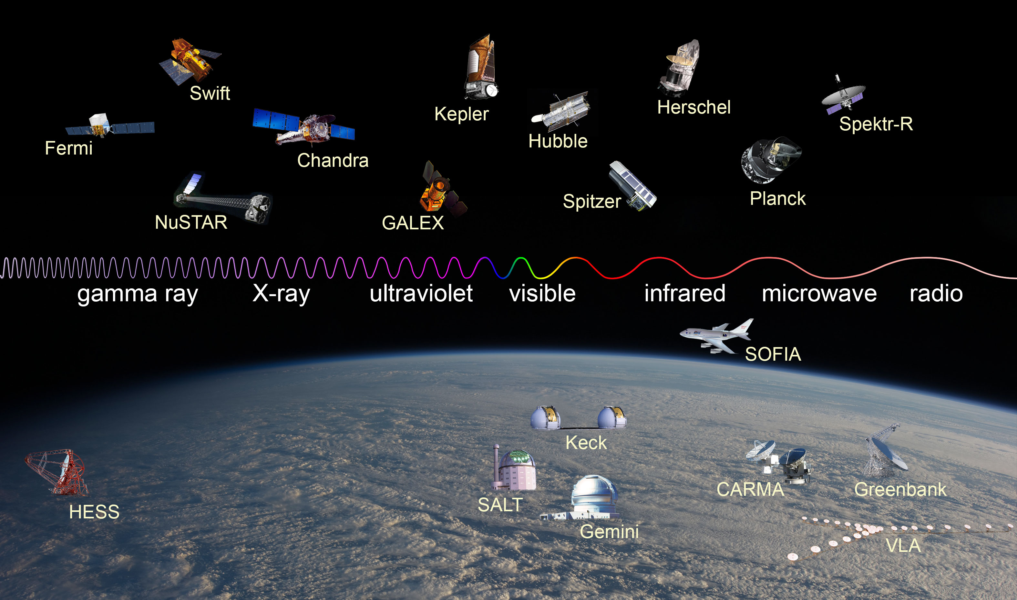
Telescopes Across the Spectrum
Light – Cosmic Messenger
Notes:
Credit: NASA / Imagine the Universe
http://imagine.gsfc.nasa.gov/science/toolbox/emspectrum_observatories1.html

Slide 24
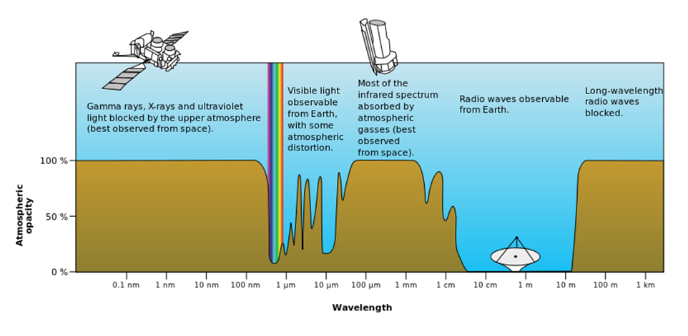
Atmosphere Opacity
Light – Cosmic Messenger
Notes:
Source: Wikipedia, original version from NASA
http://commons.wikimedia.org/wiki/File:Atmospheric_electromagnetic_opacity.svg

Slide 25
Spectroscopy: the Art of Decoding Light

Slide 26
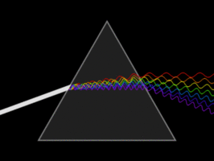
Spectroscopy
Light – Cosmic Messenger
Notes:
Source: Wikipedia
http://en.wikipedia.org/wiki/Light

Slide 27
Types of Spectrum
Light – Cosmic Messenger
Continuous spectrum (created by a hot object)
Emission spectrum (created by something that emits energy, like hot gas)
Absorption spectrum (something absorbs the energy at specific wavelength)
most used in astronomy
Notes:
Source: Wikipedia
http://commons.wikimedia.org/wiki/File:Fraunhofer_lines.svg

Slide 28
Composition of Objects

Slide 29
Solar Spectrum
Light – Cosmic Messenger
Sodium
Hydrogen
Notes:
Source: Wikipedia
http://commons.wikimedia.org/wiki/File:Fraunhofer_lines.svg

Slide 30
Spectrum Analysis
Light – Cosmic Messenger
Each element or molecule has its own spectrum, like a fingerprint allowing the identification in objects.
Notes:
Credit: Chandra / NASA
http://chandra.harvard.edu/resources/faq/astrophysics/astrophysics-5.html

Slide 31
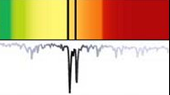
Spectrum Analysis
Light – Cosmic Messenger
Instead of looking at the spectrum directly, astronomers use a graph showing the intensity of the light as a function of the wavelength (colour).
Light intensity
Wavelength
Notes:
Source: Wikipedia
http://commons.wikimedia.org/wiki/File:Fraunhofer_lines.svg

Slide 32
Spectrum Analysis
Light – Cosmic Messenger
Hydrogen
Helium
Data from the Canada-France-Hawaii Telescope
Notes:
Credit: Canada France Hawaii Telescope

Slide 33
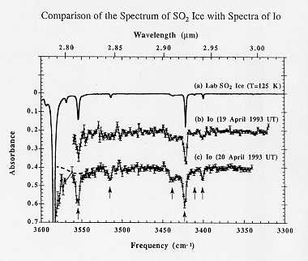
Composition of Io, moon of Jupiter
Light – Cosmic Messenger
Notes:
Credit: NASA
http://commons.wikimedia.org/wiki/File:Identification_of_Ices_in_the_Solar_System.jpg

Slide 34
Temperature of Objects

Slide 35
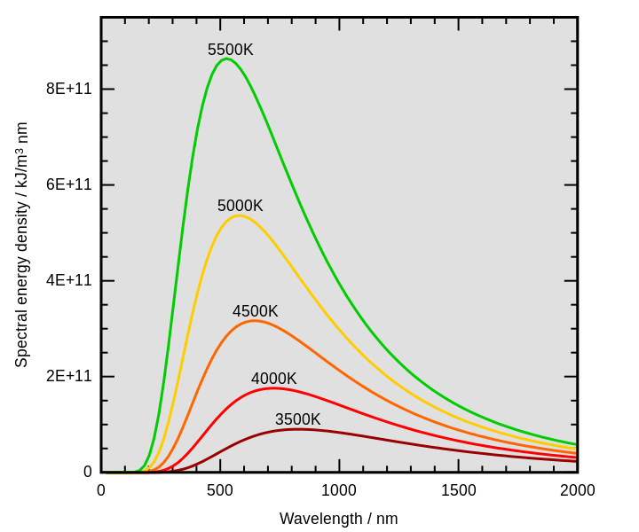
Temperature of an Object
Light – Cosmic Messenger
The hotter the object, the more light it emits.
The hotter the object, the shorter the wavelength of the peak radiation (blue, UV…)
Notes:
Source: Wikipedia
http://commons.wikimedia.org/wiki/File:Wiens_law.svg

Slide 36
Temperature of an Object
Light – Cosmic Messenger
The colours of the stars give us clues about their temperatures: blue is hotter than red.
‘cool’ star (3500 °)
hot star (30 000°)
Notes:
Source: Wikipedia
http://commons.wikimedia.org/wiki/File:Wiens_law.svg

Slide 37
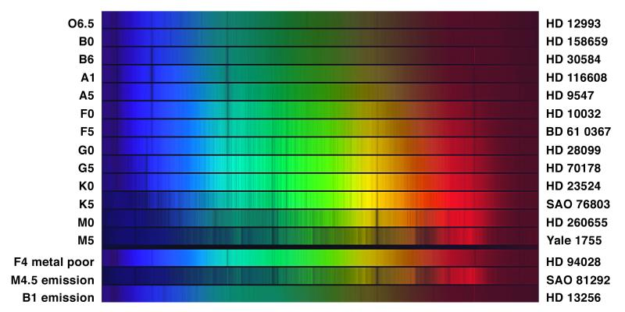
Star Spectra
Light – Cosmic Messenger
Notes:
Source: NASA
http://commons.wikimedia.org/wiki/File:Obafgkm_noao_big.jpg

Slide 38
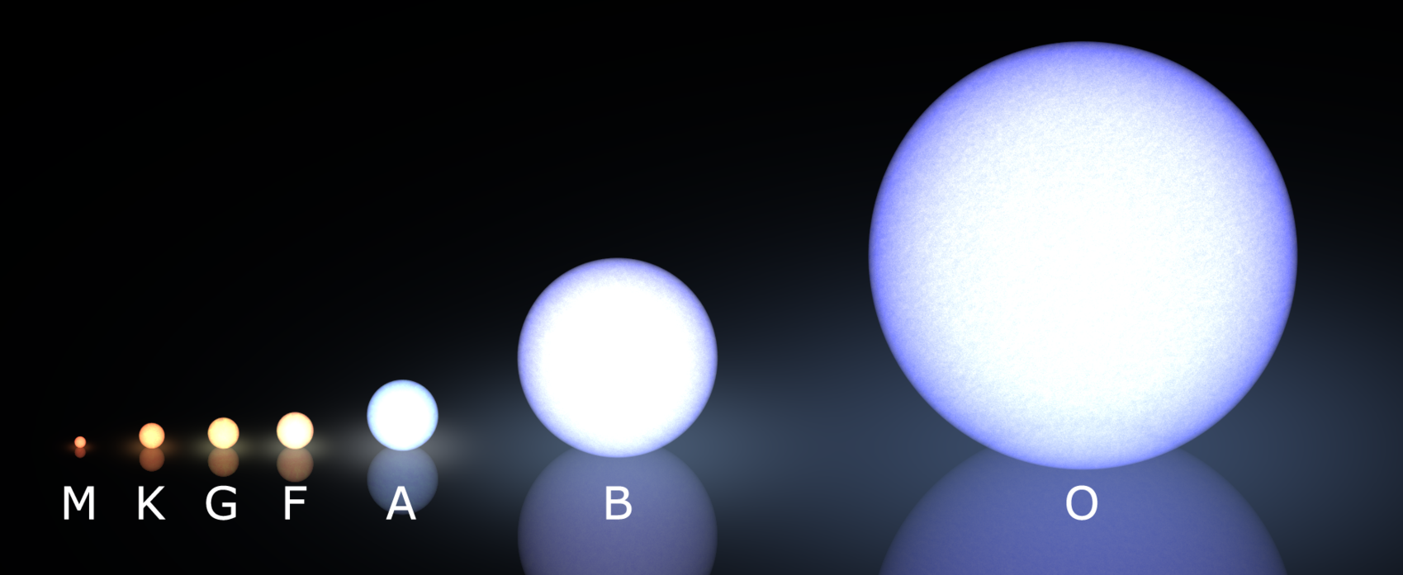
Star Spectra
Light – Cosmic Messenger
Notes:
Source: Wikipedia
http://commons.wikimedia.org/wiki/File:Morgan-Keenan_spectral_classification.png

Slide 39
Speed of Objects

Slide 40
Doppler Effect
Light – Cosmic Messenger
The speed of an object can be determined from its spectrum using the Doppler effect.
If the object is moving towards us, its light is shifted towards shorter wavelengths (blue).
If the object is moving away from us, its light is shifted towards longer wavelengths (red).
Notes:
Source: Wikipedia
http://fr.wikipedia.org/wiki/Effet_Doppler

Slide 41
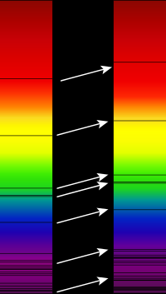
Doppler Effect
Light – Cosmic Messenger
Specifically, the spectral lines are either shifted towards the red (moving away) or towards the blue (moving towards us).
Reference spectrum (Sun)
Spectrum from a cluster of galaxies
Notes:
Source: Wikipedia
http://commons.wikimedia.org/wiki/File:Redshift.svg

Slide 42
Information Encoded in Light
Light – Cosmic Messenger
type of object → spectrum type (absorption/emission) and images at multiple wavelengths
temperature → spectrum or dominant colour
composition → spectral lines
speed → Doppler effect on spectral lines
and more (rotation, presence of exoplanets around a star…)

Slide 43
How do scientists get the nice astronomy pictures?

Slide 44
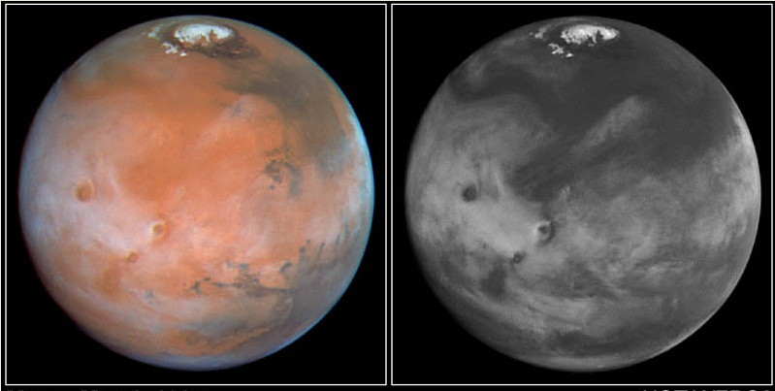
Colour Images
Light – Cosmic Messenger
Sensitive cameras on telescopes capture images in black and white. How do we get nice colour pictures?
Mars, as seen by the Hubble Space Telescope
Notes:
Source: http://hubblesite.org/newscenter/archive/releases/1997/15/image/a/

Slide 45
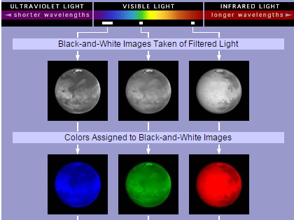
Colour Images
Light – Cosmic Messenger
We need three images, each taken through a different filter.
Then we colour the images and recombine them.
Notes:
Source: http://hubblesite.org/gallery/behind_the_pictures/meaning_of_color/mars.php

Slide 46
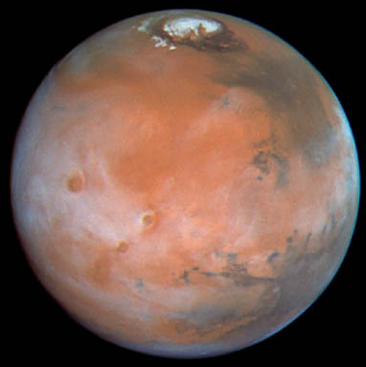
Colour Images
Light – Cosmic Messenger
Visible light image, natural colours
Notes:
Source: http://hubblesite.org/newscenter/archive/releases/1997/15/image/a/

Slide 47
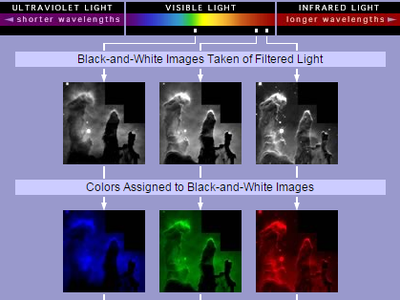
Colour Images
Light – Cosmic Messenger
Sometimes, we assign colours to precise wavelengths (here, light emitted by specific elements)
Notes:
Source: http://hubblesite.org/gallery/behind_the_pictures/meaning_of_color/eagle.php

Slide 48
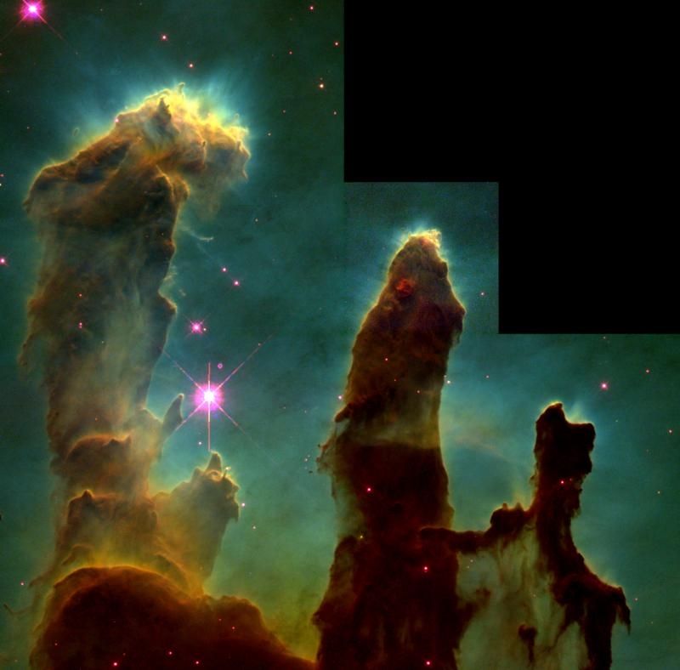
Colour Images
Light – Cosmic Messenger
Visible light image, false colours
Blue-green: hydrogen and oxygen
Red: sulfur
Notes:
Source: http://hubblesite.org/gallery/behind_the_pictures/meaning_of_color/eagle.php

Slide 49
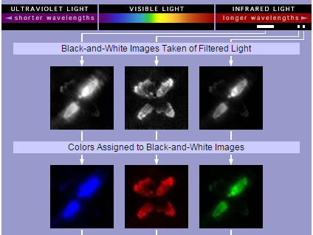
Colour Images
Light – Cosmic Messenger
Three images taken in the infrared with different colours assigned to black-and-while images.
Notes:
Source: http://hubblesite.org/gallery/behind_the_pictures/meaning_of_color/egg.php

Slide 50
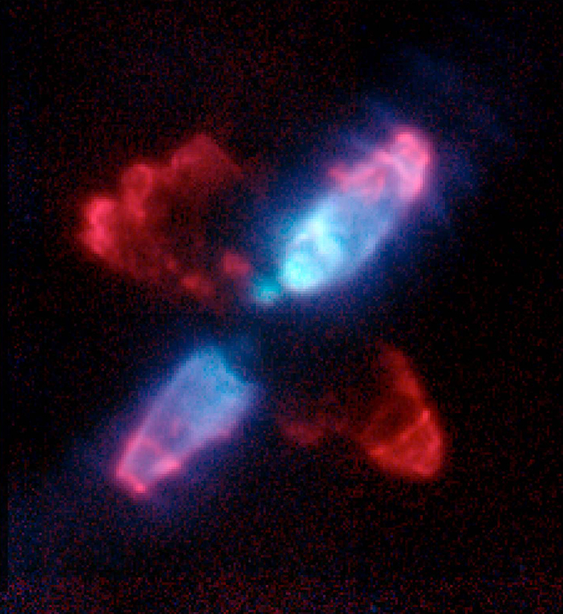
Colour Images
Light – Cosmic Messenger
Infrared image,
false colours
Green and blue: light reflected of the dust surrounding the star
Red: hydrogen cloud
Notes:
Source: http://hubblesite.org/gallery/behind_the_pictures/meaning_of_color/egg.php

Slide 51
Resources
Light – Cosmic Messenger
HubbleSite pages on creating colour images, with interactive animations.
Multi-wavelength images from the Chandra telescope (the tabs under the pictures allow you to change wavelength)
Our educational module The Solar Cycle (using UV and visible images of the Sun in HelioViewer)
Activities on light, selected by Science in School (European magazine)

Slide 52
Light – Cosmic Messenger
Thank you!
Notes:
Credit: NASA, ESA
http://hubblesite.org/image/3380/news_release/2014-27

