Slide 1
Visiting comet
Discover the Universe

Slide 2
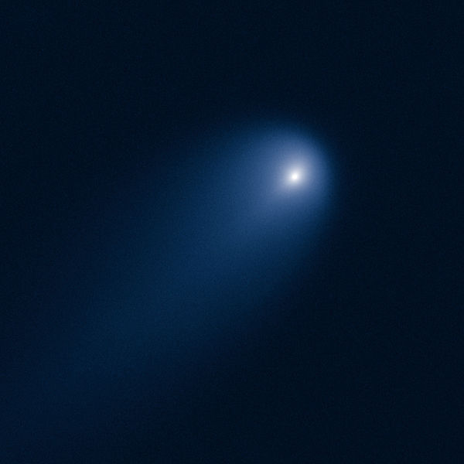
Comet C/2012 S1 ISON
Visiting comet
« Comet of the century »
Notes:
Credit (public domain): NASA, ESA, J.-Y. Li (Planetary Science Institute), and the Hubble Comet ISON Imaging Science Team
http://hubblesite.org/newscenter/archive/releases/solar-system/2013/14/

Slide 3
Questions
Visiting comet
What is a comet?
How often can they be observed from Earth?
What is special about comet ISON?
Where and when can we observe comet ISON?

Slide 4
Questions
Visiting comet
What is a comet?
How often can they be observed from Earth?
What is special about comet ISON?
Where and when can we observe comet ISON?

Slide 5
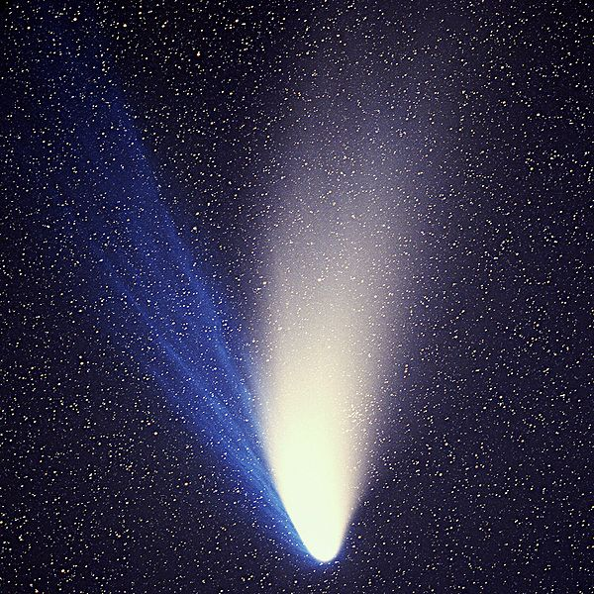
What is a comet?
Visiting comet
Comet Hale-Bopp, 1997
Notes:
Credit (Creative Commons): E. Kolmhofer, H. Raab; Johannes-Kepler-Observatory, Linz, Austria
http://en.wikipedia.org/wiki/File:Comet_Hale-Bopp_1995O1.jpg

Slide 6
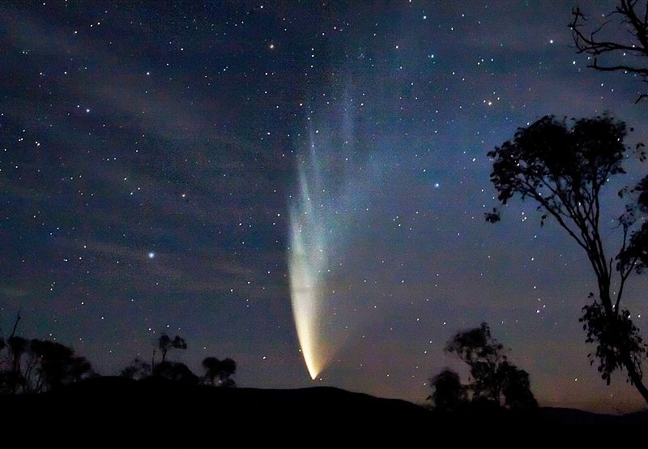
What is a comet?
Visiting comet
Comet McNaught, 2007
Notes:
Credit (Creative Commons): Soerfm
http://en.wikipedia.org/wiki/File:Comet_P1_McNaught02_-_23-01-07-edited.jpg

Slide 7
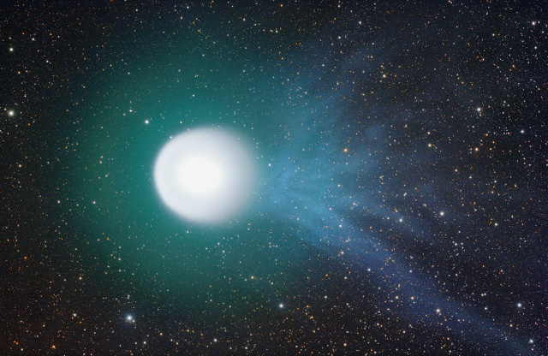
What is a comet?
Visiting comet
Comet Holmes, 2007
Notes:
Credit (Creative Commons): Ivan Eder
http://en.wikipedia.org/wiki/File:17pHolmes_071104_eder_vga.jpg

Slide 8
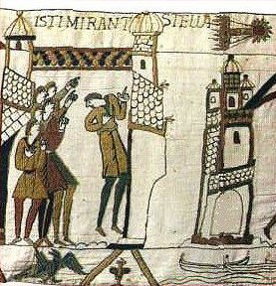
What is a comet?
Visiting comet
« comet » in Greek:
hairy star !
Halley’s comet in 1066
Notes:
Credit (public domain): http://en.wikipedia.org/wiki/File:Tapestry_of_bayeux10.jpg

Slide 9
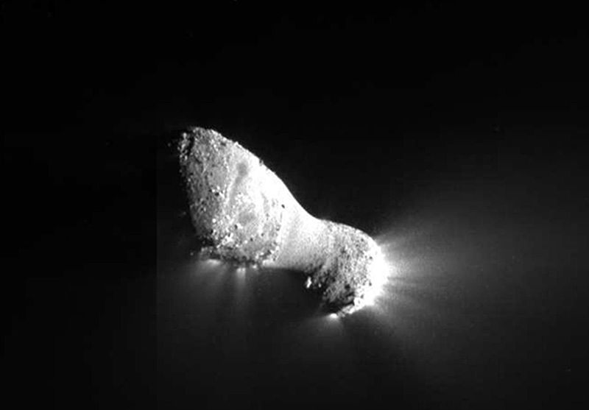
What is a comet?
Visiting comet
Comet Hartley, visited by the spacecraft EPOXI in 2011
Notes:
Credit (public domain): NASA/EPOXI
http://www.nasa.gov/mission_pages/epoxi/images/version1/IINMVUAXF_6000002_001_001_crop.html

Slide 10
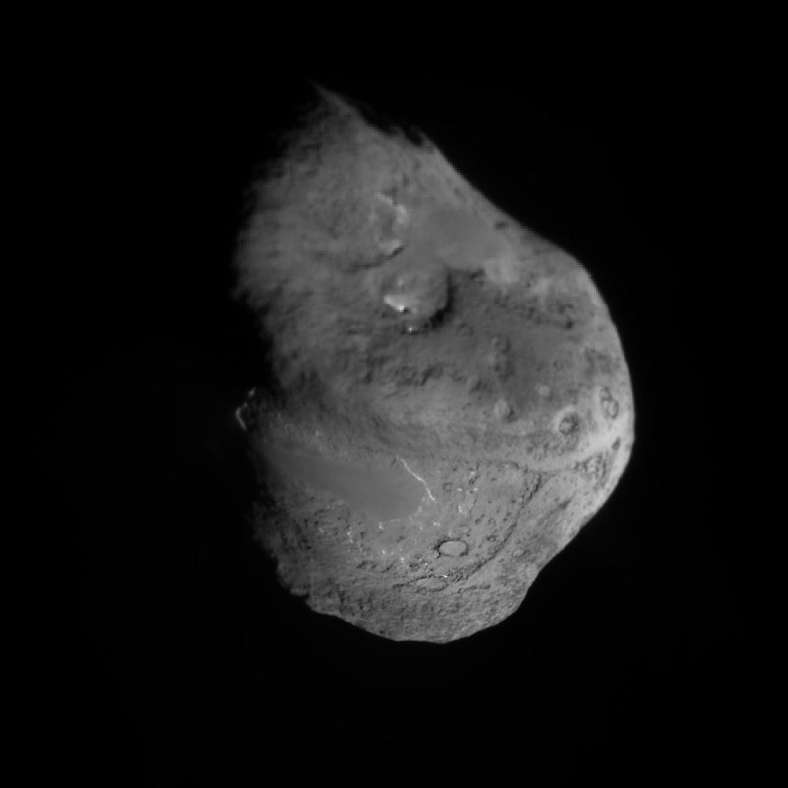
What is a comet?
Visiting comet
Comet Tempel 1, visited by the spacecraft Deep Impact in 2005
Notes:
Credit (public domain): NASA/JPL/UMD
http://photojournal.jpl.nasa.gov/catalog/PIA02142

Slide 11
What is a comet?
Visiting comet
A comet is a small body orbiting the Sun. It is characterized by:
its composition: nucleus composed of about 50% rocks and dust and 50% of ice (water, carbon dioxide, carbon monoxide, ammonia, methane…)
its orbit: orbit very elongated, which goes far in the Solar system and is not limited to the plane of the Solar system.

Slide 12
Anatomy of a comet
What is a comet?
Plasma tail (ionized gas)
Nucleus (hundreds of metres to tens of kilometres)
Dust tail (millions of km)
Coma (~ 100 000 km)
Notes:
Comet Hale-Bopp
Credit (Creative Commons): E. Kolmhofer, H. Raab; Johannes-Kepler-Observatory, Linz, Austria
http://en.wikipedia.org/wiki/File:Comet_Hale-Bopp_1995O1.jpg

Slide 13
Anatomy of a comet
What is a comet?
Far in the Solar system, the nucleus is inactive.
As it gets closer to the Sun (~3 a.u.), the ices melt and form the coma and the tail.
Notes:
CometTempel 1:
Credit (public domain): NASA/JPL/UMD
http://photojournal.jpl.nasa.gov/catalog/PIA02142
Comet Hale-Bopp:
Credit (Creative Commons): E. Kolmhofer, H. Raab; Johannes-Kepler-Observatory, Linz, Austria
http://en.wikipedia.org/wiki/File:Comet_Hale-Bopp_1995O1.jpg

Slide 14
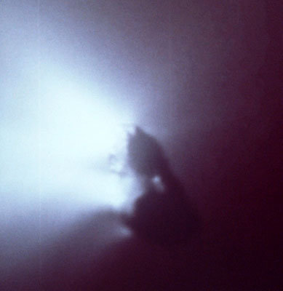
Jets on the nucleus
What is a comet?
Comet Hartley, visited by the spacecraft EPOXI in 2011
Halley’s comet, visited by the spacecraft Giotto in 1986
Notes:
Halley’s comet
Credit: © Halley Multicolor Camera Team, Giotto Project, ESA
http://spaceinimages.esa.int/Images/2003/04/Comet_Halley_s_nucleus_as_seen_by_Giotto
Comet Hartley:
Credit (public domain): NASA/EPOXI
http://www.nasa.gov/mission_pages/epoxi/images/version1/IINMVUAXF_6000002_001_001_crop.html

Slide 15
Comet tails
What is a comet?
Comet tails do not indicate the direction in which the comet is moving.
Comet tails are affected by solar wind and always point away from the Sun.
The plasma tail is more affected than the dust tail.
Notes:
Credit (public domain): NASA/SpacePlace
http://spaceplace.nasa.gov/tails-of-wonder/en/

Slide 16
Orbit of a comet
What is a comet?
Elongated orbit
Halley’s comet’s orbit, period of 76 years.
Notes:
Credit: Discover the Universe, image created with the software program Starry Night

Slide 17
Orbit of a comet
What is a comet?
Orbit inclined relative to the ecliptic (plane of the Solar system)
Halley’s comet’s orbit, period of 76 years.
Notes:
Credit: Discover the Universe, image created with the software program Starry Night

Slide 18
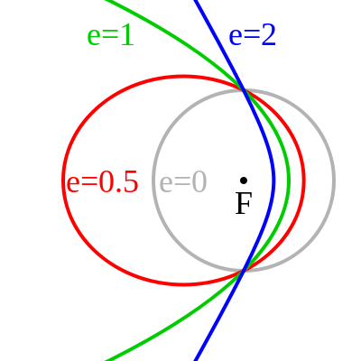
Eccentricity of an orbit
What is a comet?
The eccentricity « e » is one of the parameters defining an orbit:
e = 0: circle
0 < e < 1 : ellipse
e = 1: parabola
e > 1 : hyperbola
If e ≥ 1, the orbit is not closed: the object will not come back!
Notes:
Credit (public domain): ScottAlanHill
http://commons.wikimedia.org/wiki/File:OrbitalEccentricityDemo.svg

Slide 19
Eccentricity of an orbit
What is a comet?
Some exemples:
Object | e
Earth | 0,017
Mars | 0,093
Jupiter | 0,048
Halley’ comet | 0,967
Comet Hale-Bopp | 0,995
Comet ISON | 1,000
e = 0: circle
0 < e < 1 : ellipse
e = 1: parabola
e > 1 : hyperbola

Slide 20
Period of comets
What is a comet?
The period of a comet is the time taken to complete one full orbit.
Less than 200 years: short-period. Comets then return up to the Kuiper belt.
More than 200 years: long-period. Comets then return to the Oort cloud.
Some are visiting the inner Solar system for the first time and will never come back!

Slide 21
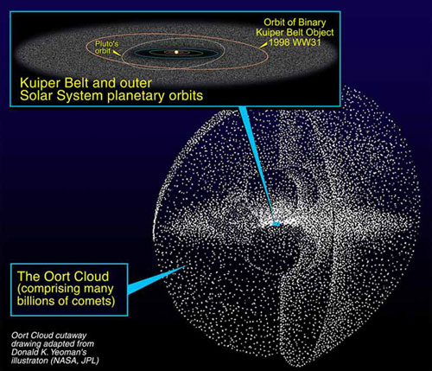
Kuiper belt and Oort cloud
What is a comet?
Comets are left-over remnants from the formation of the Solar system.
Studying them allows us to learn more about the conditions 4.5 billion years ago.
Notes:
Credit (public domain): NASA
http://en.wikipedia.org/wiki/File:Kuiper_oort.jpg

Slide 22
Comet names
What is a comet?
Comets always have the name of its discoverer(s).
The first letter in its name indicates whether it is a periodic comet (P) or non-periodic (C).
Then, we find the year of discovery, plus a letter and a number indicating when it was discovered (different letter for each half-month).
C/1995 O1 Hale-Bopp:
Non-periodic (very long period)
Discovered in 1995
First comet discovered in the second half of July (O1)
Discovered independently by Hale et Bopp.

Slide 23
Comet names
What is a comet?
There are other ways to name comets (changes throughout the years).
Periodic comets with well known orbits are given a number and the designation P:
1P/Halley
109P/Swift-Tuttle
As of today, 252 comets have received this designation, out of 3775 known comets.
Notes:
http://minorplanetcenter.net/

Slide 24
Questions
Visiting comet
What is a comet?
How often can they be observed from Earth?
What is special about comet ISON?
Where and when can we observe comet ISON?

Slide 25
How often can they be observed from Earth?
Visiting comet
At any time, many comets are visiting the inner Solar system.
Notes:
Credit: Discover the Universe, image created with the software program Starry Night

Slide 26
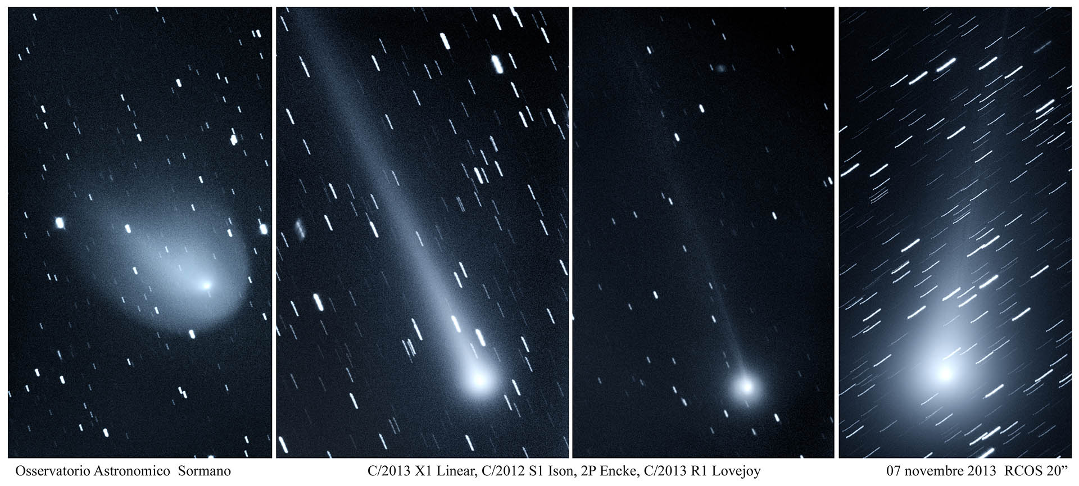
How often can they be observed from Earth?
Visiting comet
At any time, many comets are visiting the inner Solar system.
Every year, a few of them become visible to telescopes and binoculars.
Early November 2013: 4 comets were visible in the morning sky (with binoculars).
Notes:
Credit: © Sormano Astronomical Observatory
http://spaceweathergallery.com/indiv_upload.php?upload_id=89311

Slide 27
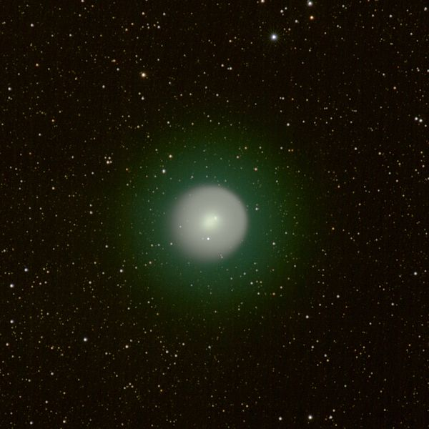
How often can they be observed from Earth?
Visiting comet
At any time, many comets are visiting the inner Solar system.
Every year, a few of them become visible to telescopes and binoculars.
On average, about one per year becomes visible to the naked eye – but it may not be obvious!
Comet 17P/Holmes (2007)
Notes:
Credit (Creative Commons): Gil-Estel
http://en.wikipedia.org/wiki/File:17P-Holmes_Auvergne_2007_11_02.jpg

Slide 28
How often can they be observed from Earth?
Visiting comet
At any time, many comets are visiting the inner Solar system.
Every year, a few of them become visible to telescopes and binoculars.
On average, about one per year becomes visible to the naked eye – but it may not be obvious!
A Great comet is a comet easily seen with the naked eye – on average one every 10 years.

Slide 29
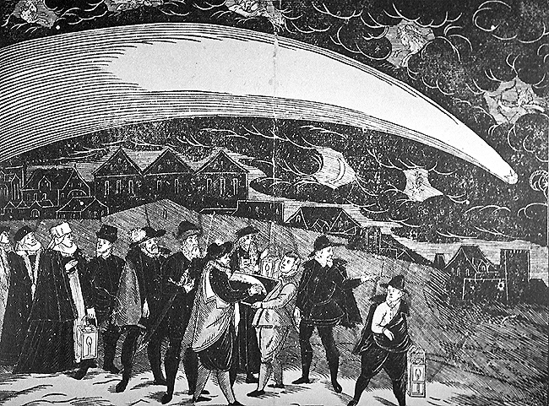
Great comets
How often can they be observed from Earth?
Great comet of 1577
Notes:
Credit (public domain): Jiri Daschitzsky
http://commons.wikimedia.org/wiki/File:Great_Comet_of_1577.gif

Slide 30
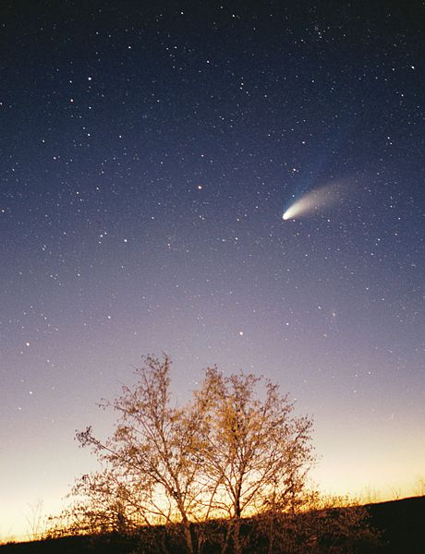
Great comets
How often can they be observed from Earth?
Comet Hale-Bopp (1997)
Notes:
Right image: Philipp Salzgeber (Creative Commons) - http://en.wikipedia.org/wiki/File:Comet-Hale-Bopp-29-03-1997_hires_adj.jpg
Left image: E. Kolmhofer, H. Raab; Johannes-Kepler-Observatory, Linz, Austria (Creative Commons) - http://en.wikipedia.org/wiki/File:Comet_Hale-Bopp_1995O1.jpg

Slide 31
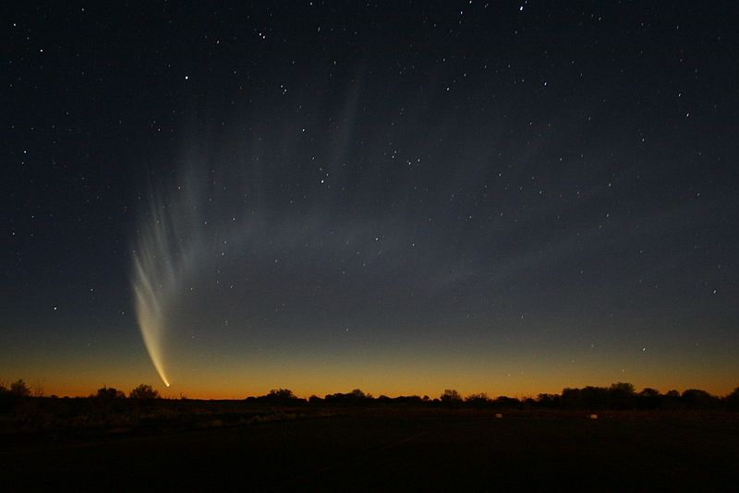
Great comets
How often can they be observed from Earth?
Comet McNaught (2007)
Notes:
Credit (domaine public): - http://en.wikipedia.org/wiki/File:Sat_comet_WEB.jpg

Slide 32
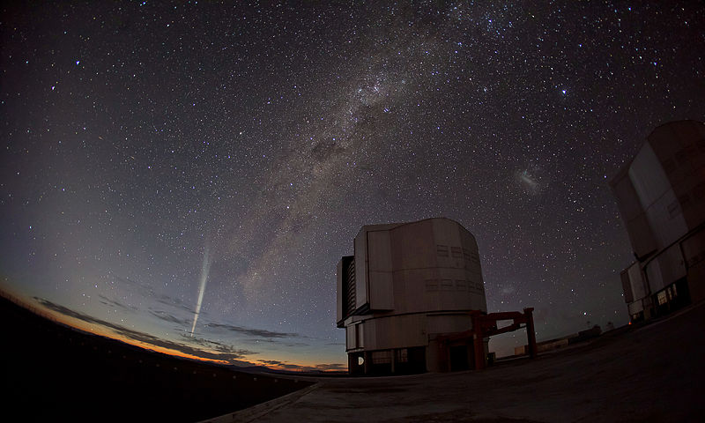
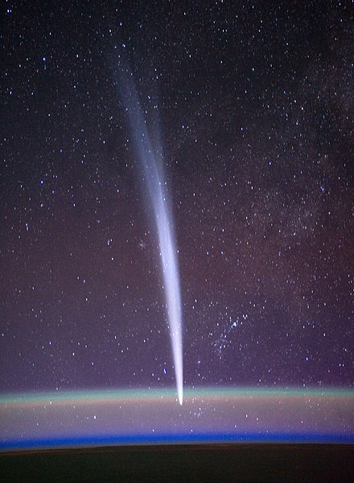
Great comets
How often can they be observed from Earth?
Comet Lovejoy (2011)
Notes:
Large image:
Credit (Creative Commons): ESO/Guillaume Blanchard - http://en.wikipedia.org/wiki/File:Christmas_Comet_Lovejoy_Captured_at_Paranal.jpg
Small image:
Credit (public domain): NASA/Dan Burbank (astronaut) - http://en.wikipedia.org/wiki/File:Iss030e015472_Edit.jpg

Slide 33
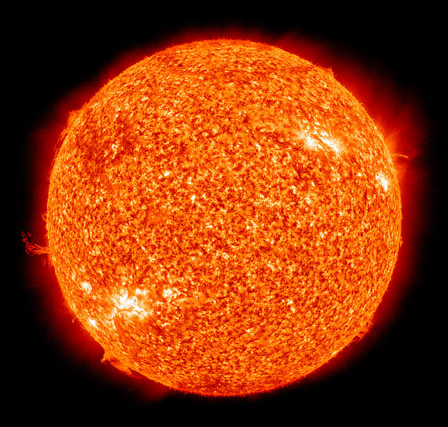
Sungrazing comets
How often can they be observed from Earth?
Sungrazing comets pass very close to the Sun.
Some of them even go as close as 100 000 km, which corresponds to 1/14th of the Sun’s diameter.
Notes:
Credit (public domain): NASA/SDO
http://en.wikipedia.org/wiki/File:The_Sun_by_the_Atmospheric_Imaging_Assembly_of_NASA%27s_Solar_Dynamics_Observatory_-_20100819.jpg

Slide 34
Sungrazing comets
How often can they be observed from Earth?
You can observe sungrazing comets with the SOHO satellite.
Each year, the SOHO satellite discovers tens of sungrazing comets.
Most of them are very small (tens of metres) and completey disintegrate from this close passage.
Notes:
Credit: SOHO (ESA & NASA)
http://sohowww.nascom.nasa.gov/gallery/Movies/comets.html

Slide 35
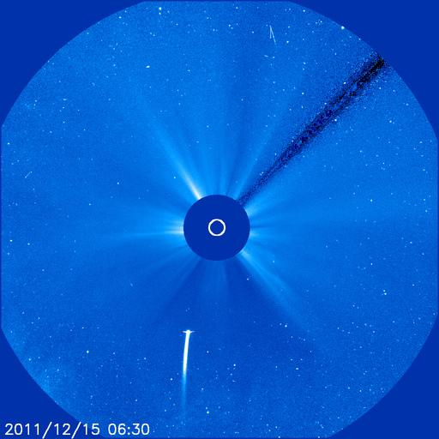
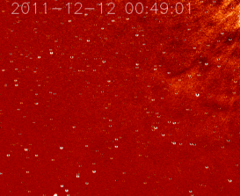
Sungrazing comets
How often can they be observed from Earth?
Before becoming a nice comet visible from the Southern hemisphere, comet Lovejoy passed very close to the Sun on December 12th 2011. At the time, nobody knew if it would survive.
Animation taken by the STEREO satellite
Notes:
Photo: SOHO (ESA & NASA)
Animation: NASA/STEREO (public domain) - http://en.wikipedia.org/wiki/File:Lovejoy-hi1a_srem_dec12_14.gif

Slide 36
Questions
Visiting comet
What is a comet?
How often can they be observed from Earth?
What is special about comet ISON?
Where and when can we observe comet ISON?

Slide 37
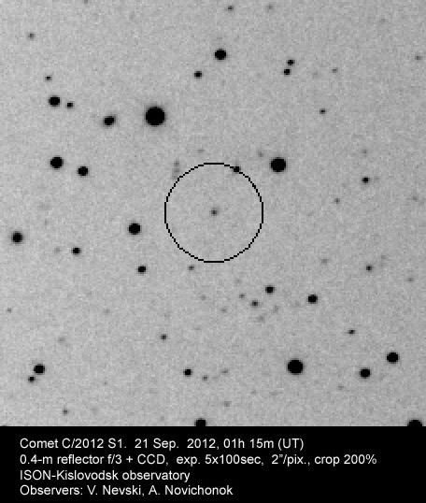
Comet ISON
What is special about comet ISON?
Name: C/2012 S1 ISON
Discovered in 2012, in September (S1)
Long-period comet, or not periodic (C)
ISON: discovered by the 40cm telescope of the International Scientific Optical Network (ISON), in Russia, by Nevski and Novichonok
Notes:
Credit: V. Nevski, A. Novichonok
http://www.astro.umd.edu/~msk/blog/articles/comet-ison-jan13

Slide 38
Comet ISON
What is special about comet ISON?
Comet ISON was discovered when it was farther than Jupiter: its nucleus must be large to be visible from this distance.
When its orbit was calculated, it was discovered ISON was a sungrazing comet, passing very close to the Sun.
It has the potential to become very bright!

Slide 39
Orbit
What is special about comet ISON?
Notes:
Credit: Jet Propulsion Laboratory / NASA
http://ssd.jpl.nasa.gov/sbdb.cgi?sstr=C%2F2012%20S1;orb=1;cov=0;log=0;cad=0#elem

Slide 40
Perihelion
What is special about comet ISON?
Closest approach to Sun (perihelion):
November 28th 2013
Distance to the surface of the Sun: 0.8 solar diameter (1.2 million km)
Notes:
Credit (public domain): NASA/SDO
http://en.wikipedia.org/wiki/File:The_Sun_by_the_Atmospheric_Imaging_Assembly_of_NASA%27s_Solar_Dynamics_Observatory_-_20100819.jpg

Slide 41
Orbital elements
What is special about comet ISON?
→ Perihelion distance
→Time of perihelion passage
→ Period
Eccentricity of 1.000 : parabolic orbit → It’s the first and last time we see it!
Notes:
Credit: Jet Propulsion Laboratory/NASA
http://ssd.jpl.nasa.gov/sbdb.cgi

Slide 42
Observations
What is special about comet ISON?
So:
large nucleus (5km?)
sungrazing comet
first visit in the inner Solar system: lots of ice
BUT very difficult to predict…
What will happen?

Slide 43
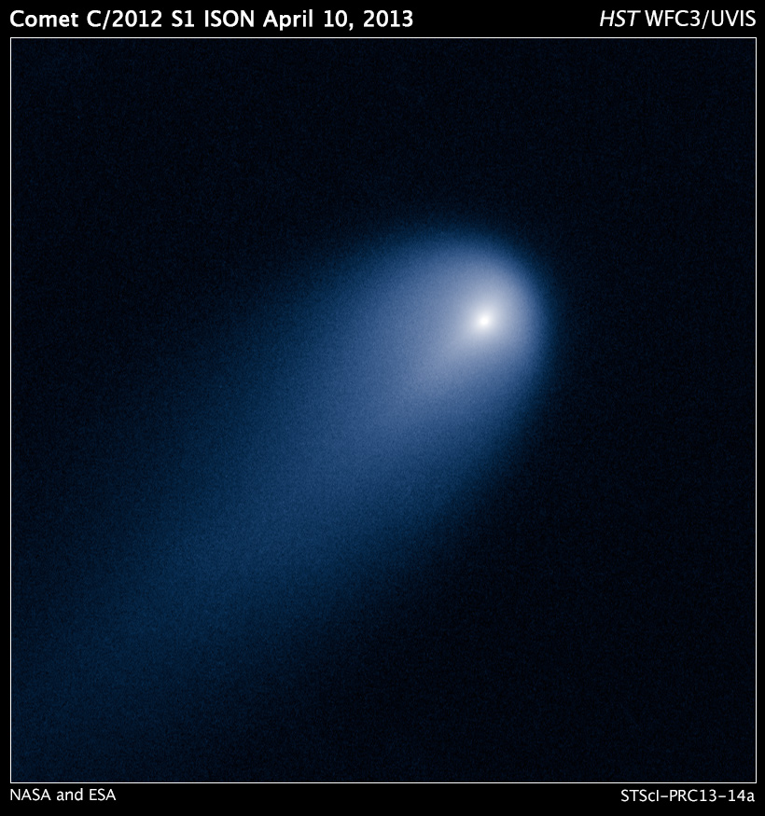
Observations so far
What is special about comet ISON?
Picture from Hubble Space Telescope
April 2013
Notes:
Credit (public domain): NASA, ESA, J.-Y. Li (Planetary Science Institute), and the Hubble Comet ISON Imaging Science Team
http://hubblesite.org/newscenter/archive/releases/solar-system/2013/14/

Slide 44
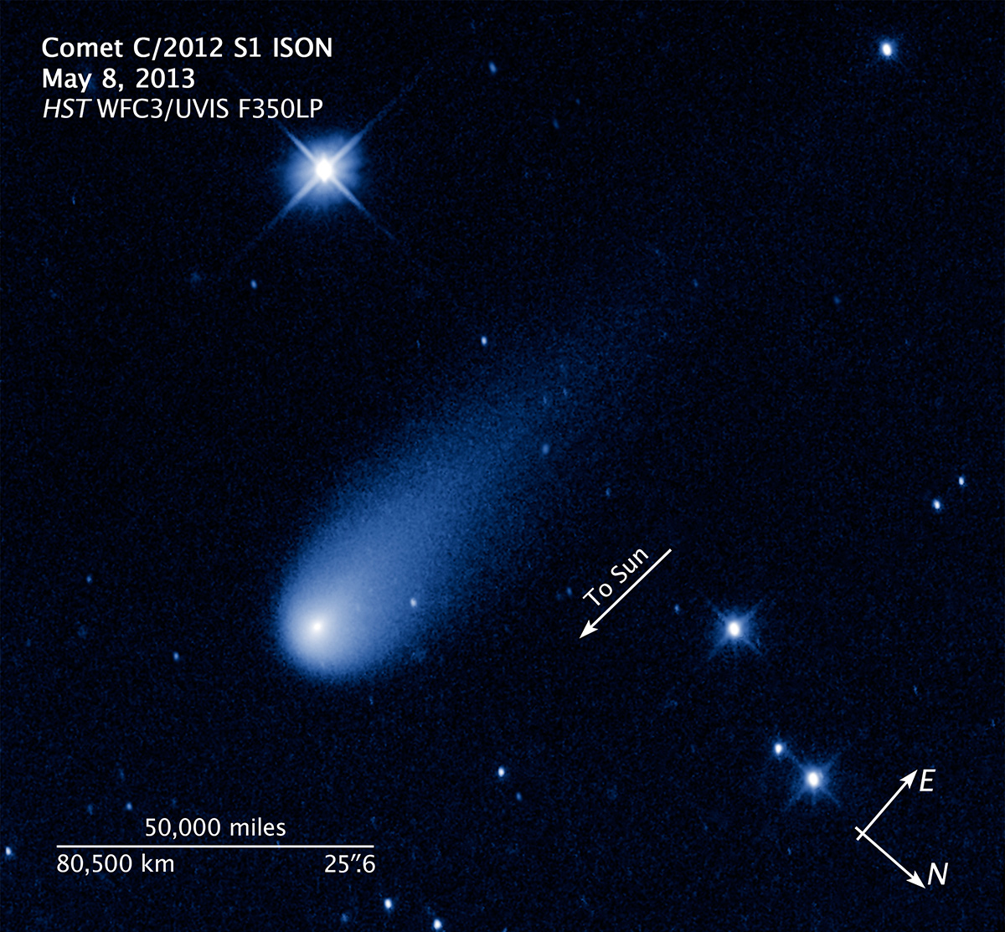
Observations so far
What is special about comet ISON?
Picture from Hubble Space Telescope
May 2013
Notes:
Credit (public domain): NASA, ESA, and Z. Levay (STScI/AURA)
http://hubblesite.org/newscenter/archive/releases/solar%20system/2013/24/image/b/

Slide 45
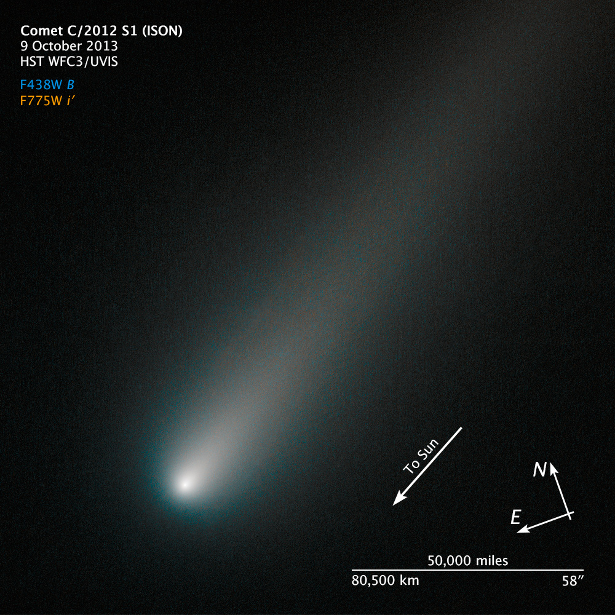
Observations so far
What is special about comet ISON?
Picture from Hubble Space Telescope
October 9th 2013
Notes:
Credit (public domain): NASA, ESA and the Hubble Heritage Team (STScI/AURA)
http://hubblesite.org/newscenter/archive/releases/2013/42/image/a/

Slide 46
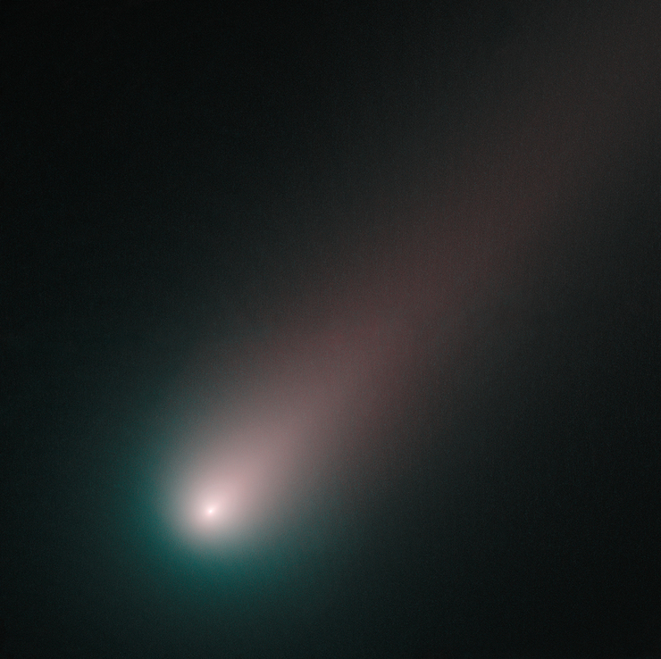
Observations so far
What is special about comet ISON?
Picture from Hubble Space Telescope
November 2nd 2013
Notes:
Credit (public domain): NASA, ESA and the Hubble Heritage Team (STScI/AURA)
http://hubblesite.org/hubble_discoveries/comet_ison/

Slide 47
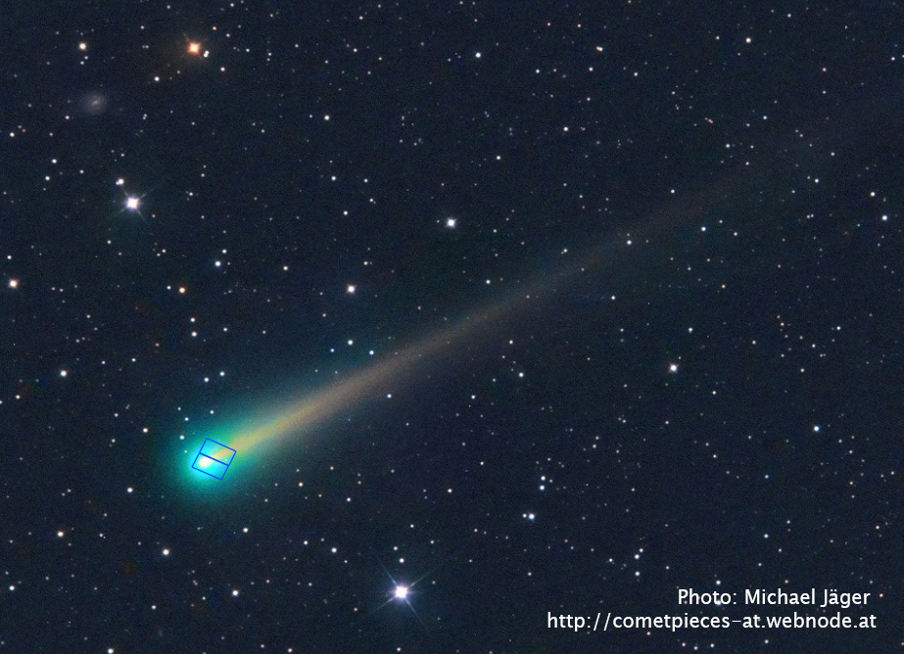
Observations so far
What is special about comet ISON?
ISON is now too big for the field of view of Hubble!
November 8th 2013
Notes:
Crédit: © Michael Jäger
http://hubblesite.org/hubble_discoveries/comet_ison/

Slide 48
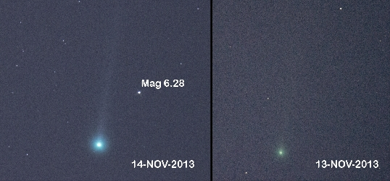
Observations so far
What is special about comet ISON?
for many months: visible with a telescope
~ November 10 : visible with binoculars
November 14 : outburst – now visible with the naked eye!
What happened?
- Nucleus fragmentation?
Notes:
Credit: © Charles Coburn
http://spaceweathergallery.com/indiv_upload.php?upload_id=89648

Slide 49
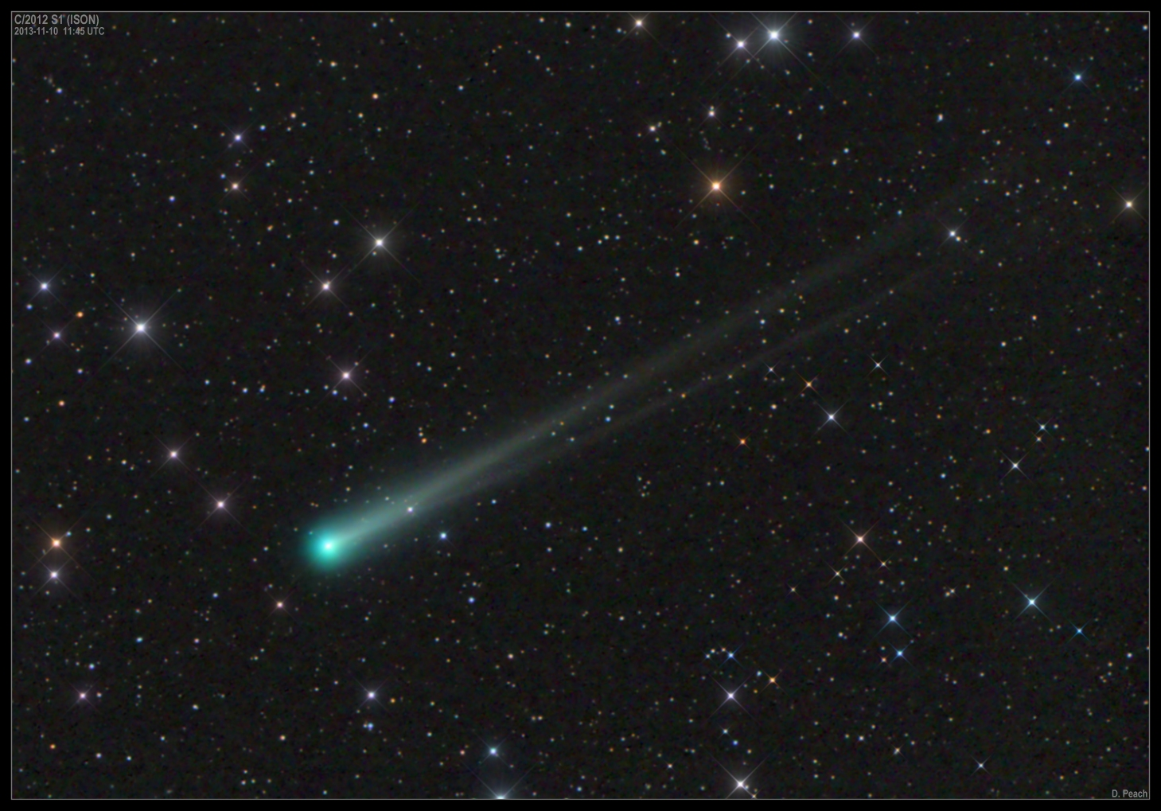
Observations so far
What is special about comet ISON?
November 10th 2013
Notes:
Credit: © Damian Peach
http://www.damianpeach.com/ison.htm

Slide 50
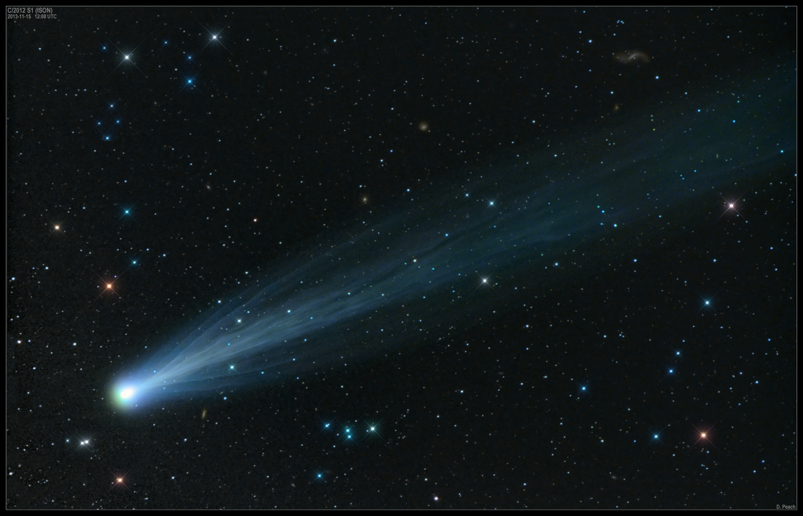
Observations so far
What is special about comet ISON?
November 15th 2013
Notes:
Credit: © Damian Peach
http://www.spaceweather.com/archive.php?view=1&day=15&month=11&year=2013

Slide 51
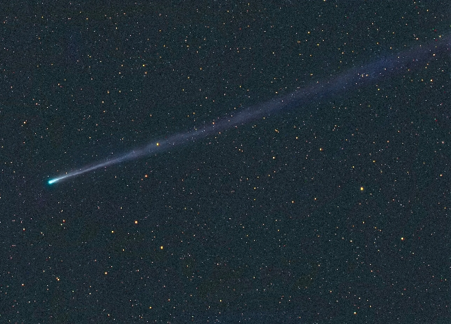
Observations so far
What is special about comet ISON?
Tail 16 million km long – 12 times the diameter of the Sun!
November 17th 2013
Notes:
Credit: ©Michael Jäger
http://spaceweathergallery.com/indiv_upload.php?upload_id=89847

Slide 52
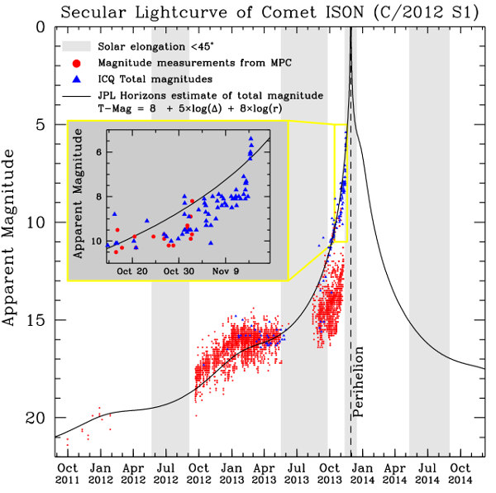
Light curve
What is special about comet ISON?
Visible to the naked eye if magnitude is less than 6.
Easily seen if magnitude is lower than about 3.
Comet follows expectations.
But will most likely not be the comet of the century (mag. -10).
Notes:
Credit: NASA Comet ISON Observing Campaign
http://www.isoncampaign.org/Present

Slide 53
Observations so far
What is special about comet ISON?
for many months: visible with a telescope
~ November 10: visible with binoculars
November 14 : outburst – now visible with the naked eye! (speed ~50km/s)
November 27-30: ISON in the SOHO field of view
November 28: perihelion – will it survive? (speed ~600km/s)
December 26: closest approach to Earth

Slide 54
Questions
Visiting comet
What is a comet?
How often can they be observed from Earth?
What is special about comet ISON?
Where and when can we observe comet ISON?

Slide 55
Where and when can we observe comet ISON?
Visiting comet
1/11
5/11
10/11
25/12
15/11
20/12
18/11
15/12
21/11
10/12
24/11
5/12
30/11
27/11
Notes:
Credit: Discover the Universe, image created with the software program Starry Night

Slide 56
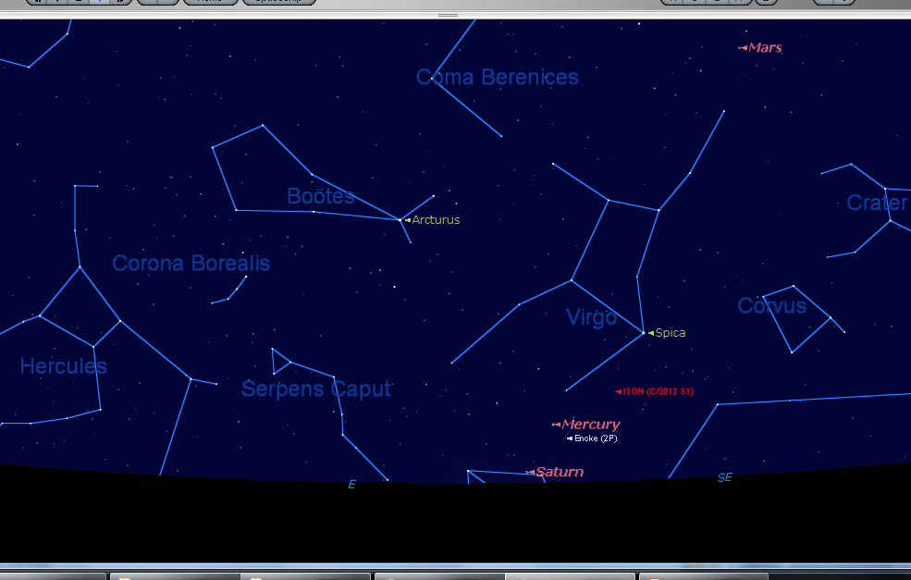
Where and when can we observe comet ISON?
Visiting comet
November 20th 2013
5:45 AM
Altitude: 10°
Notes:
Credit: Discover the Universe, image created with the software program Starry Night

Slide 57
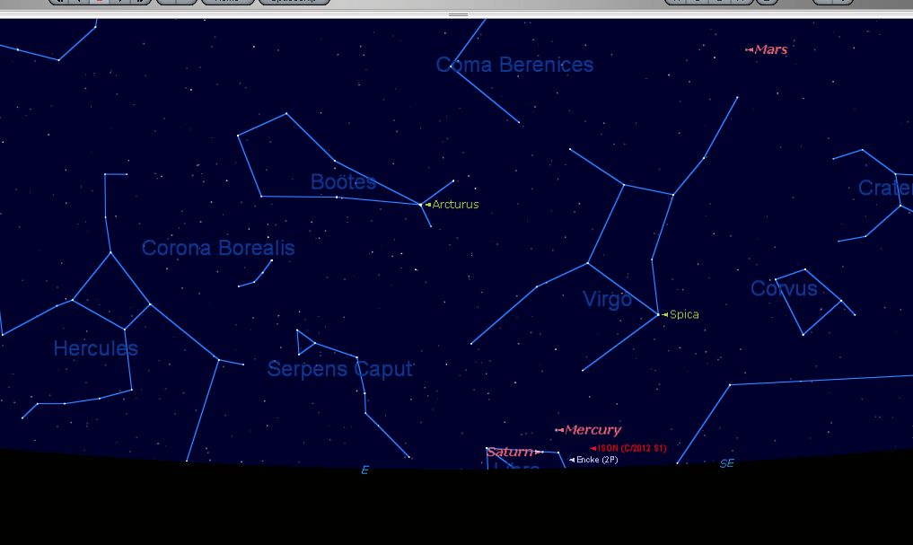
Where and when can we observe comet ISON?
Visiting comet
November 23rd 2013
5:45 AM
Altitude: 2°
Notes:
Credit: Discover the Universe, image created with the software program Starry Night

Slide 58
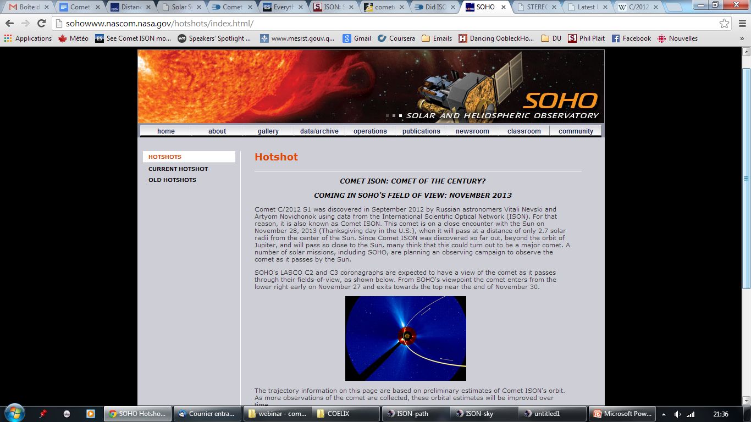
Where and when can we observe comet ISON?
Visiting comet
From November 27 to 30: observe the comet on the SOHO website.
Notes:
Credit: SOHO/NASA
http://sohowww.nascom.nasa.gov/hotshots/index.html/

Slide 59
Where and when can we observe comet ISON?
Visiting comet
http://sohowww.nascom.nasa.gov/ The Sun now
Notes:
Credit: SOHO/NASA
http://sohowww.nascom.nasa.gov/data/realtime-images.html

Slide 60
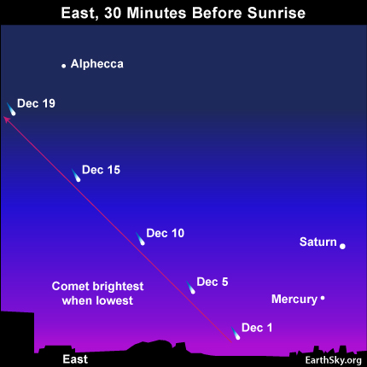
Where and when can we observe comet ISON?
Visiting comet
If it survives perihelion, the comet will be visible early December in the morning sky.
Notes:
Credit: Deborah Byrd - EarthSky
http://earthsky.org/space/big-sun-diving-comet-ison-might-be-spectacular-in-2013

Slide 61
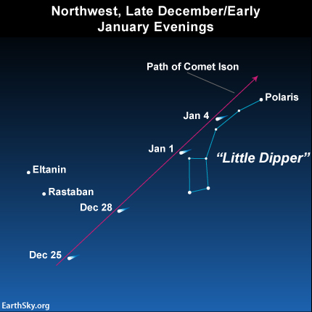
Where and when can we observe comet ISON?
Visiting comet
At the end of December, the comet becomes circumpolar and can also be observed in the evening sky.
Notes:
Crédit: Deborah Byrd - EarthSky
http://earthsky.org/space/big-sun-diving-comet-ison-might-be-spectacular-in-2013

Slide 62
Where and when can we observe comet ISON?
Visiting comet
So, what do you think?
Will comet ISON:
disintegrate and disappoint?
be visible with binoculars after perihelion?
be barely visible to the naked eye after perihelion?
easily be seen with the naked eye for a few days?
easily be seen for weeks?
be the comet of the century?

Slide 63
To stay up-to-date
Visiting comet
SpaceWeather
www.cometison2013.co.uk – nice 3D model
Sky and Telescope
Facebook: Discover the Universe, search for ISON
Twitter – search for ISON
NASA Comet ISON Observing Campaign
Hubble ISON blog

Slide 64
Discover the Universe
Thank you!
Next webinars in 2014
(You will be informed by email)
Next workshop for informal educators – May 2014
Next workshop for teachers – Fall 2014

