Slide 1
What’s happening with the star Betelgeuse?
March 4, 2020

Slide 2
The star Betelgeuse has fainted a lot in the last few months, dropping from the 10th to the 21st position of the brightest stars in our sky.
This drastic change intrigued astronomers and many were wondering if it was linked to the star reaching the final stages of its evolution.
Credit: Claude Duplessis
http://claudeduplessis.com/

Slide 3
Betelgeuse is a red supergiant star.
Betelgeuse captured by the radio telescope ALMA in Chile
Credit: ALMA (ESO/NAOJ/NRAO)/E. O’Gorman/P. Kervella
https://www.eso.org/public/images/potw1726a/?lang

Slide 4
Betelgeuse is a red supergiant star.
If it replaced the Sun at the centre of the solar system, it would engulf planets all the way to Jupiter. That’s big!
Betelgeuse captured by the radio telescope ALMA in Chile
Credit: ALMA (ESO/NAOJ/NRAO)/E. O’Gorman/P. Kervella
https://www.eso.org/public/images/potw1726b/

Slide 5
The next step in its stellar evolution will be to explode: that’s what we call a supernova. It’s impossible to predict when this will happen. It could be tomorrow or in 100,000 years!
Animation (artist rendition) of a supernova
Credit: NASA, ESA, and the Hubble SM4 ERO Team https://hubblesite.org/contents/media/videos/2009/25/620-Video.html

Slide 6
Observations of Betelgeuse in early and late 2019. We can see its brightness has changed, as well as its shape. Many scientists are now studying Betelgeuse to better understand red supergiant stars.
Credit: ESO/M. Montargès et al. https://www.eso.org/public/news/eso2003/?lang

Slide 7
Betelgeuse is also a variable star, meaning its brightness varies with time. Usually, the dips in brightness are not as extreme as the one right now.
Since the end of February, Betelgeuse has started brightening again. It will most likely not explode soon.

Slide 8
Observe it in the sky and compare it to the stars Bellatrix and Rigel.
Betelgeuse is usually similar to Rigel in terms of brightness but it’s now much more similar to fainter Bellatrix.
Credit: Claude Duplessis
http://claudeduplessis.com/

Slide 9
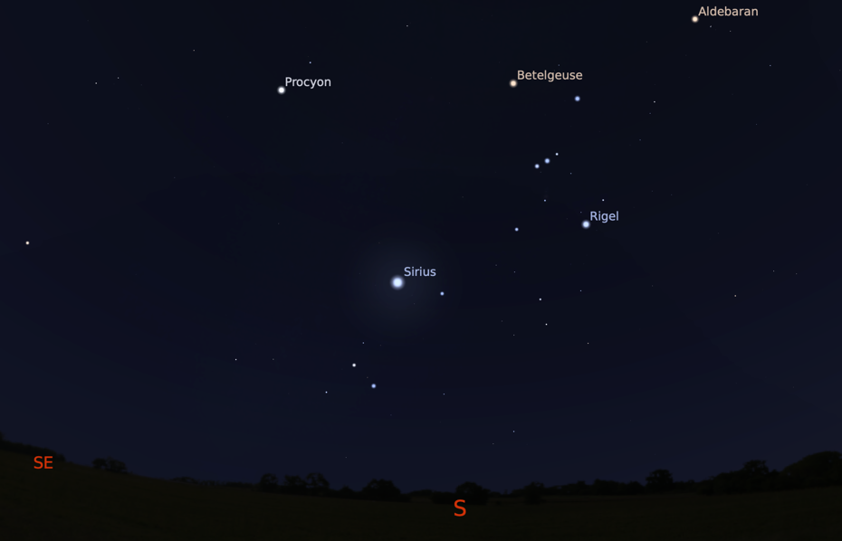
The sky at the beginning of March, around 7pm.
Orion is visible to the south after sunset.
Image created with Stellarium
http://stellarium.org/

Slide 10
to go further…

Slide 11
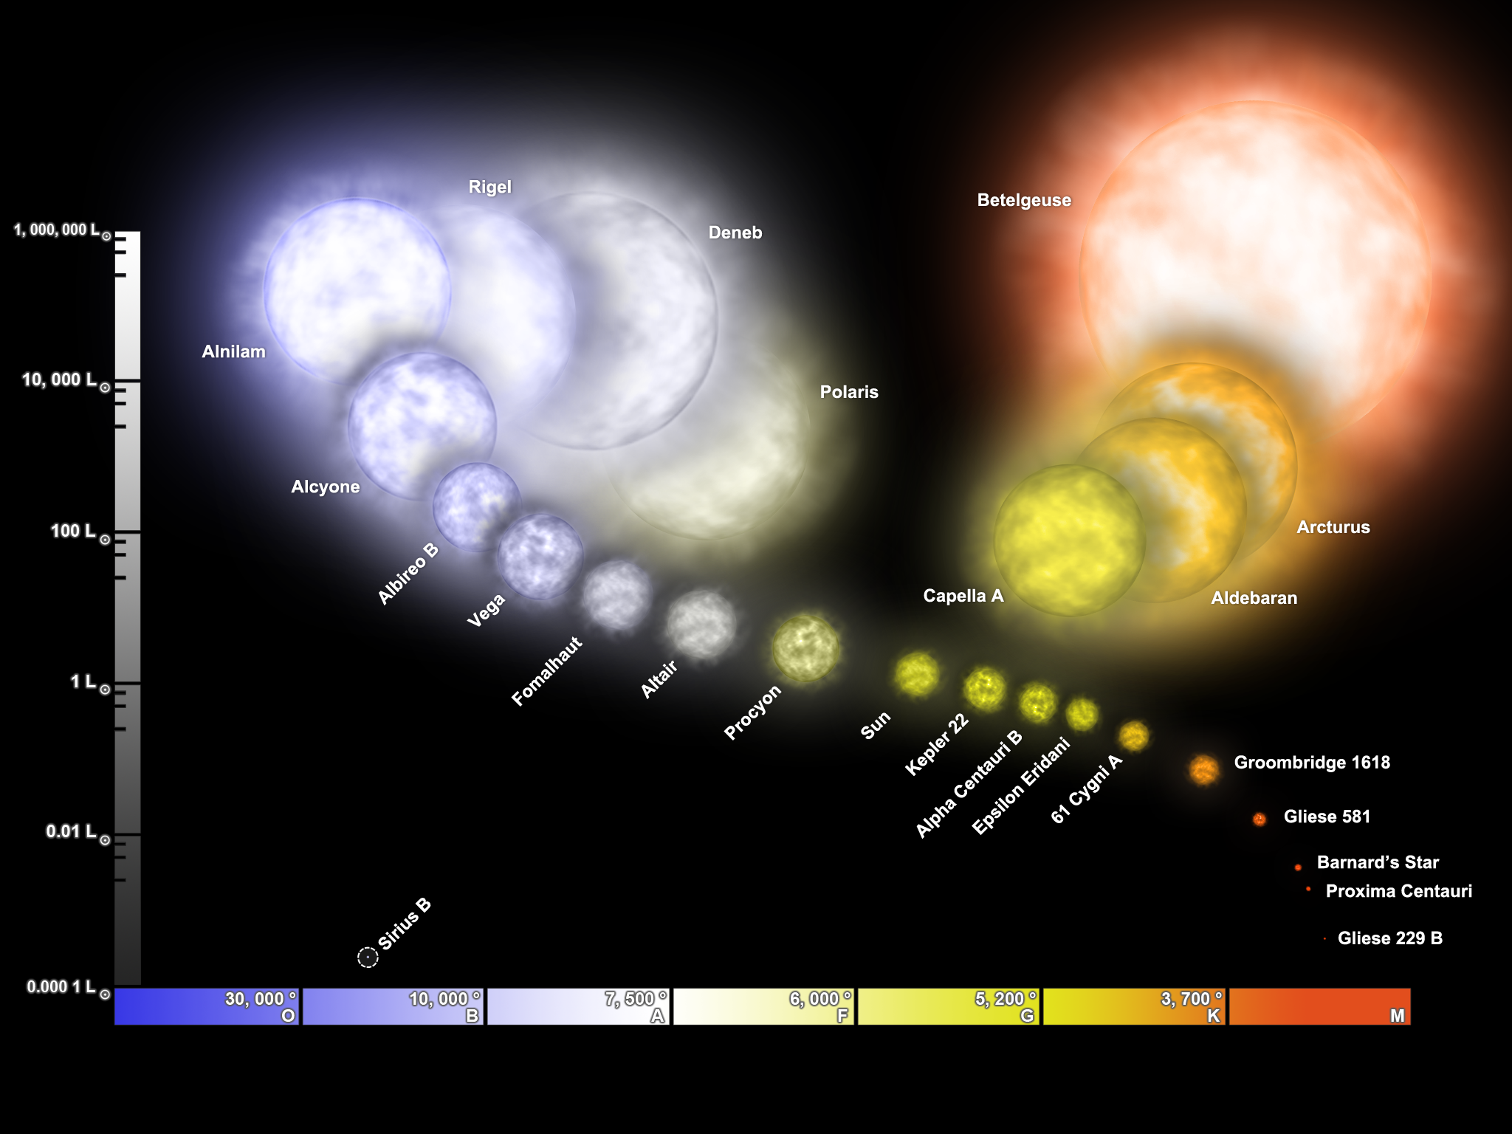
Hertzsprung-Russel diagram, showing the different types of stars. Luminosity is on the vertical axis while temperature (and colour) is on the horizontal axis.
The hottest and very luminous stars are blue giants at the top left, while faint and red stars are at the bottom right. Betelgeuse is a red supergiant (very luminous but less hot than blue stars).

Slide 12
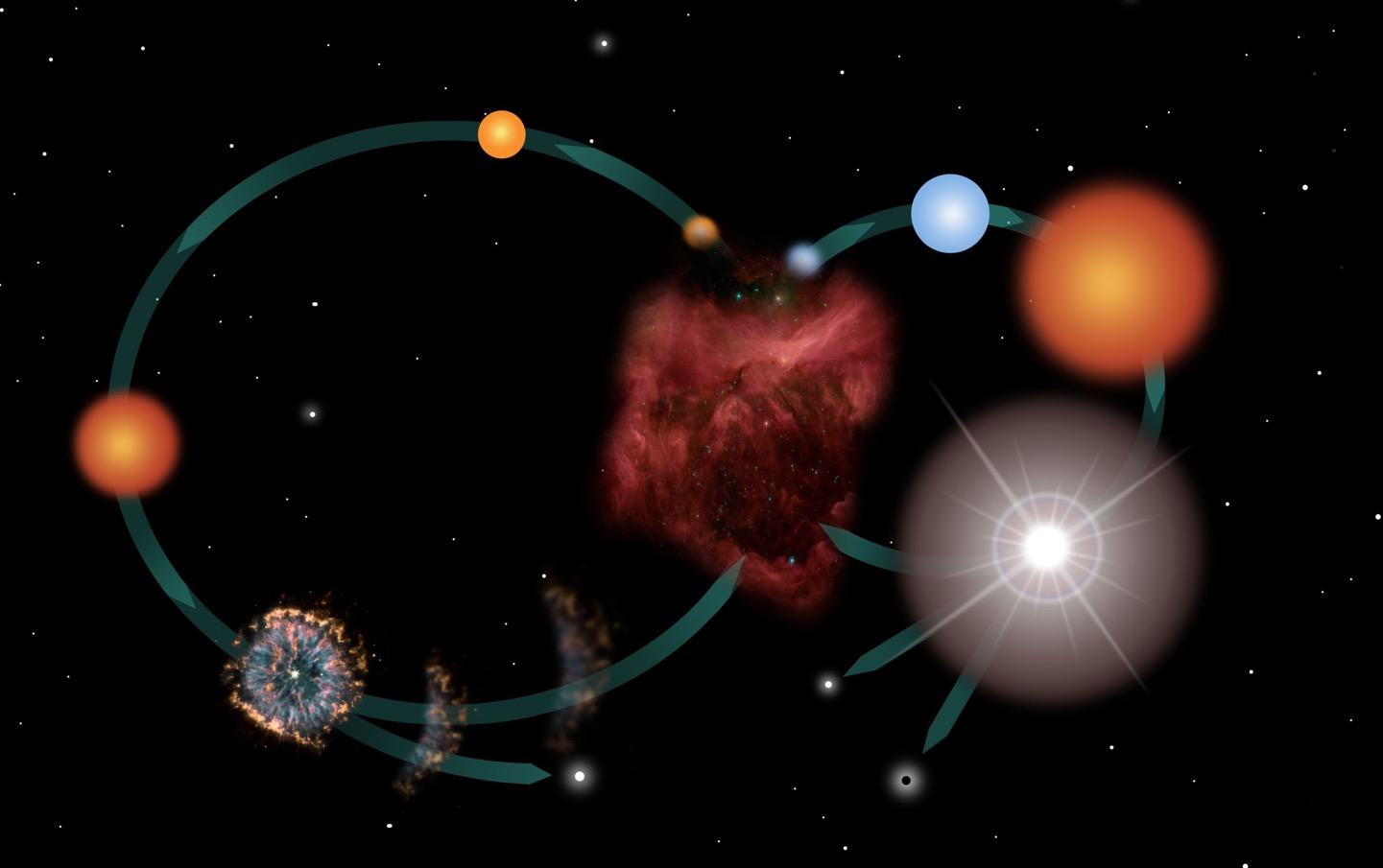
LIFE CYCLE OF STARS
Sun-like Star
MASSIVE STARS
Blue Star
LOW-MASS STARS
Protostars
Red Supergiant
Nebula
Red Giant
Supernova
Planetary Nebula
Neutron Star
Black Hole
White Dwarf

