Slide 1
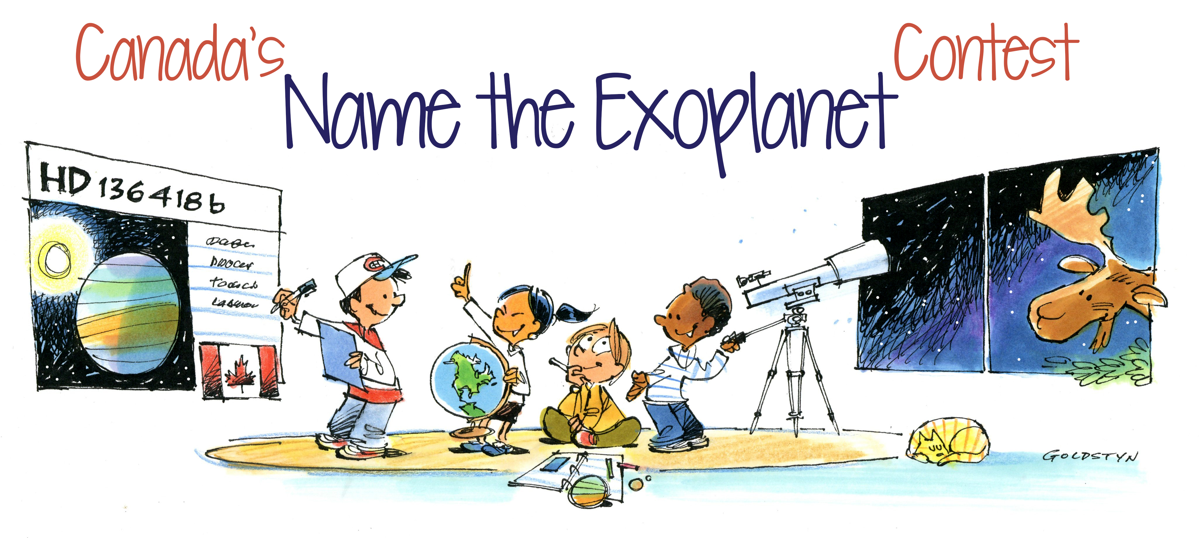
Organized by the Canadian Astronomical Society

Slide 2
We invite YOU to find a name for a planet and its host star!
Submit your ideas before Sept. 20, 2019
A committee will review submissions and will select finalists
You can then vote to select the winning names
And you can win prizes!
GOLDSTYN

Slide 3
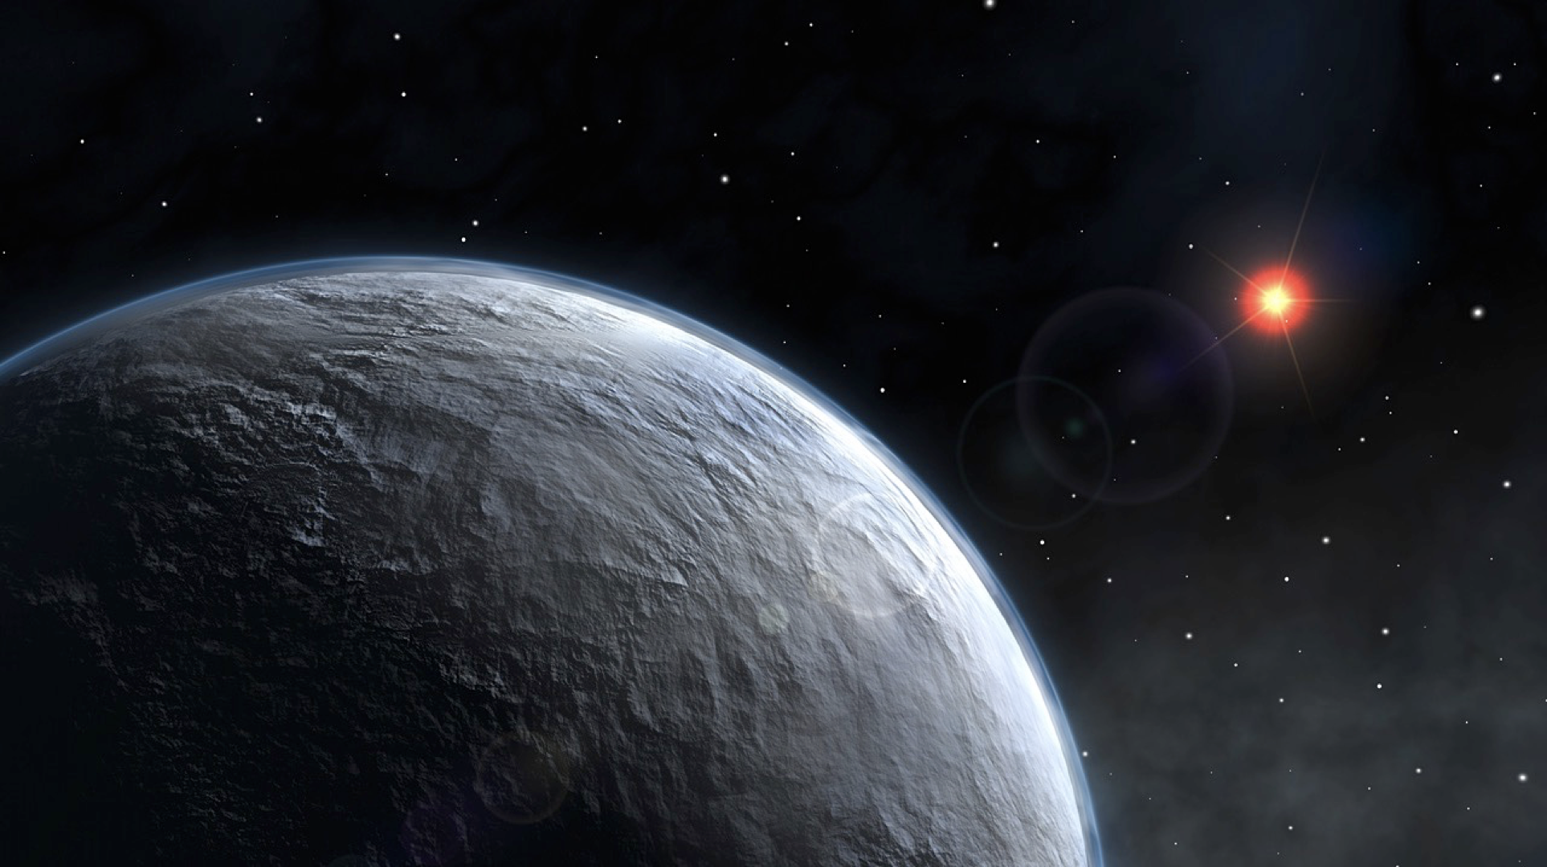
What is an Exoplanet?
An exoplanet is a planet that orbits around a star other the Sun
This image is an artist rendering of what an exoplanet could look like. The technology to photograph detailed images of exoplanets does not yet exist.
Credit: ESO

Slide 4
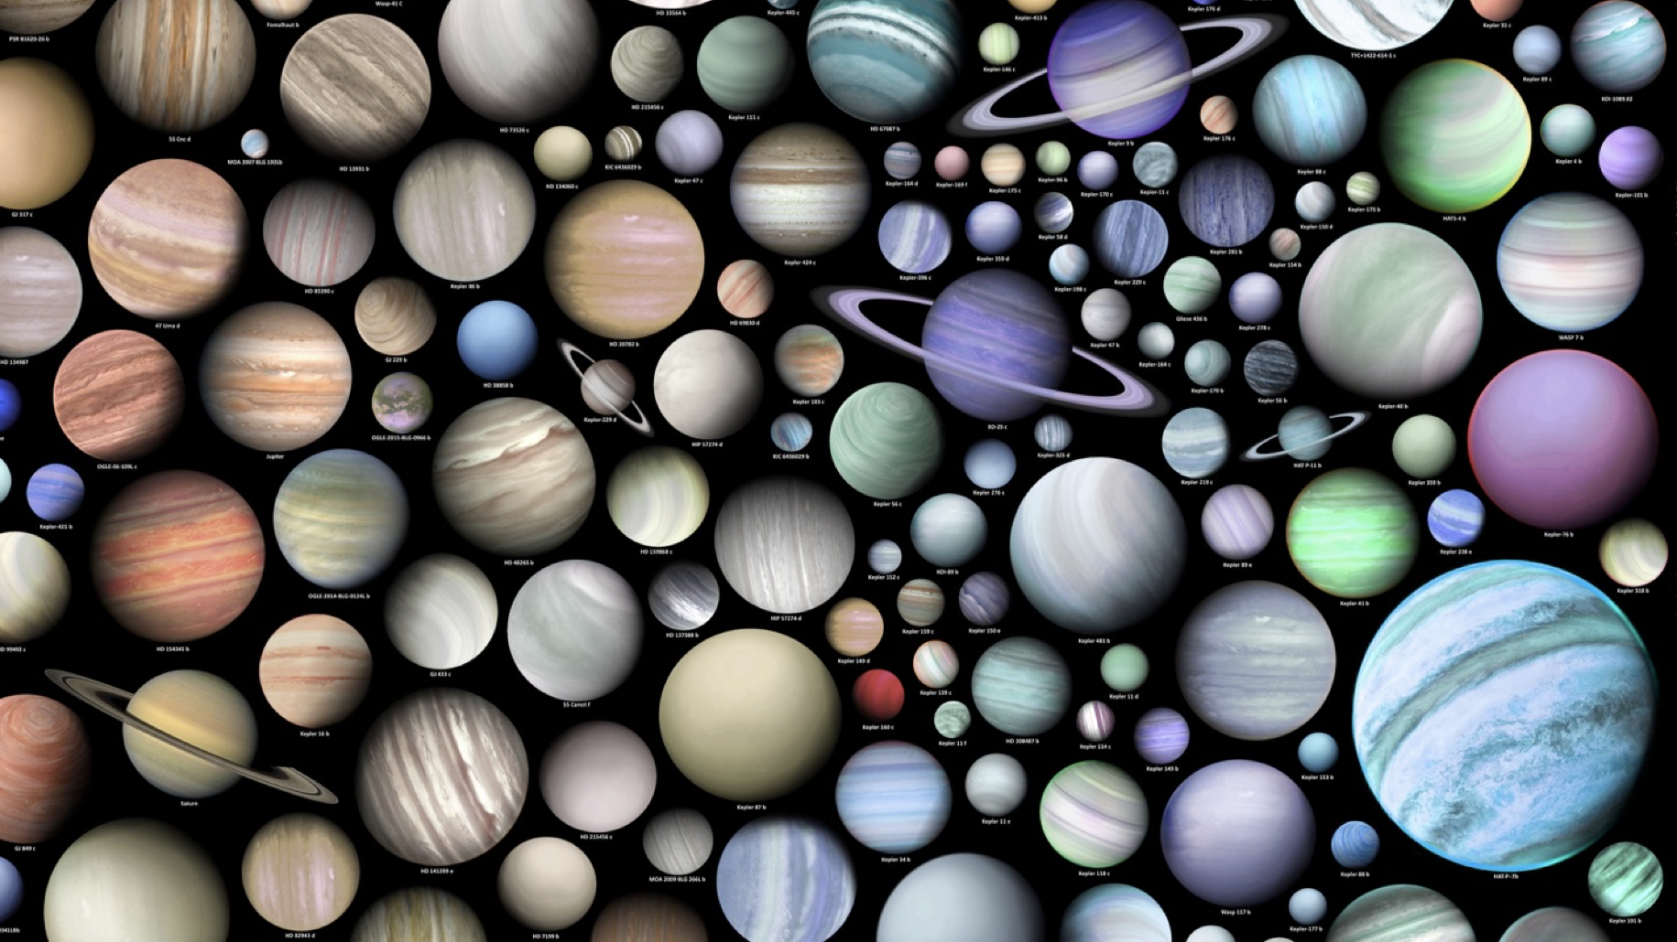
We have now discovered over 4000 exoplanets but we estimate their number to billions in our galaxy alone
Artist’s rendering of exoplanets
Copyright: Martin Vargic, www.halcyonmaps.com/infographics#/exoplanets/

Slide 5
Some are smaller than the Earth and others are larger than Jupiter
Artist’s rendering of exoplanets
Copyright: Martin Vargic, www.halcyonmaps.com/infographics#/exoplanets/

Slide 6
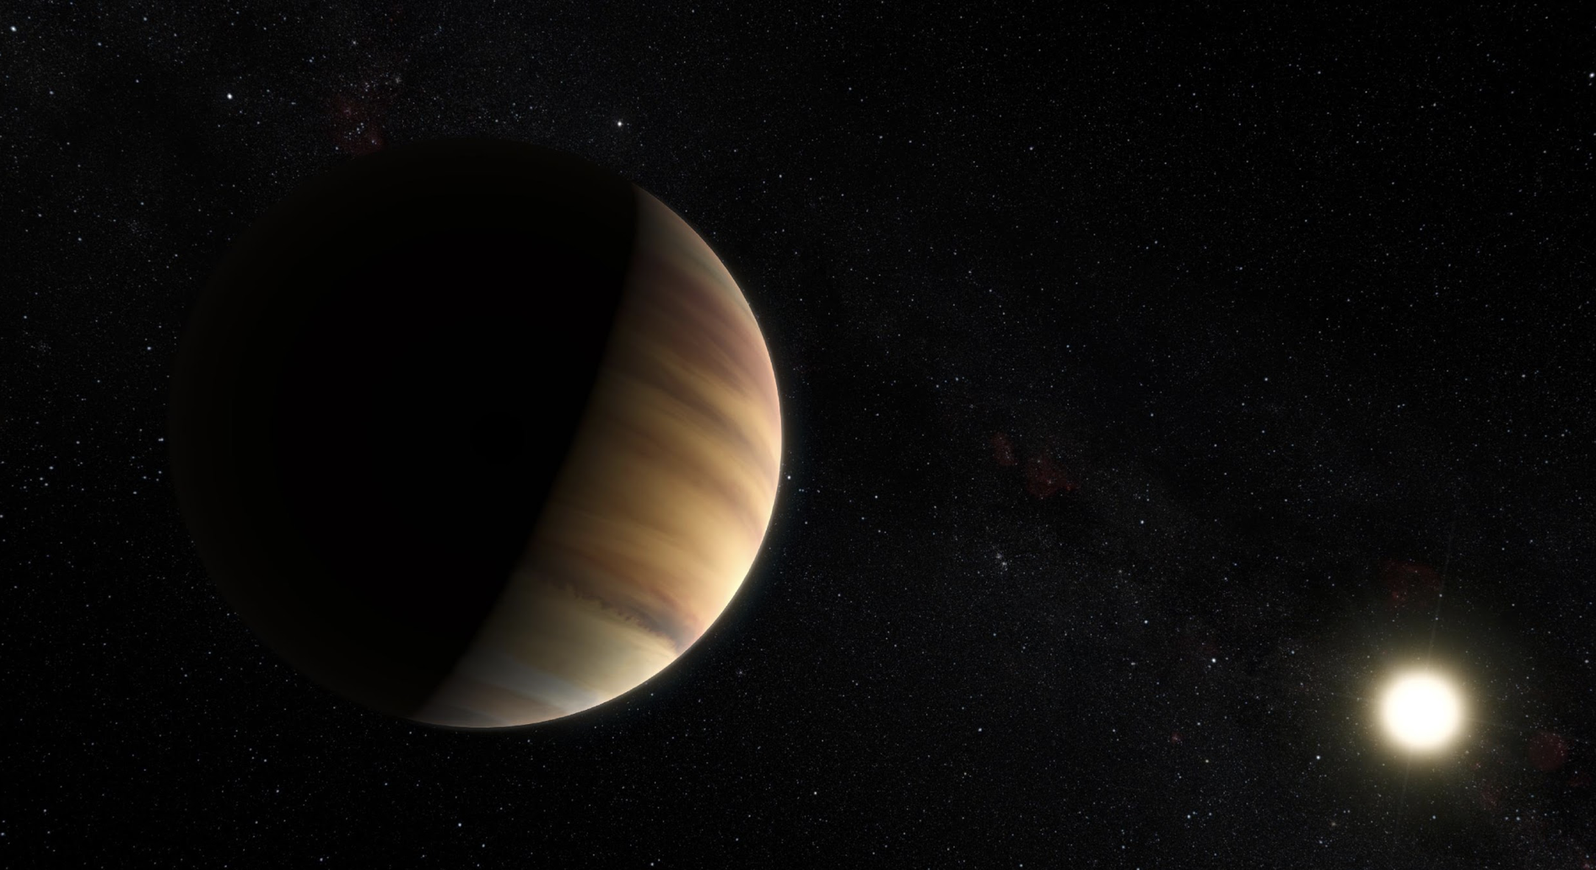
Canada’s Name the Exoplanet Contest
Canada has been assigned the planet HD136418b, a gas giant planet around the star HD136418, located 320 light-years away.
We need to find proper names for the star and its planet.
planet HD136418b
star HD136418
Artist’s rendering
Credit:ESO/M. Kornmesser/Nick Risinger

Slide 7
We don’t know what the planet really looks like! This is not a picture, it’s an artist drawing.
The planet was discovered in 2009 but we’ve never seen it! We know it’s there because its gravity affects the motion of the star.
Artist’s rendering
Credit:ESO/M. Kornmesser/Nick Risinger

Slide 8
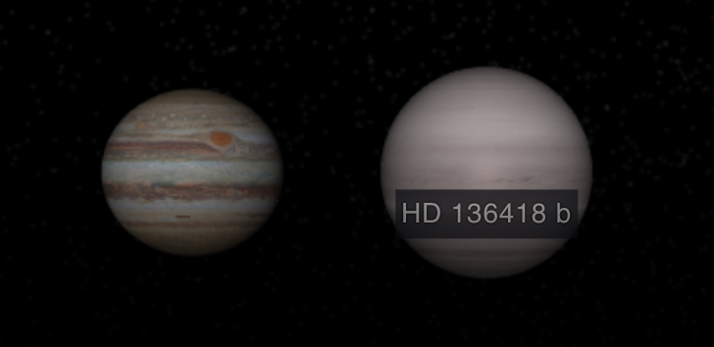
HD 136 418b compared to Jupiter
Even though we’ve never seen it directly, we know the planet HD 136 418b is a gas giant, larger than Jupiter. It orbits its star in 464 days (1 year and 3 months).
Credit: NASA

Slide 9
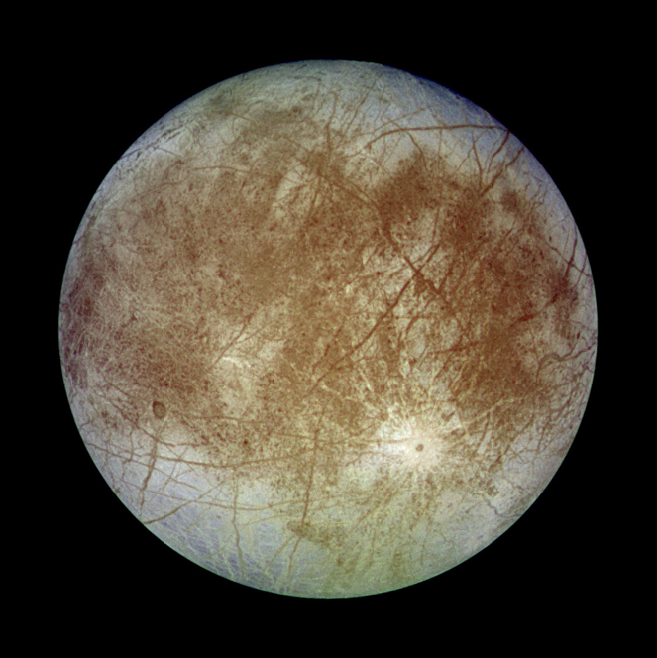
Exomoon
HD136418b could have many moons. After all, Jupiter has 79 of them!
We haven’t discovered any moons around HD136418b so far, but they could exist.
These exomoons* could resemble Jupiter’s moons and contain a lot of water. For example, Europa, one of Jupiter’s moon, could have 3 times as much water as Earth.
Europa has an icy surface and possible oceans underneath.
Credit: NASA//JPL/DLR
*exomoon: moon around exoplanets (moon outside our Solar system)

Slide 10
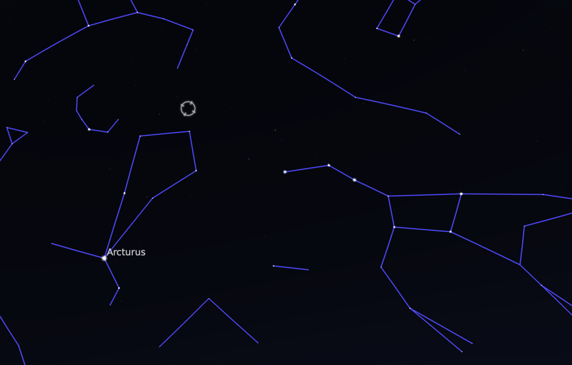
Where is the star HD 136418 in the sky?
HD136418 is located in the constellation of Boötes, near the Big Dipper in Ursa Major.
Unfortunately, you can’t see it with the naked eye. You would need binoculars or a telescope.
Boötes
Ursa Major
Image created with the planetarium software Stellarium

Slide 11
Ready to participate in the contest?
Visit casca.ca/exoplanet for all details and submission form

Slide 12
More advanced information …

Slide 13
Details about the Star and the Planet
STAR HD 136418
Distance : 320 light-years
Mass: 1.33 times the mass of the Sun
Age: 4 billion years
Type of star: sub-giant
Magnitude : 7.85
PLANET HD 136418b
Mass: 2.1 times the mass of Jupiter
Diameter: 1.2 times the diameter of Jupiter
Orbital Period: 464 days
Orbital distance: 1.29 astronomical units
Discovered in 2009

Slide 14
Radial Velocity Method
Since the star and the planet orbit a common centre of mass, we can detect the motion of the star using the Doppler effect on the light of the star (blue-shifted then red-shifted).
By analyzing the light from the star HD136418, scientists discovered a planet must be orbiting it.
This method only works for massive planet with a gravitational pull large enough for us to notice its effect on the star.
Credit: ESO/L.Calçada

Slide 15
Doppler Effect
When an object emitting waves (sound, light…) is moving, the frequency of the wave is affected by the motion of the object.
OBJECT MOVING TOWARDS YOU
Higher frequency
For sound: higher pitch
For light: blue-shifted
OBJECT MOVING AWAY FROM YOU
Lower frequency
For sound: lower pitch
For light: red-shifted

Slide 16
Questions?
Ask us on Twitter using the hashtag #NameExoWorldsCanada
Or contact the members of the Name the Exoplanet Contest organizing committee who created this presentation:
Frédérique Baron, Institute for Research on Exoplanets, baron@astro.umontreal.ca
Julie Bolduc-Duval, Discover the Universe, julie@discovertheuniverse.ca
Last update: 3 September 2019

