Slide 1
Annular Solar Eclipse
June 10, 2021
Teachers! Make sure to check the slide notes. They have a lot of info for you!
Notes:
These slides are intended for teachers to use for their students to learn about the annular solar eclipse that will occur on June 10, 2021. The base slides are intended for Grades K-6, or ages 4-12, and the “Advanced” slides and notes sections are intended for Grades 7-12 or ages 12-18.
Depending on your classroom, you may use all the slides or only some sections. It is recommended to at least use the section “June 10, 2021 Annular Eclipse”, as it contains information specific to the event.
Feel free to modify the slides and activities to suit your classroom and students or use as-is. The material covered here is intended to be used over multiple classes, and so depending on your teaching schedule, some material may need to be cut or used in other ways outside of class time.
Each slide contains substantial notes, which can also be found in the accompanying PDF document.

Slide 2
Topics
The Earth, Moon, and Sun system
Phases of the Moon
Solar Eclipses
Eclipse demo
June 10, 2021 Annular Eclipse

Slide 3
The Earth, the Moon, and the Sun
Notes:
This section focuses on the Earth-Moon-Sun system, their movements in their orbits, and why they move the way they do.
Estimated time for section: 25 minutes
This section does not have Advanced slides, but each slide has an Advanced notes section. These activities and lesson plan ideas are appropriate for higher grades. If you complete all suggested Advanced topics and activities, this section is estimated to take 50 minutes.

Slide 4
What do you think?
How would you describe the Earth, the Moon, and the Sun on their own? What about together as a system?
Consider:
How do you interact with each every day or night?
When or why do you notice these interactions?
Does the interaction of any TWO have noticeable effects?
Does the interaction of ALL THREE have any noticeable effects?
Notes:
Before diving in, try checking in with your students to get them talking about the subject at hand. Ask them to group in pairs or in small groups and produce a description they’re happy with as a group that describes the Earth, the Moon, and the Sun individually as well as how they interact in a system. “System” may be a new word for some classrooms, so please define it as necessary (“a set of things working together as parts of a mechanism or an interconnecting network”).
Once every group is ready, display the “consider” questions. Ask them if they would like to revise their descriptions.
Depending on your format, you can ask students to submit their descriptions in a form, post in a chat, or verbally present their descriptions.
Once all the groups have shared, ask your students what was in common between the answers, and if they think they still missed anything. Some key points to mention could include:
EARTH: We live on Earth, it is the 3rd planet from the Sun, it is the only planet with liquid water in our solar system, and the only place in the universe confirmed to have life. The Earth is rocky, or a terrestrial planet. It is mostly covered in water.
MOON: Earth’s only natural satellite. About 1/4 the size of Earth, not made of cheese. Covered in dust and does not have an atmosphere.
SUN: Our star. Energy source for Earth and the solar system. Relatively small star.
Earth-Moon system: Ocean tides are created by the Moon.
Earth-Sun system: The Sun provides heat and light to Earth. Day and night cycle. Seasons.
Sun-Moon system: Sunlight reflects off the Moon.
Earth-Moon-Sun system: The light reflected off the Moon at night can light up the night. Eclipses seen on Earth are caused by various positions of the Moon relative to the Earth and the Sun, which is investigated further here! (phases of the Moon could be mentioned here as well ONLY IF you are not planning on using the student activity in the next section).
ADVANCED:
The activity described above is suitable for all age groups. It may be supplemented by encouraging older students to provide more detailed descriptions, potentially building on concepts previously covered in class. For example, a Grade 11 physics class could do this activity with the caveat that the physical characteristics of each object be included, such as age, mass, functional features, etc. and how those interact together (e.g. nuclear fusion in the Sun provides radiant energy which travels and interacts with Earth, resulting in transferred heat). In particular, the Sun’s corona and the Earth’s atmosphere are important characteristics that older students should consider in their list.

Slide 5
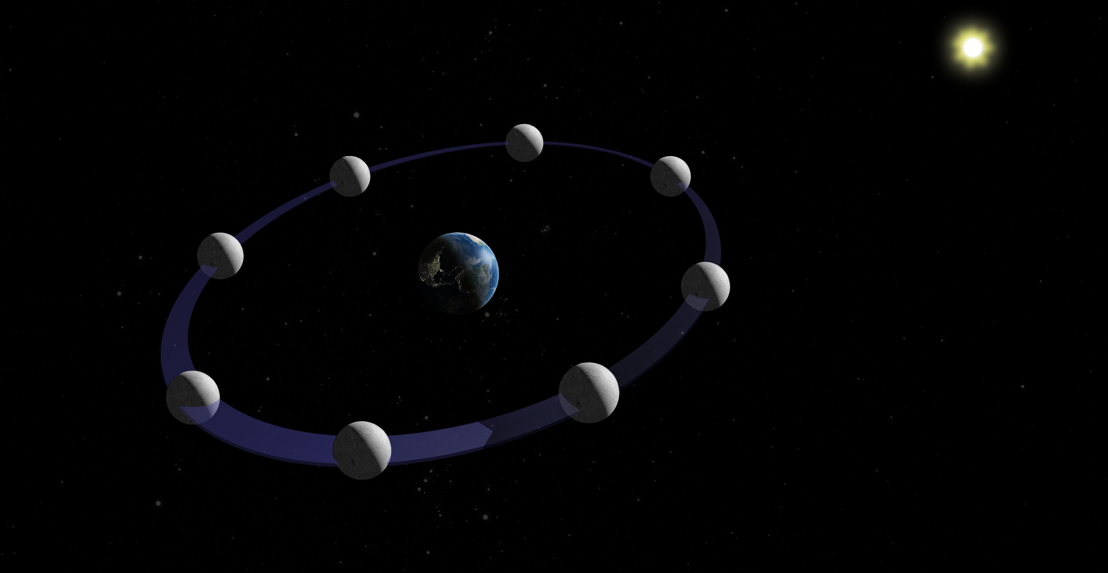
The Earth and the Moon
Illustration not to scale
Notes:
Image credit: Discover the Universe
Main ideas:
The Moon orbits the Earth once every 27 days.
The image here is not to scale. Use the eclipse demo activity to show a scale model of the Earth and the Moon. The Moon is farther than what people expect!
The orbit of the Moon is inclined 5° relative to the orbit of the Earth around the Sun (called the ecliptic).
An orbit is a curved path that celestial bodies follow. The gravitational force of the Earth is what keeps the Moon in orbit.
It is the Moon’s gravitational pull on the Earth’s oceans that causes changes in the ocean’s tides. [Tides are not directly covered by this kit]
ADVANCED
The Moon is gravitationally bound to the Earth, meaning the gravitational pull of the Earth on the Moon is what keeps the Moon in orbit. The gravitational force of celestial bodies is proportional to the mass of the bodies as well as inversely proportional to the distance between them – meaning that the more massive the celestial objects are, and the closer they are, the stronger the gravitational force. The farther away objects are, and the less massive, the less gravitational force between them.
This is a good opportunity to review the gravitational force with appropriate classes. Depending on what has been covered, this may be anything from a review of what the gravitational force is (attractive force between two or more bodies) to a calculation of the gravitational force between the Earth and the Moon (using Newton’s law of gravitation). This exercise could further be expanded to review the similarities and differences between the Earth and the Moon, such as age, mass, composition, atmosphere/lack of atmosphere, gravitational constant, travel to the Moon from Earth, and more. Additionally, the distance between the Earth and the Moon should be mentioned (384,400 kilometres on average).

Slide 6
The Earth and the Sun
Illustration not to scale
Notes:
Image credit: Discover the Universe
Main ideas:
Just like the Moon is in orbit around the Earth, the Earth is in orbit around the Sun. Remember that the orbit of the Earth around the Sun is called the ecliptic. The Earth takes about 365 days to orbit the Sun.
All planets in the Solar system are in orbit around the Sun. Other objects too: asteroids, comets…
The Earth orbits the Sun while the Moon orbits it, creating a more complex system.
The Sun provides heat and light to Earth and is the Earth’s main source of heat!
ADVANCED
This is a good opportunity to discuss the Earth’s orbit around the Sun and potentially how it compares to other planets. The Earth’s distance from the Sun should be mentioned (an astronomical unit, or about 150 million kilometres). A deeper analysis could also be done of the energy that arrives to Earth from the Sun in terms of type, how much is reflected and absorbed, and how much of the Sun’s total energy Earth receives.

Slide 7
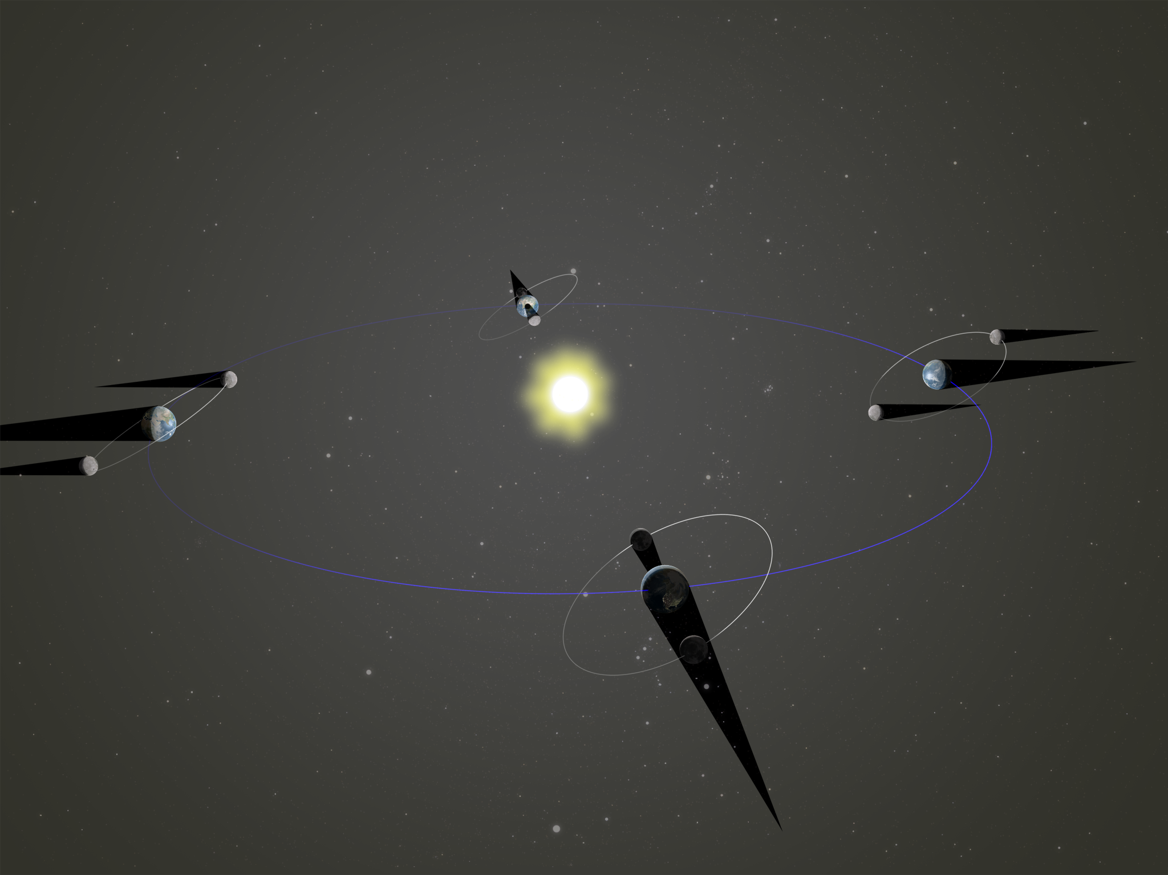
The Earth, the Moon, and the Sun
Illustration not to scale
Notes:
Image credit: Discover the Universe
Main ideas:
Three of these objects together create a more complicated system, with interesting celestial events!
The WHITE orbits are the Moon’s orbit around Earth. The BLUE line is the ecliptic, or the Earth’s orbit around the Sun.

Slide 8
Phases of the Moon
Notes:
This section addresses the Sun as a light and energy source. The Moon is not a light source itself, but that it reflects light from the Sun that is then visible from Earth. The position of the Moon in its orbit around the Earth will dictate what phase it appears in.
Assumptions made about students' knowledge in this section are that the Moon, Earth, and Sun move in orbits, and that the Moon is a natural satellite of Earth. Advanced activities and discussion points assume that students have covered some geometric optics, namely reflection.
Estimated time for section: 25 minutes
If you are completing all of the Advanced activities and discussions as well, the total estimated time for this section is 50 minutes.

Slide 9
What do you think?
Knowing that the Moon, Earth, and Sun are in a system with complex outcomes, what might some of these outcomes be?
Considering the phases of the Moon, discuss:
Are the phases of the Moon an interaction between the Sun, the Moon, and the Earth OR only an interaction between the Sun and the Moon?
Why or why not?
Notes:
Before diving in, ask your students about interactions that happen between the Earth, the Sun, and the Moon together. They should be making a list either individually or in small groups. This list may or may not be shared or submitted.
Show the “considering” questions. You students should go back to their groups and come up with an answer as well as a justification.
Ask students to hold onto their responses, as they will be asked to revisit them at the end of this section.

Slide 10
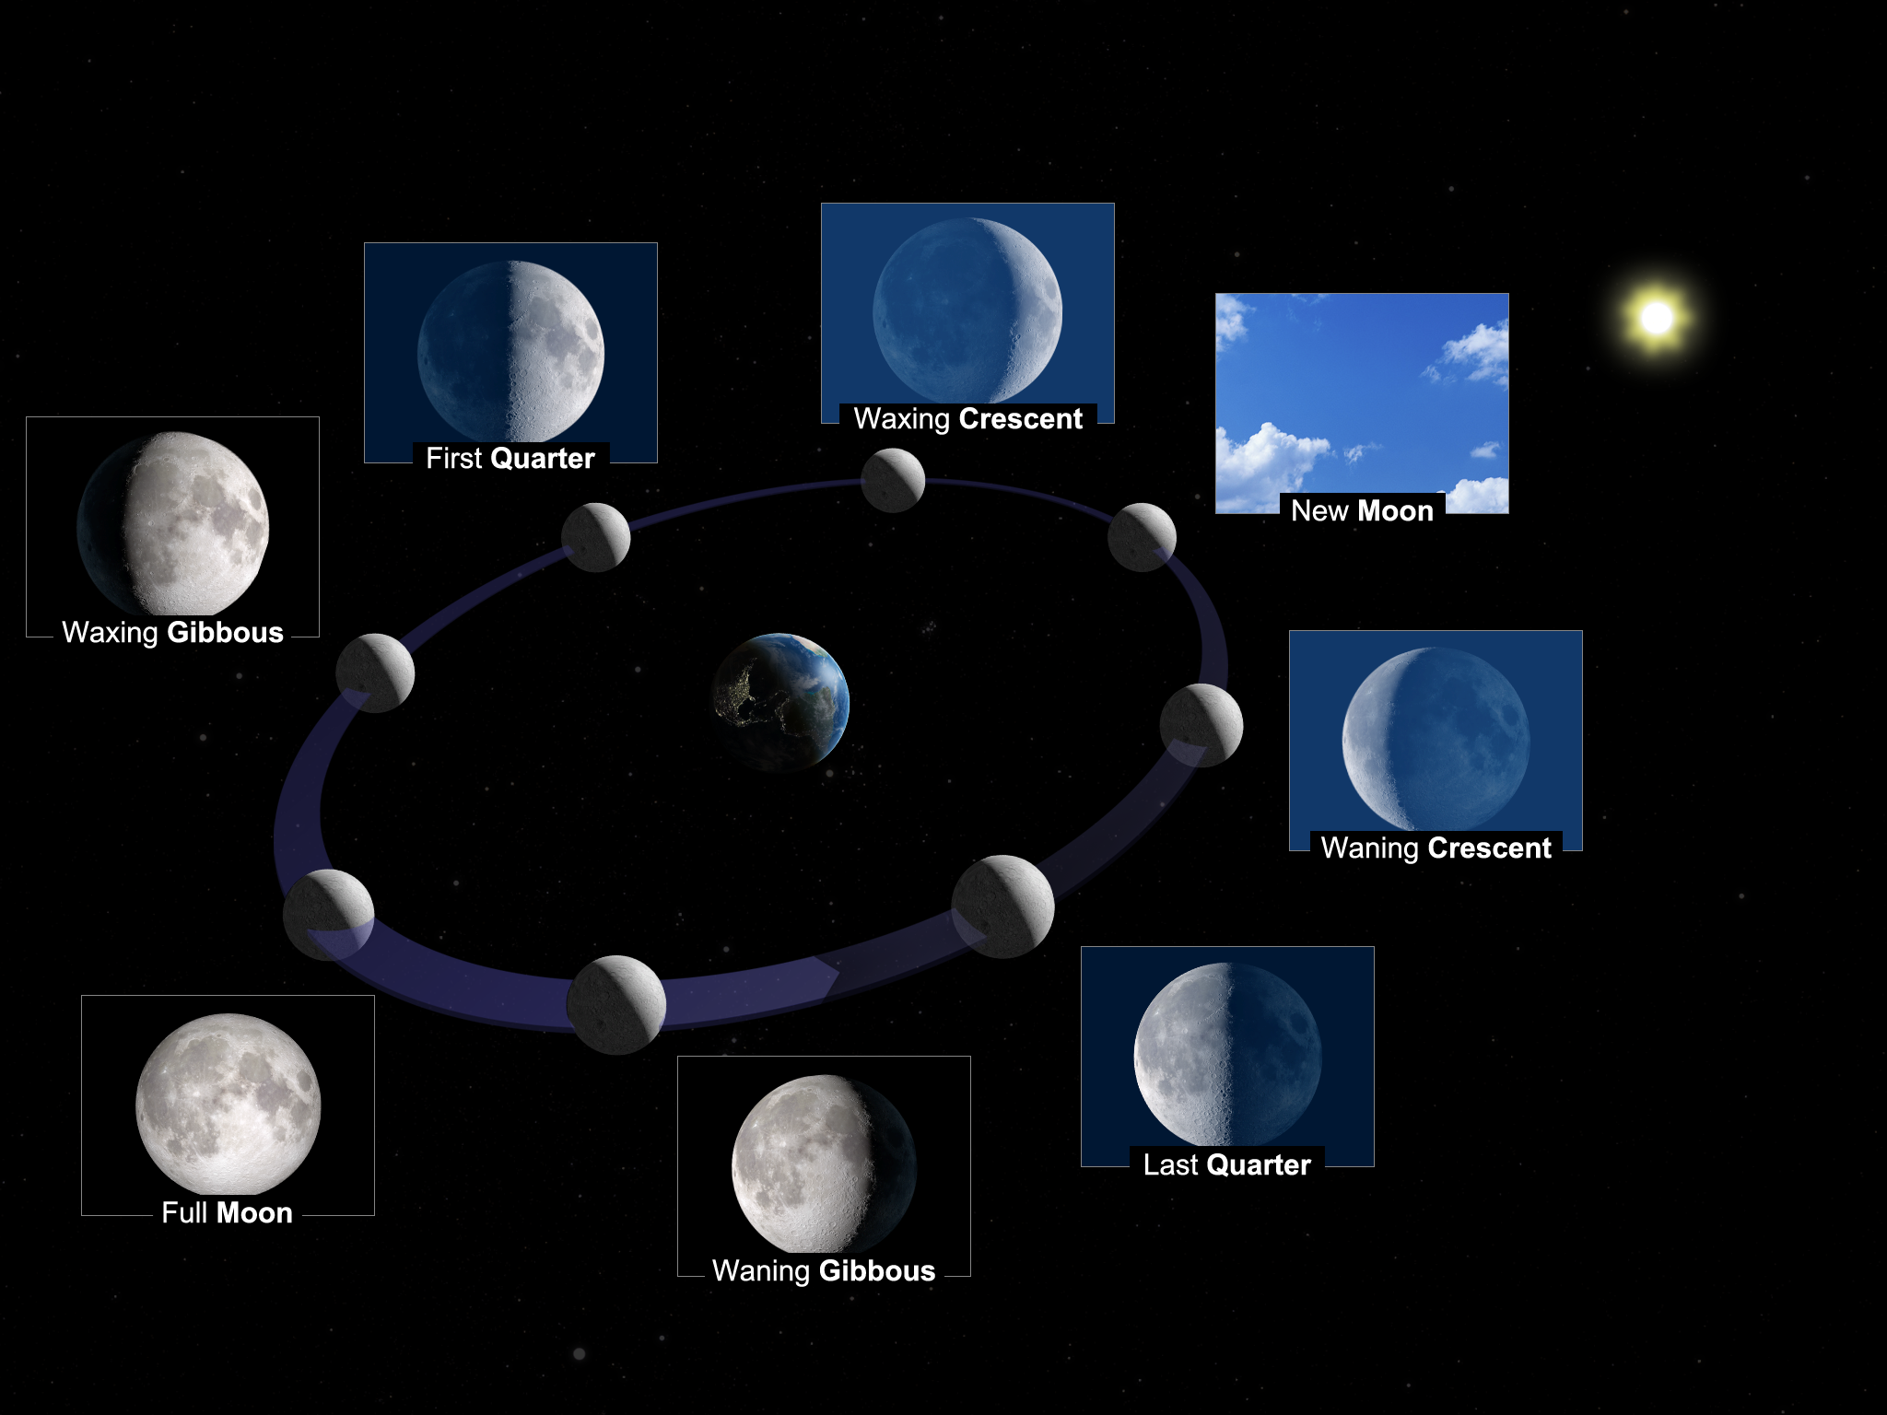
Phases of the Moon
Illustration not to scale
Notes:
Image credit: Discover the Universe
Main ideas:
- The Moon does not shine on its own. It reflects the light from the Sun.
- Half of the Moon is always lit by the Sun, just like the Earth. It is day on the lit side, and night on the unlit side.
- From the Earth, we don’t always see the same fraction of the Moon's day side. This fraction changes as the Moon goes around the Earth. This is what causes the phases of the Moon.
“Waxing” implies that the part of the Moon reflecting light onto Earth is getting larger with time.
“Waning” implies that the part of the Moon reflecting light onto Earth is getting smaller with time.
For each position of the Moon on its orbit, think of the view that a person on Earth would have when looking up. Visualizing in 3D is not always easy to reconcile the two perspectives: the view from space (where we see the 3 objects) and the view from the Earth's surface, which shows the phase of the Moon in the sky.

Slide 11
Are full Moon and new Moon eclipses?
No, due to the 5-degree inclination of the Moon’s orbit.
Illustration not to scale
Notes:
Before revealing the slide, ask students for a quick YES/NO to the title!
Main ideas:
A Full Moon is when the Earth is between the Moon and the Sun, and therefore its full face is visible. Due to the 5 degrees of inclination in the Moon’s orbit, it is not directly behind the Earth but slightly above or below it – it’s not in the Earth’s shadow.
A New Moon is when the Moon is between the Earth and the Sun, and therefore we see its “back”. Due to the 5 degrees of inclination in the Moon’s orbit, it is not directly between the Earth and the Sun but slightly above or below – its shadow does not fall on the Earth.
Eclipses don’t happen every month because of this difference in the orbits. Most months, the shadows miss the other object (Moon or Earth).

Slide 12
What do you think?
Now that you know more about the phases of the Moon, would you change your answer to the question posted at the beginning?
Are the phases of the Moon an interaction between the Sun, the Moon, and the Earth OR only an interaction between the Sun and the Moon?
Why or why not?
Notes:
Ask students to return to their groups and revise their answer. Another poll of the groups may be conducted, or oral presentations of their answers could be presented. Answers may be submitted in an appropriate format.
All groups should conclude that the phases of the Moon are an interaction of the Moon, the Earth, and the Sun. The Sun does not reflect different amounts of light off the Moon, but it is the position of the Moon in its orbit around the Earth that make the Moon appear to be in phases as observed from Earth. This is a subtle point that may require a group discussion with your class before moving on.

Slide 13
Solar eclipses
Notes:
This section addresses what occurs during a solar eclipse of either kind: total or annular. The conditions needed to create an eclipse, the Moon casting a shadow on the Earth, and how often they happen are discussed.
Assumptions about students’ knowledge in this section include that the Earth and Moon move in orbits, and that the Moon is a natural satellite of the Earth.
Estimated time: 35 minutes + optional take home project
If you are completing all the Advanced activities and additional slides on top of the base material, the total time estimate for this section is 50 minutes plus 2 optional take home projects / labs.

Slide 14
What do you think?
How would you define a solar eclipse? Can you draw a diagram of what happens during a solar eclipse in the Earth, Moon, and Sun system?
Consider:
Is there more than one type of solar eclipse? How many are there?
How often do solar eclipses happen?
Notes:
Before moving on, check in with your students’ knowledge. They may answer the first question in pairs, or in small groups. You may ask students to recreate their diagram on the board or screen share, depending on your classroom.
Share the “consider” questions one at a time. Open the floor for a group discussion with the whole class to see if your students come to a consensus.
ADVANCED
For classes where optics have been discussed, encourage students to draw ray diagram(s) to represent their thoughts on what happens during a solar eclipse.
For the “consider” questions, encourage students to answer with more detail and quantified details (e.g., “I expect solar eclipses to happen every [time period] because of [reason]”).

Slide 15
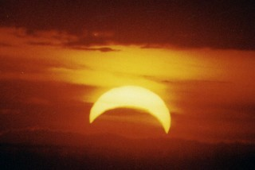
Solar Eclipse
Solar eclipse (eclipse of the Sun) : the Moon’s shadow falls on the Earth
→ we look at the Sun and the Moon covers it
© Thomas Collin
Notes:
Picture credit:
© Thomas Collin - used with permission

Slide 16
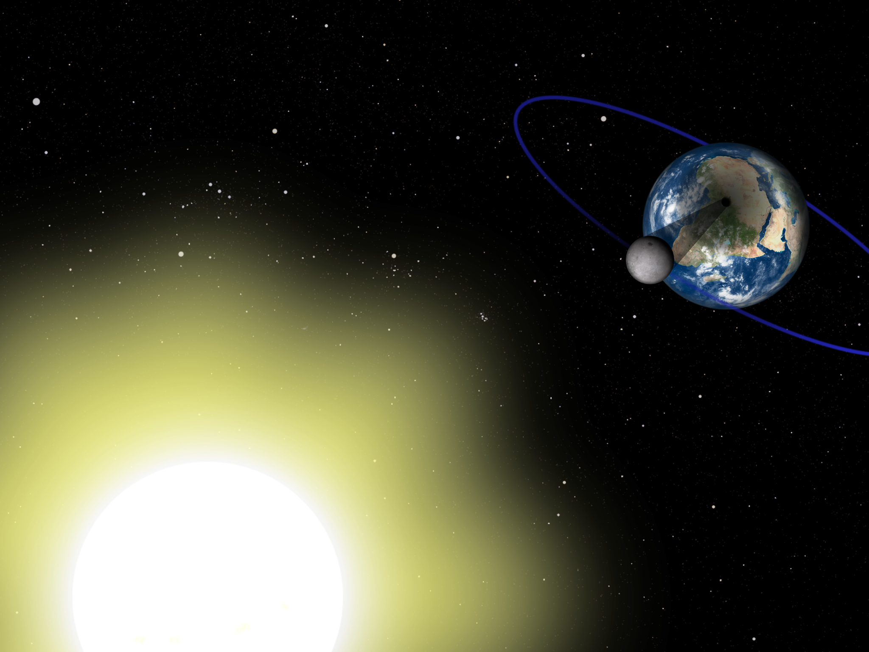
A solar eclipse happens when the Moon passes between the Earth and the Sun (at new Moon).
If the alignment is perfect, the shadow of the Moon will fall on the surface of the Earth.
Illustration not to scale
Notes:
Image Credit: Discover the Universe

Slide 17
Frequency of Solar Eclipses
There are eclipses every 6 months or so, but they are not visible from everywhere on Earth.
Illustration not to scale
Notes:
Image credit: Discover the Universe
Twice a year, the alignment of the orbits is right, and the shadows will fall on the other object (Earth or Moon). Compare the shadows in the red oval compared the other shadows. These are called eclipse seasons and will last 35 days. Every new moon and full moon during that period will be an eclipse.
For example, there will be a lunar eclipse on May 26 which is a full moon. About 2 weeks later, on June 10, the Moon will be on the other side of the Earth: it will be new moon and there will be a solar eclipse.

Slide 18
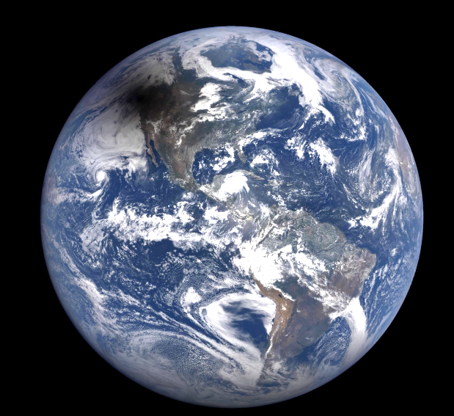
Solar eclipse of August 21, 2017 by DSCOVR - EPIC
https://epic.gsfc.nasa.gov/galleries/2017/total_solar_eclipse/video
Notes:
The shadow of the Moon is clearly visible on the Earth. The link will bring you to a video of this eclipse.

Slide 19
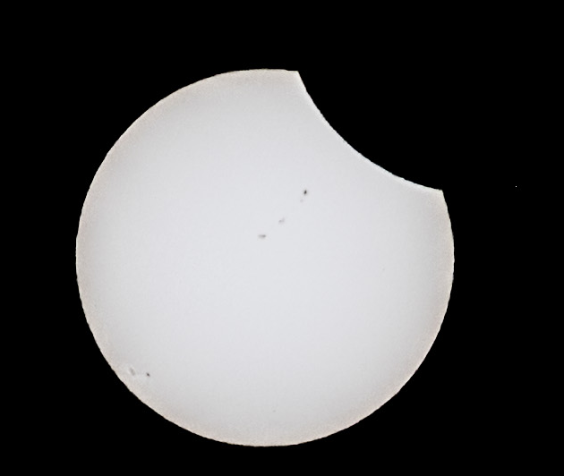
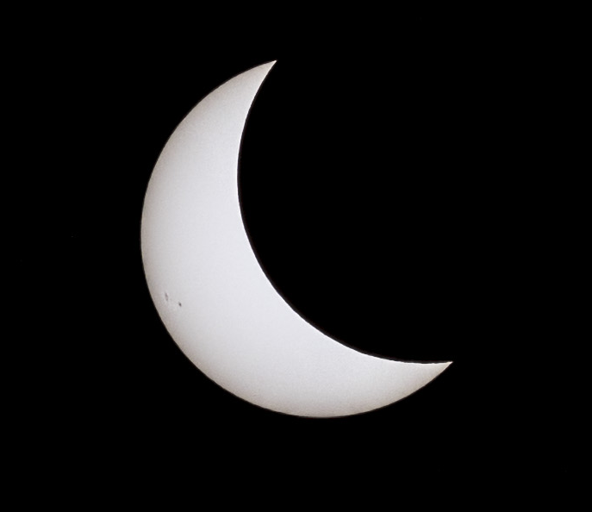
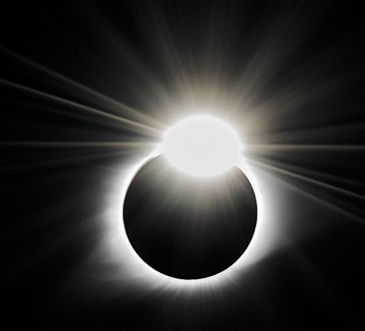
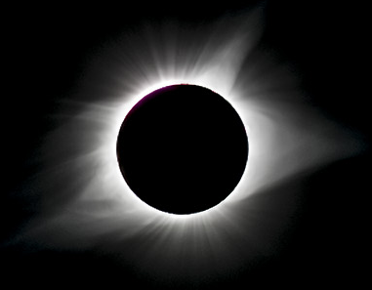
As seen from Earth:
© Andreu Cardo Martinez
Notes:
This is the process of a total solar eclipse. It starts with a partial eclipse when the Moon starts covering the Sun. As the eclipse progresses, more and more of the Sun is covered, until the Moon blocks it completely (bottom right). Then the reverse process would happen as the Moon continues in its orbit and slowly ”leaves” the Sun.
This is not the only type of eclipse to observe, however!
Note to students that these photos are taken during the day. They are NOT taken at night! Solar filters block out most of the light, so that only the brightest objects are still visible – in this case, the Sun.

Slide 20
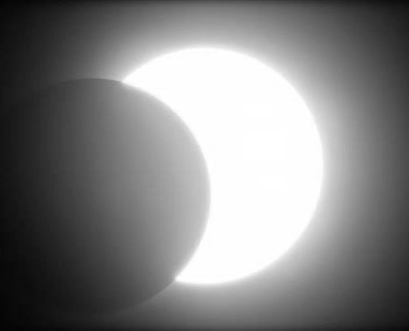
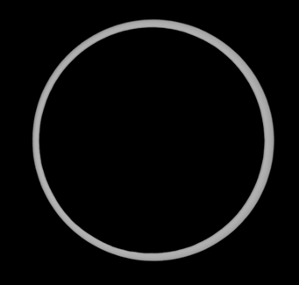
Three types of solar eclipses
Total eclipse
- when the Moon blocks the Sun completely
Annular eclipse
- when the Moon is in front of the Sun but appears smaller than the Sun
Partial eclipse
- when the Moon is not completely in front of the Sun
Credits: Andreu Cardo Martine, Sébastien Gauthier and Canadian Space Agency
Notes:
For total solar eclipses, the Moon is positioned exactly in front of the Sun for those observing on Earth and it is close to Earth, thus blocking out more of the Sun. The bright part around the Moon is the outer atmosphere of the Sun, called the corona. The corona is less bright than the Sun and we only see it when the Sun is blocked.
For annular solar eclipses, the Moon is positioned exactly in front of the Sun for those observing on Earth and it is further away from Earth in its orbit, thus appearing smaller and blocking out less of the Sun. A ring of Sun remains visible around the Moon, and it must be observed through a solar filter.
For partial solar eclipses, the Moon is not positioned exactly in front of the Sun for those observing on Earth and thus only blocks a part of the Sun. This is both a type of eclipse in the way it may be the only type viewable in a particular region, but it is also a phase of the previous two types – both before and after their maximums.
The image of the partial eclipse is a simulation, not a real picture. It allows us to see the Moon in front of the Sun, which might make it clearer to the students, compared to the pictures on the previous slide.

Slide 21
What do you think?
We know that there are 3 types of solar eclipse: partial, annular, and total.
Using words and diagrams, explain the difference between each type.
Consider:
What must be true for all types of solar eclipse? How are they the same?
What could be different between the three types of solar eclipse, given what you know about the Earth, Moon, and Sun system?
Notes:
You may wish to assign this as a take home assignment or project. Students could create a diagram showcasing similarities and differences between the types, which may be 3 different diagrams, and provide a verbal or written explanation for the diagrams.

Slide 22
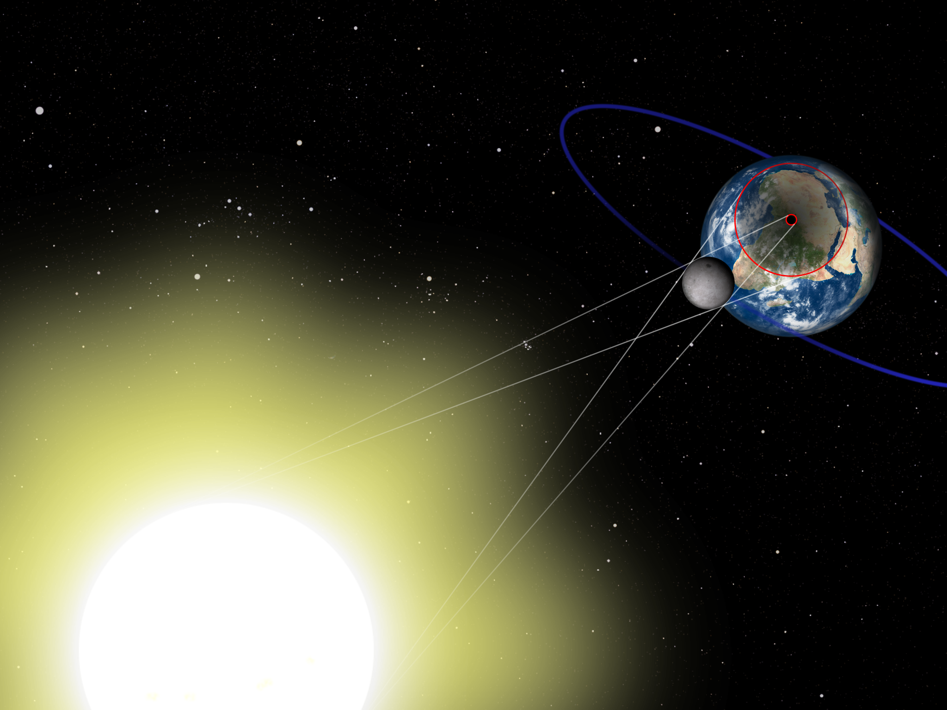
Umbra
Penumbra
Illustration not to scale
Notes:
Image credit: Discover the Universe
ADVANCED – unhide this slide if you intend to use it for your class(es)
This version of this image (same as slide 16) shows guiding lines for the umbra and penumbra that accompany every eclipse (of any type!). The umbra is otherwise known as the “path of totality” for total solar eclipses. The penumbra defines where the eclipse is visible at all, even as a partial eclipse. The small red circle shows the instantaneous instance of the umbra, and the large red circle shows the instantaneous instance of the penumbra. The blue circle is the orbit of the Moon around the Earth.
Potential discussions questions to ask your students include:
Which area has LESS sunlight, the umbra or the penumbra? Why? Can you support your answer with at least one ray diagram?
Do the locations of the umbra and penumbra change with time? Why or why not? How could we verify this with either existing information or our own data collection? (hinting towards using the eclipse viewing as a optional, non-assessment activity!)
What kind(s) of eclipse are shown in this photo? How do you know?
If you are interested in discussing umbra and penumbra instances with your students, a simple lab or demonstration could be:
Place a light source on a table or stool. Preferably something with bright light, such as a bright flashlight or a lamp with the cover removed. The table or stool should be about 1.5 - 3 metres away from a blank wall.
Turn on the light and stand between the light source and the wall.
If possible, take note of how far away you are from the wall. What does your shadow look like? Is it crisp and completely dark, or are there blurry edges that are lighter?
What happens to your shadow if you move further from the wall? What happens if you move closer to the wall?
At what distance from the wall does your shadow cease to be dark (i.e., the umbra has dispersed)? At what distance is your shadow completely dark with no blurry edges (the penumbra fades into the umbra)
What might this tell us about how solar eclipses are viewed on Earth for total versus annular eclipses, knowing that they are defined by how close the Moon is to the Earth?

Slide 23
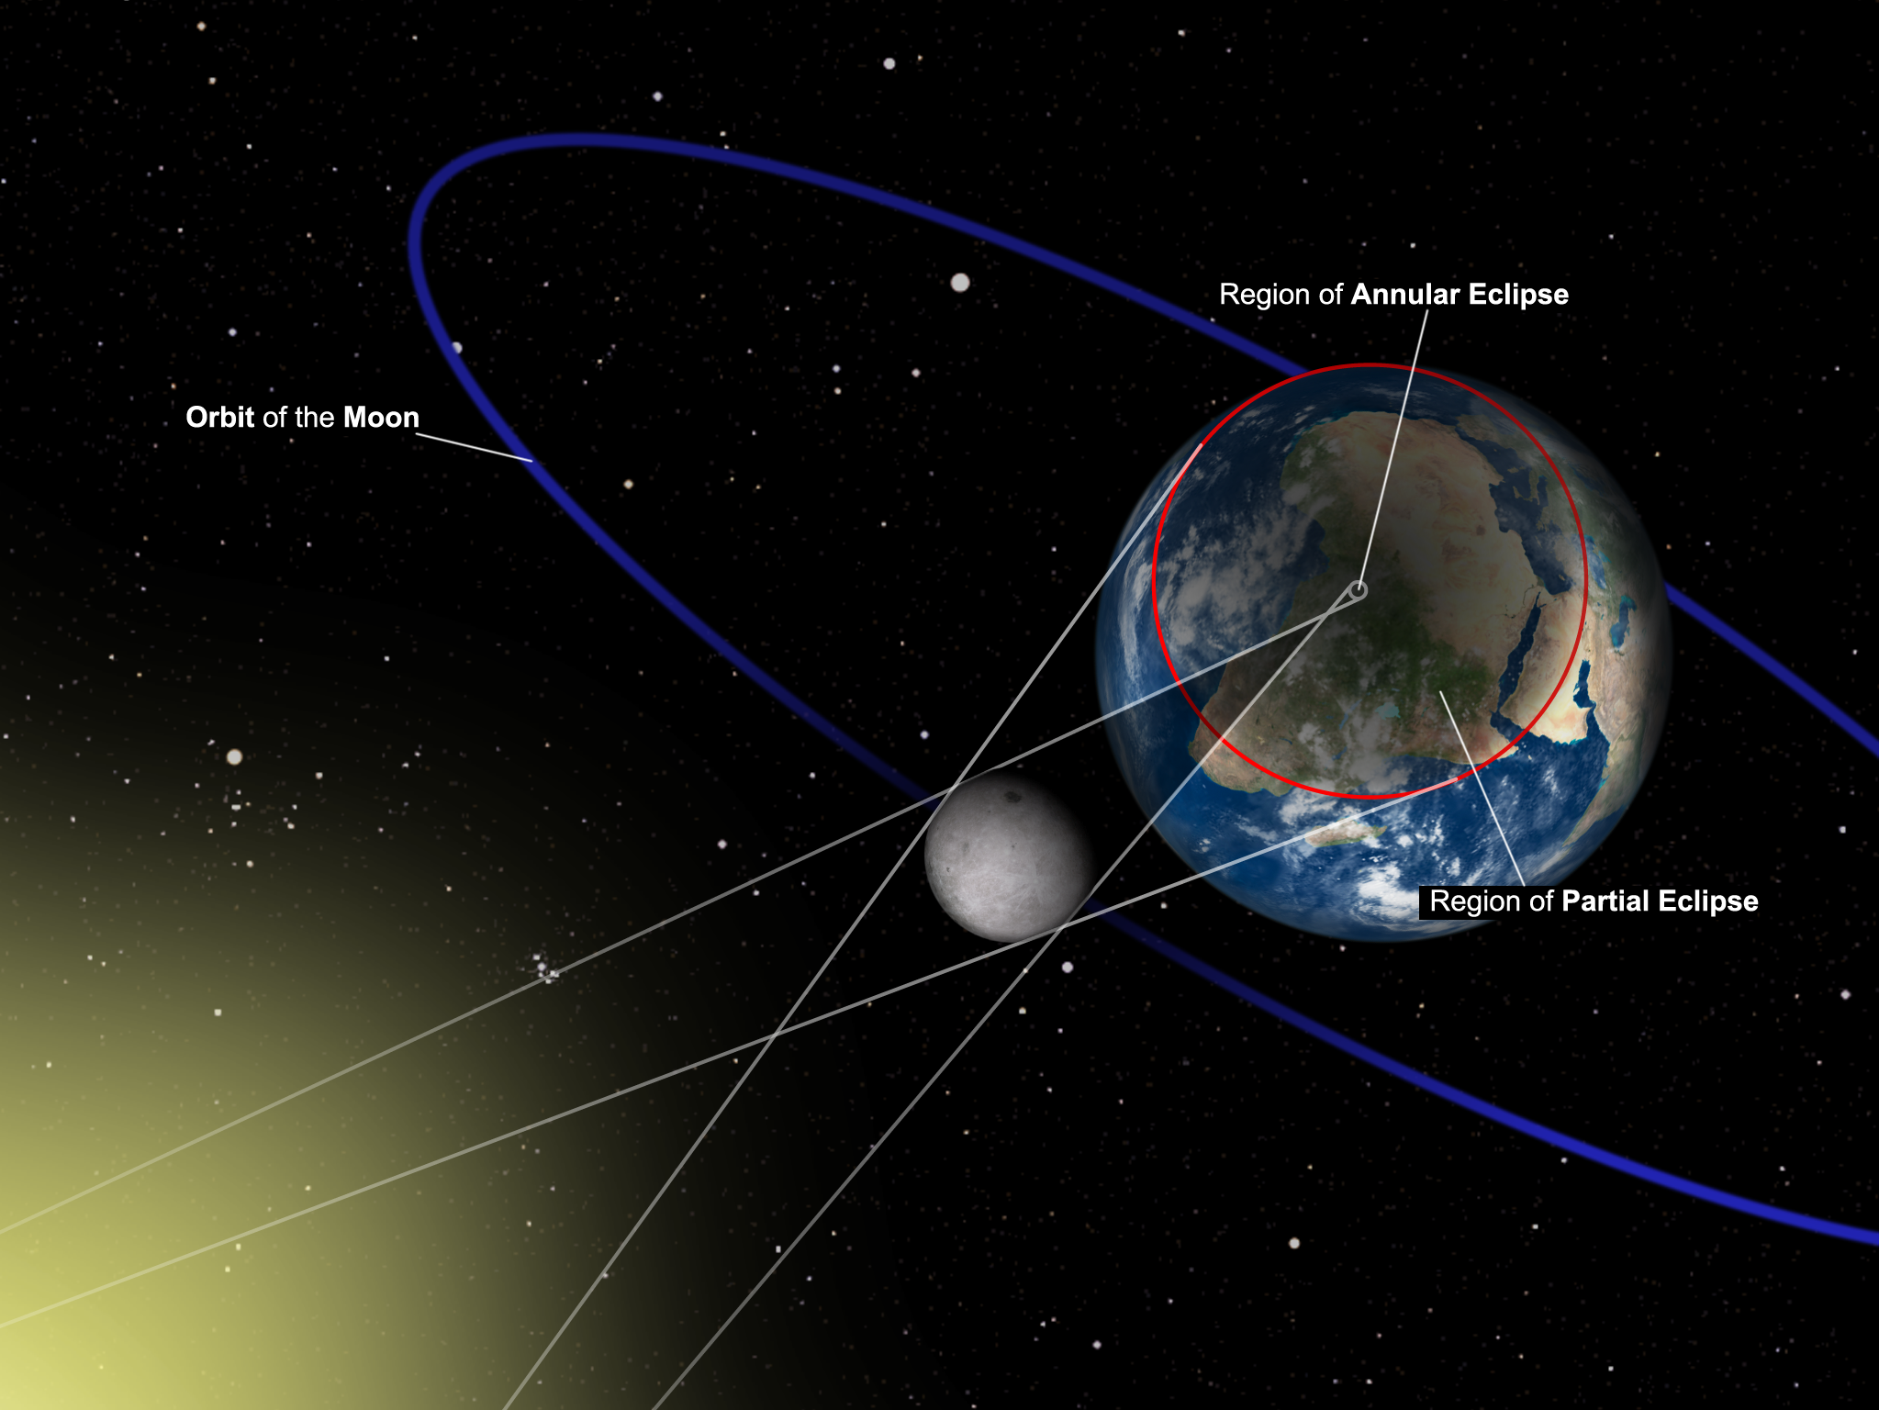
Illustration not to scale
Notes:
Image Credit: Discover the Universe
ADVANCED – unhide this slide if you intend to use it for your class(es)
This is another version of the previous image, this time specific to an annular solar eclipse.
Encourage discussion about the similarities and differences between this image and the previous one, which illustrate the similarities and differences between total and annular eclipses from an optics perspective. Students should notice the complete depletion of the umbra BEFORE the light rays reach Earth in the case of an annular eclipse. In this case, the large red circle still represents the penumbra. The darker middle circle defining the path of annularity, or region of annular eclipse, is called the antumbra. This is the defining feature for distinguishing annular eclipses from total solar eclipses, and gives the observer the impression that the occluding body, the Moon, is inside the light source, the Sun.
Consider adding an additional question to the demonstration / lab suggested on the previous slide to investigate antumbras:
Move the Light source further away from the wall (up to 5 metres).
Turn on the light source and put yourself between the wall and the light source.
Move away from the wall until you notice your shadow no longer has an umbra.
Continue to move away from the wall. What do you observe? At what distance?
As you continue to move away from the wall, what happens?

Slide 24
Eclipse Activity demonstration
Notes:
In addition to the discussions and content throughout the previous sections, you have received an eclipse demo with your Eclipse Kit. You can use this demo yourself to model for your students or make it a part of a project or lab for your students to use themselves.
Note that this demo can also be used for lunar eclipse discussions and the size of the Earth to the Moon, among other topics.
If used as a demo, 15 minutes could be allotted. If this is a lab or project with observations expected, this should be allotted a class with some take-home time.
Alternatively, this demo could be used to fill time during the eclipse itself if you are observing with your students. It is interesting to see the evolution of the eclipse, but it is not necessary to observe for the entire 2-3 hours that the eclipse is happening. Observing at the maximum of the eclipse is more essential than during the partial phases.

Slide 25
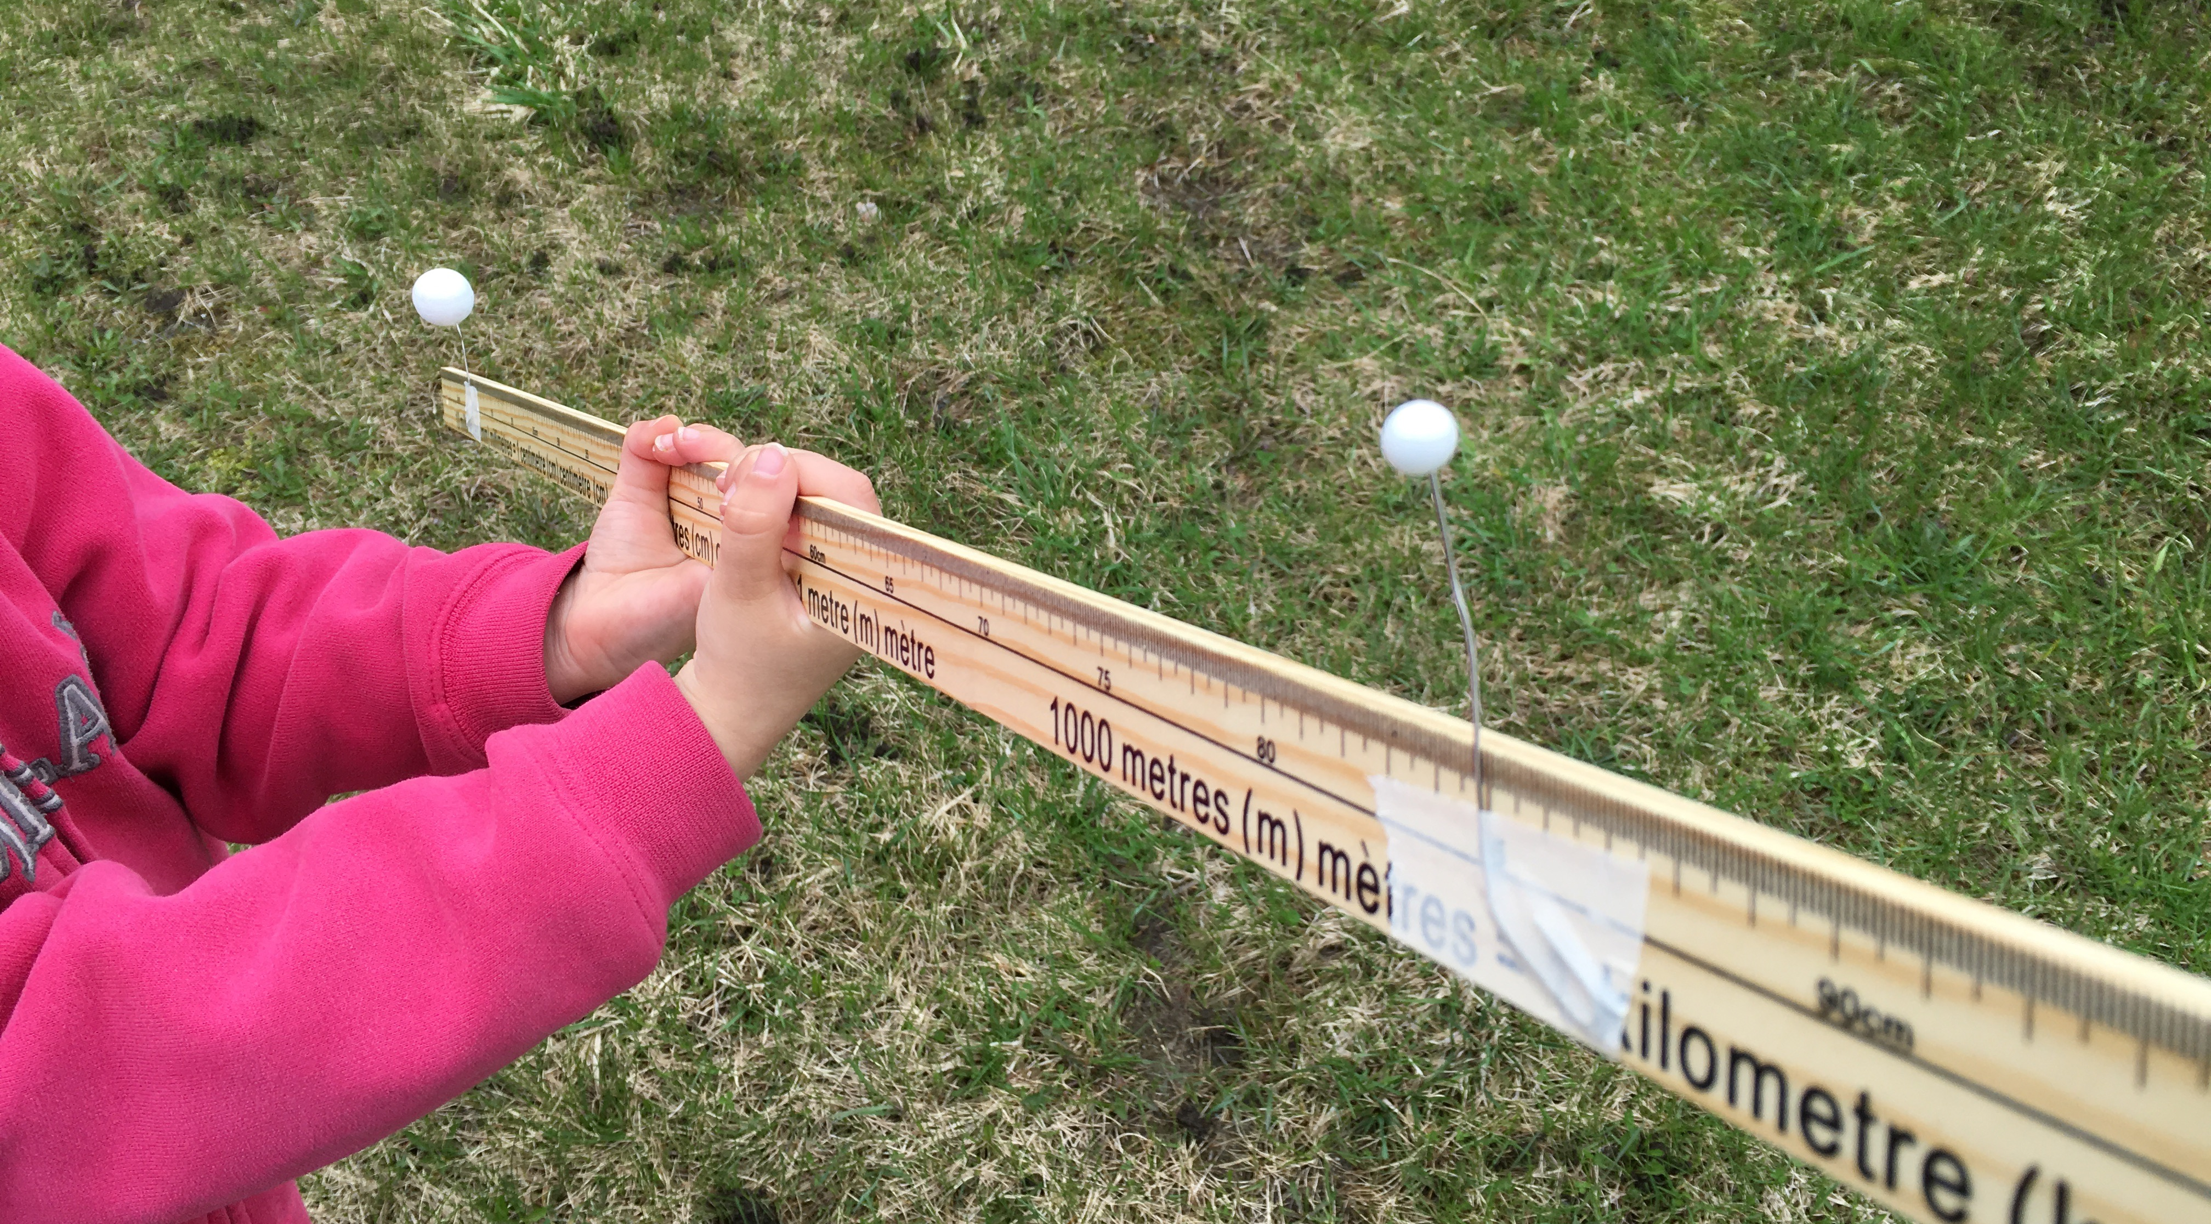
Method
  Hold the ruler in the sunlight and align the Earth and the Moon to create eclipses, either solar or lunar.
  Careful not to create shadows with your hands!
Since the alignment can be difficult, we can use the shadows of both balls on the ground. They should be right on top of one another to create an eclipse.
Notes:
Image Credit: Discover the Universe
The perfect alignment for eclipses is very hard to obtain using the demo. This helps understand why eclipses don’t happen every month.
If you are presenting this as an in-class activity or a lab, the following slides may help students in their observations.
Inquiry questions that may be posed to students include:
If the Moon was larger, what would change about your observations? Would it be easier or harder to cause a solar eclipse? What might this tell you about the frequency of solar eclipses if the Moon was larger? Would a solar eclipse in this scenario look the same or different, and how so?
If the Moon was smaller, what would change about your observations? Would it be easier or harder to cause a solar eclipse? What might this tell you about the frequency of solar eclipses if the Moon was smaller? Would a solar eclipse in this scenario look the same or different, and how so?
If the Moon was further away from Earth, what would change about your observations? Would it be easier or harder to cause a solar eclipse? What might this tell you about the frequency of solar eclipses if the Moon was further away? Would a solar eclipse in this scenario look the same or different, and how so?
If the Moon was closer to Earth, what would change about your observations? Would it be easier or harder to cause a solar eclipse? What might this tell you about the frequency of solar eclipses if the Moon was closer? Would a solar eclipse in this scenario look the same or different, and how so?

Slide 26
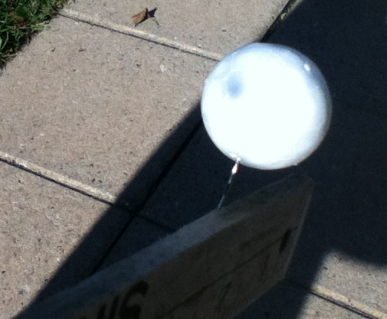
Observations – SOLAR Eclipse
  Shadow of the Moon
Notes:
Image credit: Discover the Universe

Slide 27
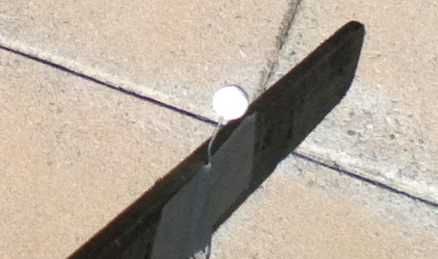
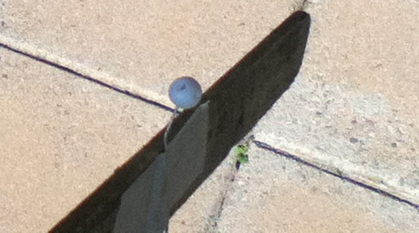
observations: Lunar eclipse
  Lit Moon
  Eclipsed Moon

Slide 28
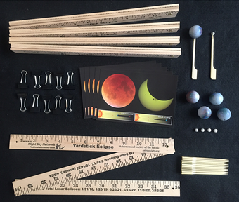
Eclipse demo activity
  This demo activity is from the Astronomical Society of the Pacific: https://myasp.astrosociety.org/product/KT110/yardstick-eclipse-activity-set-of-5
  You can see a video they created here: https://youtu.be/FVYLHCezJug

Slide 29
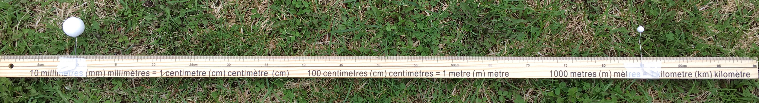
To create more activity kits
  Styrofoam ball - 2.5 cm (Earth)
  Styrofoam ball about 0.7 cm (Moon)
  2 paper clips
  1m ruler or stick
  On the ruler, put the balls 75cm apart. This now represents the Earth-Moon system to scale.

Slide 30
June 10, 2021 annular eclipse
Notes:
This section covers the specifics of the June 10, 2021 eclipse. The path of the shadow of the eclipse, the timing, and how to observe safely.
This section, while making assumptions of the learning goals addressed in previous sections, can be covered on its own if necessary.
Estimated time: 15 minutes + possible take home activity or class discussion

Slide 31
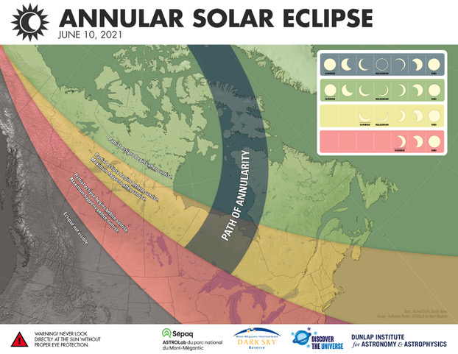
Notes:
The path of annularity defines where the annular solar eclipse is visible. The coloured regions show where the partial solar eclipse is visible. For some in the southern regions, the eclipse begins before sunrise.

Slide 32
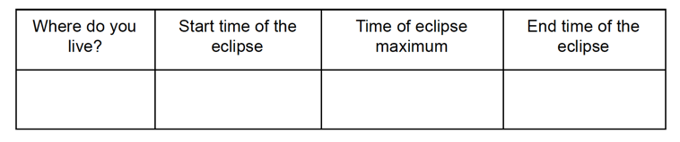
The local times for the eclipse are:
Since the eclipse happens very early in the morning, the Sun will still be quite low in the eastern sky. Think of how you can see it from your location, and whether buildings or hills could block the view.
Notes:
This is for you and your students o complete! Each student should fill the information sheet they will be taking home.
Find your observing time in the accompanying table, or use the search function on Time and Date: https://www.timeanddate.com/eclipse/map/2021-june-10
Due to the observation times being early in the morning, reviewing the safety information with your students and ensuring they have their information sheets filled out and taken home will help ensure they and their families will enjoy the eclipse safely.

Slide 33
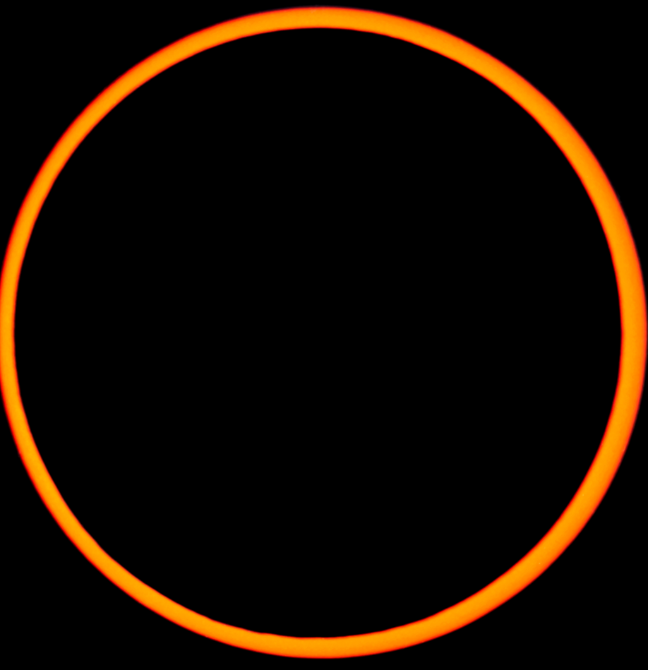
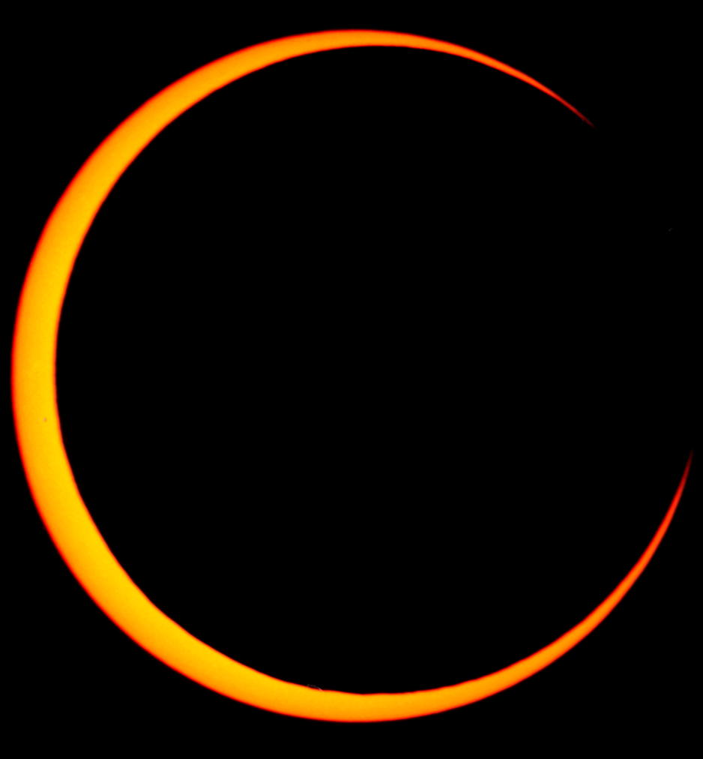
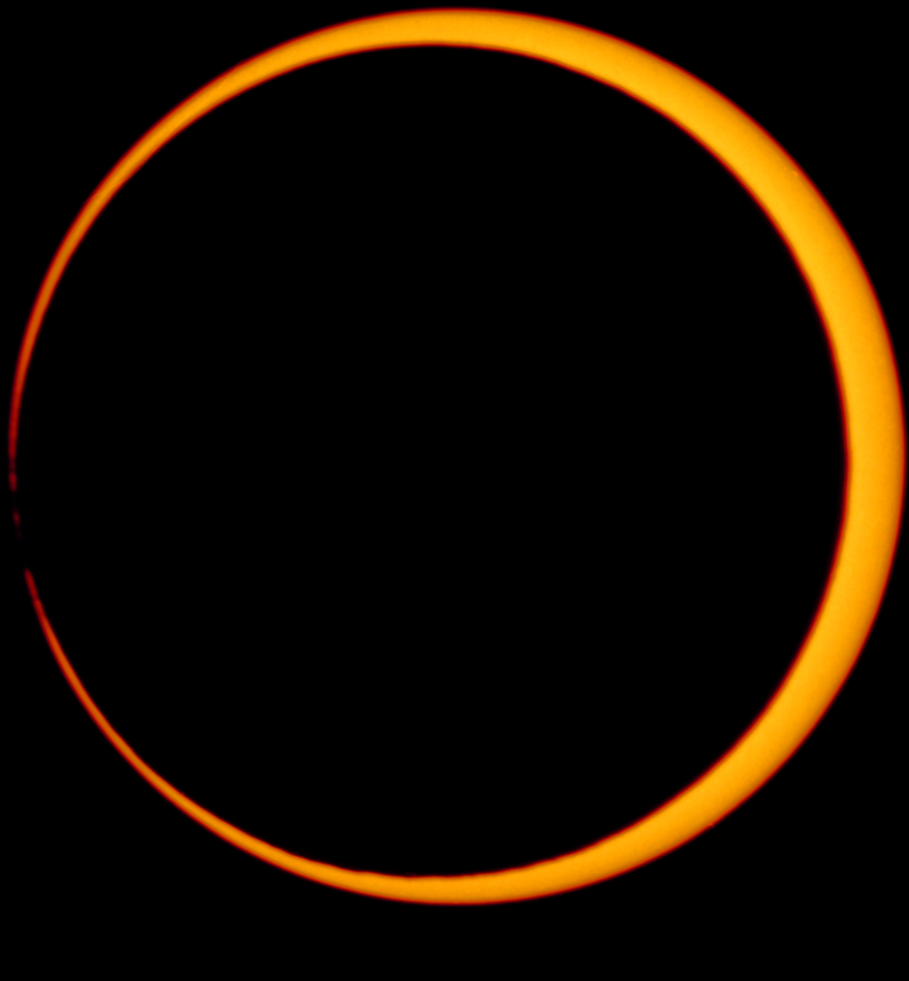
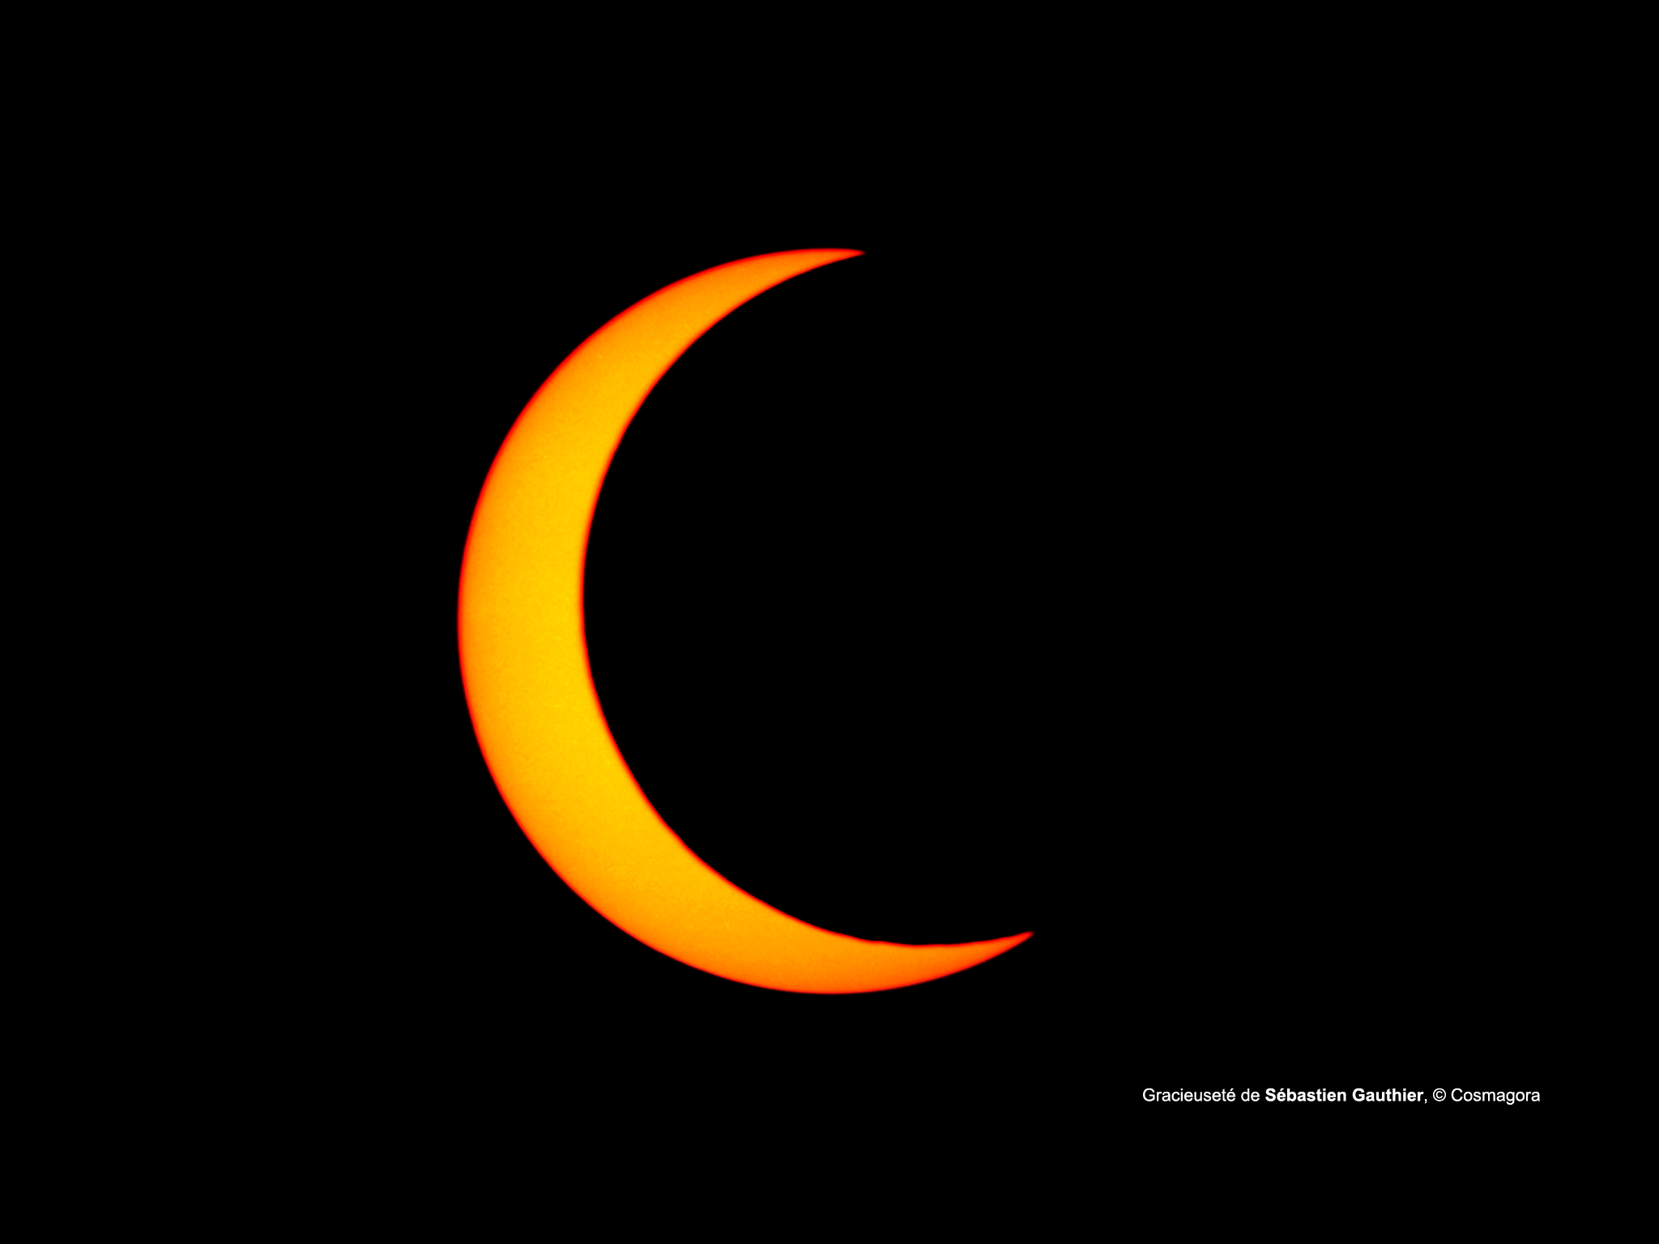
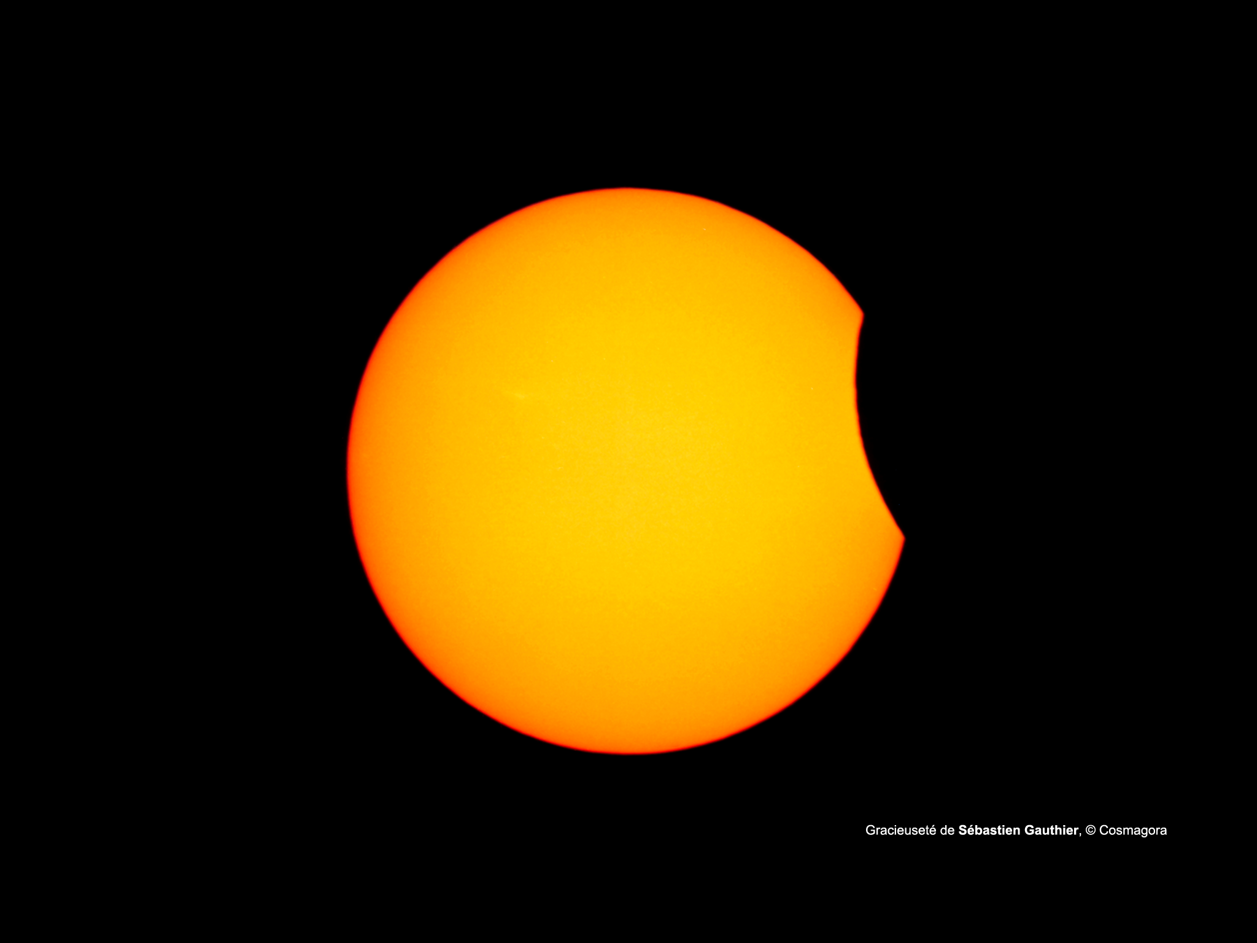
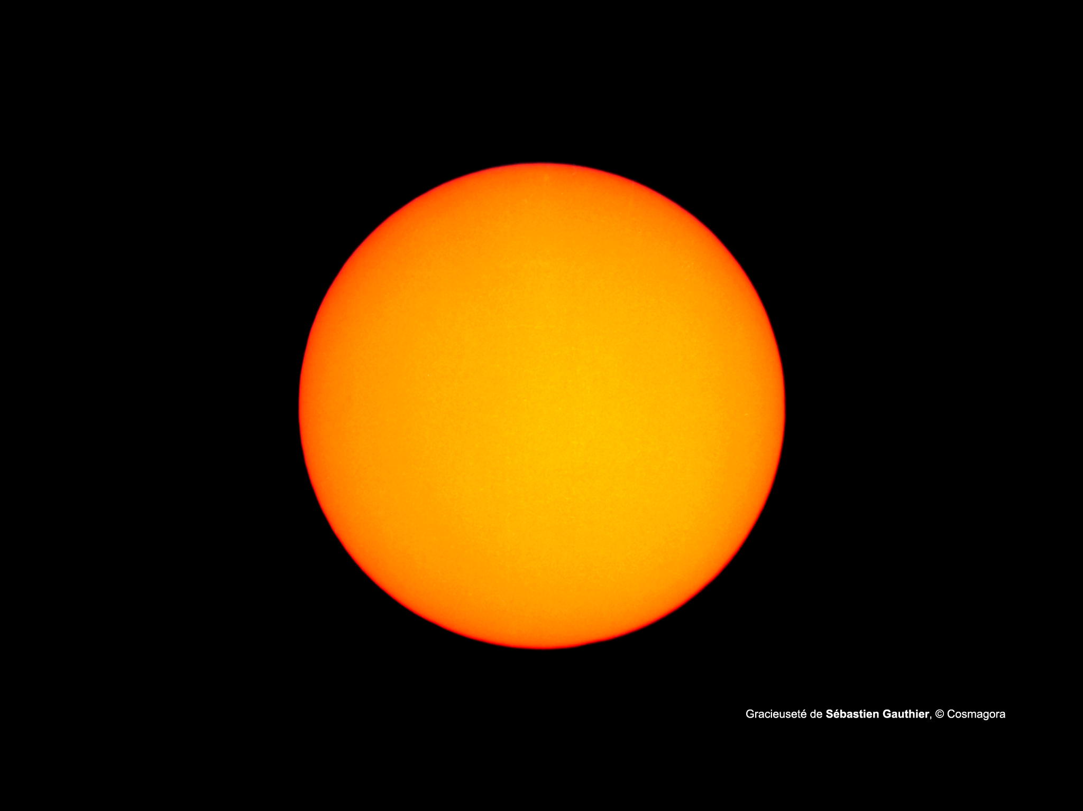
What will you see?
Eclipse maximum (annular)
Annular eclipse begins
Annular eclipse
ends
Eclipse begins
Eclipse ends
Before the eclipse
After the eclipse
Notes:
Image credit: Sébastien Gauthier © Cosmagora
This is an annular solar eclipse. Depending on whether your region’s eclipse viewing starts before or after sunrise, you may or may not see the first couple of phases. If you are further SOUTH, the eclipse may begin after sunrise and so the first view on the Sun will already be during the eclipse.
Main concepts:
The eclipse may start before or after sunrise depending on your location. Let students know what they will see first during their observation.
The Moon is moving in front of the Sun, and we are watching that movement
Because the Moon will be a bit further away from Earth that day, it will appear smaller and will not block the Sun completely, creating an annular eclipse (annular = ring). The orbit of the Moon is not a perfect circle, so sometimes it’s a bit further away.
This view is NOT AT NIGHT. It is the view through a solar filter, much like what students can expect to see while wearing their eclipse glasses (discussed on the next slide!)
ADVANCED
One question you may get from students here is WHY more South regions see the eclipse during and after sunrise and North regions see the full eclipse? This could be an investigative discussion, side project, or assignment question as well. Note that the Earth is rotating at the same time as the eclipse, but the alignment for the eclipse happens regardless. During the summer months in the Northern Hemisphere, the Earth’s North pole is tilted TOWARDS the Sun. Therefore, more Northern locations have an earlier sunrise. For older or more interested students, this could be folded into a discussion about the Arctic Circle and the rotation of Earth causing a night and day cycle.

Slide 34
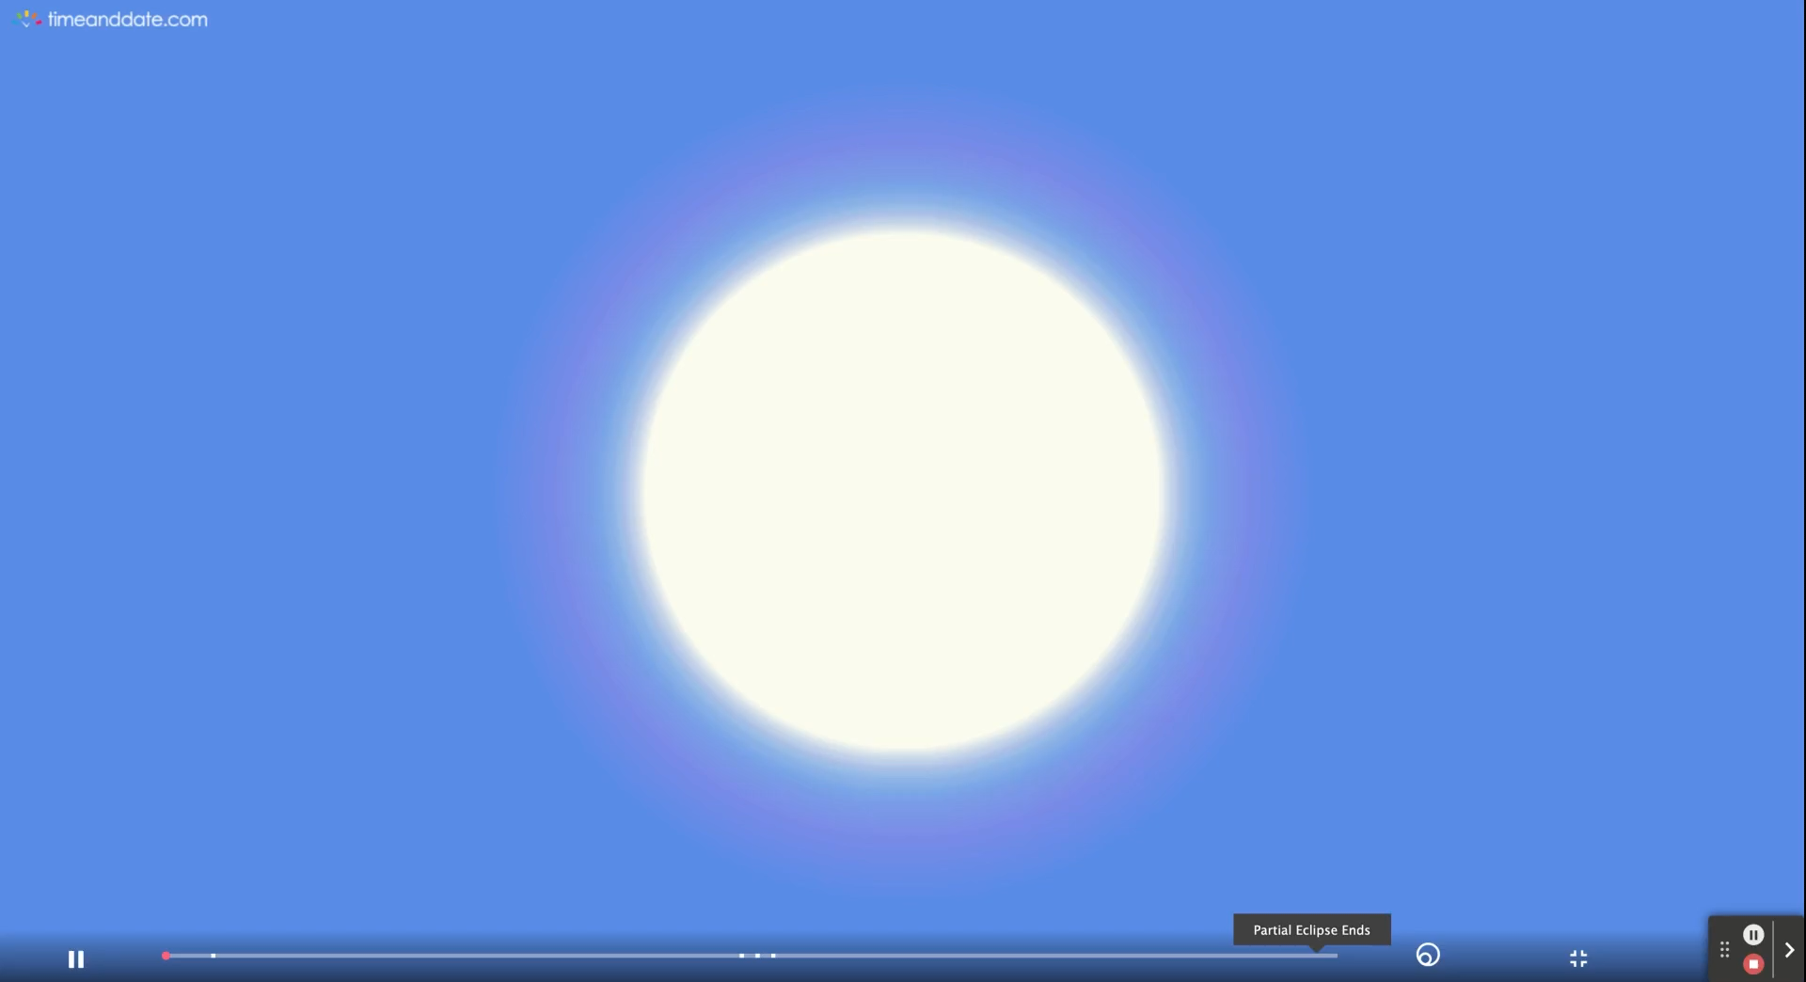
Notes:
There are accurate simulations of what your students can expect to see in their location on June 10, 2021 on TimeAndDate. Find your location on the map (https://www.timeanddate.com/eclipse/map/2021-june-10) and select “See animation of how it will look”. You may also find the general resources on the main eclipse page useful (https://www.timeanddate.com/eclipse/solar/2021-june-10).
If you are not located in the path of annularity, you will see a partial eclipse for the whole duration (about 2 hours).
This video is a sped-up version of what you and your students can expect to see during the eclipse if you are located in the path of annularity. The duration of the annular eclipse is a few minutes, and the total time of the eclipse is about 2 hours.

Slide 35
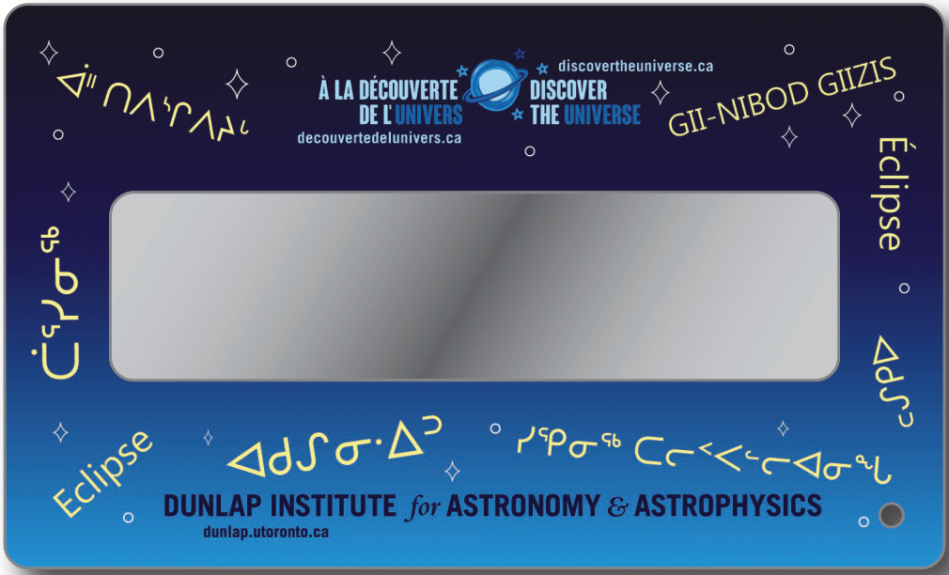
Never look at the Sun directly without proper eye protection!
Notes:
The viewers are safe for direct solar viewing. Since this is an annular eclipse, a portion of the Sun is always visible, and therefore at no point is it safe for anyone to look directly at the Sun or the eclipse.
It is encouraged to have a group discussion with your class on why it is dangerous to look at the Sun without proper eye protection. This includes why the eclipse glasses are necessary and why sunglasses are not sufficient.
These eclipse glasses have been ISO certified for direct solar viewing, and block out 99.997% of the Sun’s light. Any less, and it could cause eye damage as well as vision loss and blindness. You can learn more about eye safety during eclipses and transits here: https://www.rasc.ca/eye-safety
Encourage your students to look through their viewers and describe what they see. If possible, repeat outside and ask them to look at the Sun while wearing them. This will help emphasize the difference in observations before using them to view the annular solar eclipse. These observations may be turned into an observation lab with assessed deliverables.
This could be phrased as an in-class outdoors activity, a lab, or a take-home project. If a lab report or deliverable is required, the statement could be structured as:
Purpose: To safely observe the Sun and test solar viewing eye equipment
Materials: Eclipse glasses, writing materials
Procedure: While wearing the eclipse glasses, observe the following and describe what you see:
Sun on a clear day
Sun on a cloudy day or a foggy day
A bright light that is not the Sun (indoors or outdoors, natural or artificial)
An object that does not emit light (e.g., a table, a wall)
Analysis:
Did you have the same observations across any of the objects? Why do you think that was the case?
You observed the Sun on two different occasions under different circumstances. What was the same about your observations? What was different?
Comparing your observations from all the objects, what can you conclude about how much light the Sun emits? Do you think it would be safe to observe the Sun directly without your eclipse glasses or similar safety equipment?
If an investigative or writing project is more appropriate, encourage students to investigate the importance of eye safety in astronomy. This could be taken as a historical, technical, and medical perspective – giving students the freedom to come to the same conclusion in a variety of ways.

Slide 36
What Solar eclipses mean to us
Notes:
This is for you (and maybe your students) to complete! This can be a review of knowledge or experiences observing eclipses of any kind, cultural and historical relevance of eclipses to your community, and more.
You can learn more about Indigenous perspectives on solar eclipses through our colleague Laurie Rousseau-Nepton and her videos in the “Videos with Laurie” folder on this USB key.

Slide 37
Upcoming eclipses
Depending on your region, there may be a solar eclipse happening again soon. Check out a complete list here of upcoming solar and lunar eclipses: https://www.timeanddate.com/eclipse/list.html?region=north-america
Some upcoming solar eclipses of note for North America include:
- June 10, 2021 (annular solar eclipse)
- October 14, 2023 (annular solar eclipse but partial in Canada)
- April 8, 2024 (total solar eclipse)
- March 29, 2025 (partial solar eclipse)
- August 12, 2026 (total solar eclipse but partial in Canada)

Slide 38

discover the universe
Our goal is to help teachers and educators by providing free and online educational resources and training in astronomy.
Offered by:

